Slide 1
Level 4 Applied Nutrition for Health, Wellness, Weight Management, and Sports Performance (610/2287/1)
Applying the principles of nutrition

Slide 2
Lesson content
How to select, collect, and use information gathered to improve performance through dietary changes.
The use of different strategies to support dietary change to improve performance.
How to select and apply appropriate communication methods to meet different needs.
Advice and guidance that can be offered within own scope of practice.
Limitations and boundaries of the scope of practice when providing nutritional advice and guidance.
How to use and store information by the appropriate data protection legislation.
The importance of maintaining professional competence.
  Reflective practice
  Continuing professional development (CPD).

Slide 3
Collecting information, selecting tools and measures

Slide 4

How to collect and use information
Share your thoughts and ideas:
What information do you need to complete a nutritional analysis for a client?
How will data protection and GDPR guidance impact information collected and stored?

Slide 5
Informed consent
Before gathering information, it is essential to obtain the client’s informed consent.
Informed consent needs to be obtained before:
Collecting any personal and sensitive data.
Conducting assessments, including height and weight and other body measurements.
Transferring their personal information, which includes sharing information with other professionals.

Slide 6
Informed consent
An informed consent form used for dietary purposes should include:
An explanation of the purpose of the intervention.
A description of what will happen, including any measurements to be taken.
An explanation of any possible risks, as well as benefits.
Clarification of the responsibilities of the client.
A reference to confidentiality and privacy.
An emphasis that participation is voluntary, and the individual has the right to change their mind.
The opportunity for the client to ask questions (questions and answers should be recorded and signed to indicate the authenticity of the questions and responses provided).
Client and advisor signatures and date.

Slide 7
Information to gather
Personal details, e.g. name, contact number, emergency contact
Age
Gender
Height and weight
Sport and exercise participation – type of sport event/level of competition/position for team sports
Energy requirements and needs
Goals
Relevant medical history and any medications
Any ‘dieting’ history for weight management
Any allergies
Any dietary specifics, e.g. vegan
Any cultural and religious restrictions.

Slide 8
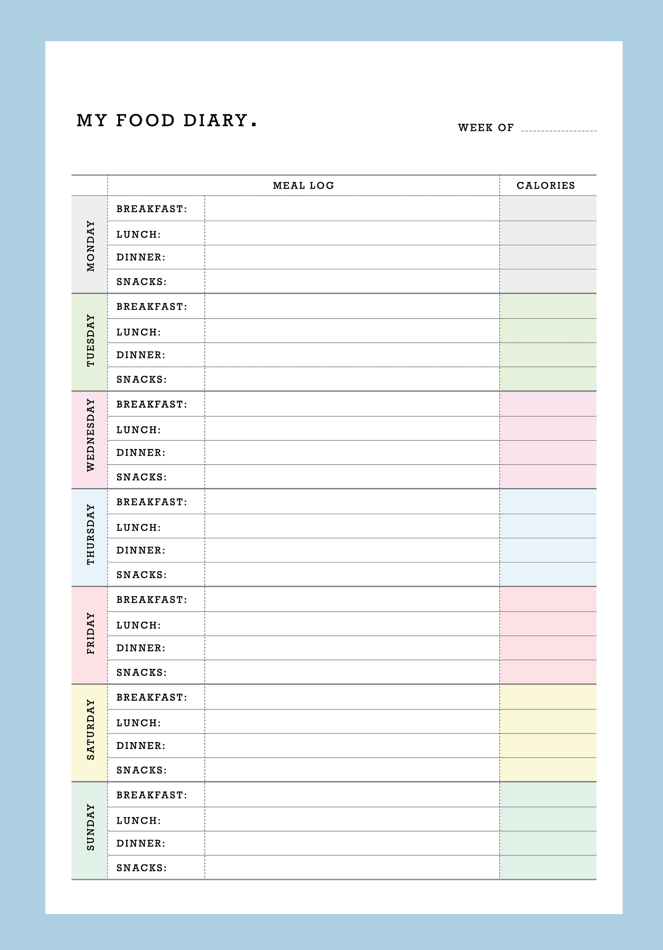
Information to gather
Current eating behaviours and habits (food diary etc.)
Food likes/dislikes
Timing of food intake
Specific macronutrient content
Any additional supplementation taken
Water, caffeine and alcohol intake
Food preparation and cooking methods
Client’s current knowledge on healthy eating
Any barriers to making changes to eating behaviours.

Slide 9
When gathering information - Data protection Act 2018
All information collected and recorded must adhere to the Data Protection Act and General Data Protection Regulations.
The data protection principles state that anyone responsible for using personal data must make sure the information is:
Used fairly, lawfully and transparently.
Used for specified purposes.
Used in a way that is adequate, relevant and limited to only what is necessary.
Accurate, and where necessary, kept up to date.
Kept for no longer than is necessary.
Handled in a way that ensures appropriate security, including protection against unlawful or unauthorised processing, access, loss, destruction or damage.

Slide 10
When gathering information - Data protection Act 2018
In practice, this means:
Maintaining confidentiality.
Collecting only essential information.
Obtain consent before sharing information.
Only sharing information in essential circumstances.
Only sharing information with relevant professionals.
Secure storage of any information.
Retention of information for established timeframes.
Safe disposal of information when it is no longer needed.

Slide 11
Methods of assessing energy requirements
Eatwell Guide daily calorie requirement – general population:
  2000 Kcal for women
  2500 Kcal for men
Formulas:
  Schofield formula
  Harris Benedict
  Mifflin-St. Jeor equation
Total daily energy expenditure (TDEE)
The bigger the person, the more energy it costs to keep them alive each day.

Slide 12
Factors that affect energy requirements
Daily activity, exercise and physical training levels
Amount and type of exercise and activity
Type of sport and level of competition
Sport environment and climate
Amount and type of food eaten
Age, gender, weight
Individual biology
Body mass
Body composition
Health conditions and medications.

Slide 13
Basal metabolic rate
Resting metabolic rate (RMR) or basal metabolic rate (BMR)
The amount of energy or calories the body needs in 24 hours when it is resting.
The energy it takes to keep all the body systems functioning and keep the person alive for a day.
One calculation = Schofield equation.

Slide 14
Schofield calculation
Males | Females
10-17 years BMR – 17.7 x W + 657 SEE = 105 | 10-17 years BMR = 13.4 x W + 392 SEE = 112
18 – 29 years BMR = 15.1 x W + 692 SEE = 156 | 18– 29 years BME = 14.8 x W + 487 SEE = 120
30– 59 years BMR = 11.5 x W + 873 SEE = 167 | 30 – 59 years BMR = 8.3 x W + 846 SEE = 112
W – weight in kg SEE = standard error in estimation

Slide 15
Pair activity – Calculate your partners BMR
Use the calculation chart
Step 1: Find the right equation for the individual’s sex and age – need to know their weight in kg.
Step 2: Select the correct equation, enter the weight, and complete the calculation.
Step 3: Calculate SEE value
  SEE value + 120 =
  SEE value – 120 =
Even very sedentary people use a bit more energy during an average day, so further calculations are required to estimate daily energy expenditure (DEE) – a rough estimate.

Slide 16
Harris-Benedict equation
Approximate values for daily energy expenditure (DEE)
This formula requires BMR to be multiplied by a physical activity level factor.
Males | Females
BMR x 1.4 inactive | BMR x 1.4 inactive
BMR x 1.7 moderately active | BMR x 1.6 moderately active
BMR x 1.9 very active | BMR x 1.8 very active

Slide 17

Pair activity – Calculate your partner’s BMR with activity level
Activity levels:
Inactive – desk-based job, little or no exercise.
Moderately active – more physically demanding job and/or moderate exercise or sport 3-5 times per week.
Very active – hard exercise or sport 6-7 times per week, or very physically demanding job and performs some structured exercise.

Slide 18
Mifflin-St Jeor equation
Considered the most accurate method for estimating BMR in individuals of a healthy BMI.
Has been compared to Harris-Benedict and the other regression equations and performed with greater reliability, getting the BMR within a 10% error margin in 82% of people tested compared to measurement by indirect calorimetry.
Simplified equations:
BMR (men) = 10 x weight (in kg) + 6.25 x height (in cm) - 5 x age (in years) + 5.
BMR (women) = 10 x weight (in kg) + 6.25 x height (in cm) - 5 x age (in years) - 161.
Pair activity – Calculate your partners BMR using the Mifflin-St Jeor equation

Slide 19
Activity – independent task
Independent task:
You have 15 minutes to recall and write down everything you ate and drank yesterday?
Record:
Type of food and drink.
How much – quantities and portion sizes.
Timing – when.
Your activity levels and exercise for the day.

Slide 20
Activity – Partner task
Work with a partner:
Give your partner your 24-hour recall, and you take theirs.
Read the information
Analyse portion, quality food sources or food swaps for each food group:
  Starches
  Fruit and veg
  Proteins
  Dairy and dairy alternatives
  Fats
  Food high in fat, salt and sugar
  Hydration – fluid intake

Slide 21
Activity – Partner task
Work with a partner:
Discuss
How useful is the information recorded?
What other information may you need?
Any issues with the information gathered?
Did they recall all meals, snacks and drinks?

Slide 22
24-hour recall – some issues
May lack accuracy due to individuals' inability to remember and recall everything.
Only valid for one 24-hour period which may not reflect true eating habits – over time.
Difficult to quantify portion size, especially if not familiar with portion sizes.
Some may leave out information intentionally – concerns of judgement.
Whilst this is method that is used – the accuracy, validity and reliability of information are very low.

Slide 23
Food diary
Completed by the client.
Minimum of 3 days, aiming to include 1 weekend day.
7 days recommended to give a realistic indication of clients’ ‘normal’ eating habits.
Include:
Timing of meals and snacks, and any condiments used.
Type of food and drink consumed.
Portion sizes.
Reason for eating (if desired).

Slide 24
Methods of collecting nutritional information
A food diary can help to identify:
Food likes and dislikes
Eating habits, e.g. snacking/ rituals/eating times and mood
Social life and eating habits, e.g. restaurants, pub food, takeaways
Indication of total calorie intake
Quantity and quality of food choices
Portion size for different food groups
Fluid intake and types of fluid
Alcohol intake
Variation in food and drink intake at weekends or during holidays.

Slide 25
Food diary – factors that affect accuracy, validity and reliability
Subjective information – not objective
Relies on the client’s accuracy of recording
  They have to remember to fill it out at the right time, so as not to miss details or make mistakes.
  Need a good sense of portion sizes to get it right.
  It takes time.
  They may lose interest after a couple of days.
Relies on the client’s honesty
  They may feel self-conscious (fear of judgement), e.g. reporting food, tracking in social situations, alcohol, certain types of foods, quantities etc.
Better than 24-hour recall but the accuracy, validity and reliability of information are still variable.

Slide 26

To guarantee accuracy
The only way to guarantee accuracy would be to follow someone around 24/7 for a week and film/photograph everything they ate, replicate and weigh it and then input this data into nutrition analysis software for analysis.
Otherwise, it will not be 100% accurate.
If the information is inaccurate, then it is not a reliable source.

Slide 27
Methods to assess body composition
Small group task:
What are the limitations or benefits of different methods?
How invasive are different methods? When may this be an issue?
Bioelectrical impedance analysis (BIA)
Skinfold calipers and analysis
BMI
Waist circumference

Slide 28
Accuracy of different assessments
Multiple variables can impact the reliability of information gathered, including:
Time of day measurement is taken
Competence of the person taking the measurement (human error)
Accuracy of calculations
Quality of the equipment
Calibration of equipment.
Issues:
Client sensitivities
Disordered eating
Age of client (chaperone for some measures).

Slide 29
Behaviour change, consulting skills and support strategies

Slide 30
Strategies to support behaviour change
Share your thoughts and ideas:
What different strategies and approaches can be used to support someone making changes to their eating behaviours?

Slide 31
Behaviour change
Behaviour change is the process and strategies individuals use to intentionally change their habits.
Key components include:
Awareness – recognising the need for change.
Motivation – finding internal and external motivation to change.
Action - taking steps to introduce new behaviours or modify existing ones.
Consistency – maintaining the change over time.

Slide 32
Transtheoretical model (TTM)
Prochaska and DiClemente (1983)
Originally developed to assist in smoking cessation programmes
The stages of change model comprises of three elements:
Stages of change
Process of change
Self-efficacy

Slide 33
Stages of change
Contemplation
Maintenance
Action
Preparation
Pre-contemplation
Relapse
Termination
The cycle ends
Consider individual readiness to make a change at each stage?

Slide 34
Activity – Pairs
Work with a partner:
Discuss something you may want to change linked to your 24-hour recall.
Identify the stage you are currently in.
Do you believe you will successfully make the change?
What would improve the chances of you making the change?
Swap roles

Slide 35
Processes of change
Consciousness raising – raising awareness of issues and risks with current behaviour, e.g. information leaflets.
Self-liberation – can be supported by expressing belief in someone’s ability to succeed at making a change, so that they start to believe change is achievable too.
Social liberation – creating an environment where it is easier for someone to change their behaviour, e.g. making workouts available via an app to enable them to exercise at home.
Counter conditioning – could involve helping someone to identify healthier alternatives to a current behaviour, e.g. food swaps or portion sizes.
Stimulus control – this can include helping someone identify trigger management strategies to avoid an unwanted behaviour, restructuring the environment, e.g. not buying chocolate biscuits to keep at home or avoiding high-risk cues, e.g. not going to the pub ‘for one’ after work.

Slide 36
Processes of change - continued
Self-reevaluation – a prompt or tool such as a weekly coaching session or journalling can aid reflection of self in relation to behaviours, e.g., noticing effects.
Environmental reevaluation – asking questions about how a behaviour affects the people or environment around the individual can raise awareness of how current behaviour affects wider circumstances, e.g. family and friends worried about health, children imitating unhealthy eating or inactivity behaviours.
Contingency/ reinforcement management – implementing incentives or rewards for changes made (could be part of a goal setting process).
Dramatic relief – experiencing and expressing feelings linked with the current behaviour could be explored in a consultation or even a role play scenario, e.g. ‘I feel too tired to cook at the end of the day’.
Helping relationships – could involve discussing what social support systems someone could put in place to help them as they make changes.

Slide 37
Behaviour change stages and processes
Stages of change
Processes of change | Precontemplation | Contemplation | Preparation |  | Action | Maintenance
 | Cognitive and affective processes
 | Consciousness raising
 | Emotional arousal/dramatic relief
 | Self-reevaluation
 | Environmental reevaluation
 |  | Social liberation
 | Behavioural processes
 |  |  | Self-liberation
 |  |  | Counterconditioning
 |  |  | Stimulus control
 |  |  | Helping relationships
 |  |  |  | Reinforcement management
Adapted from: Velasquez, MM, Maurer G, Crouch C, DiClemente, CC et al (2001). Group Treatment for Substance Abuse: A Stages of Change Therapy Manual. New York. Guilford Press.

Slide 38

Self-efficacy
Efficacy expectations - perceived confidence about their ability, not the same as their actual ability!
Outcome expectations - do they see possible actions as making a difference to their current circumstances.

Slide 39
Self-efficacy – Bandura
An individual’s perception of their ability is a key factor determining their motivation:
to initiate a change (intention) – get started
to expend effort whilst making a change (volition) – commit to something, e.g. make changes to their diet
to keep going and sustain the change (adherence) – keep doing it!

Slide 40
Self-efficacy
Self-efficacy can be developed and improved by helping the person to:
Accurately reflect on their past successes.
Reframe any past failures and see these as lessons and opportunities for learning.
Use positive self-talk and affirmations and develop a growth mindset.
Visualise and focus on success.
Break tasks and actions into manageable steps and take one step at a time.
  (Lawrence & Bolitho. 2011)

Slide 41
Not thinking about making a change.
Does not see any reason or need to make changes.
Have little awareness of the consequences of their chosen behaviour.
Do not see any problem with behaviour or choosing to ignore this (denial).
Not ready!
Precontemplation
Pair task:
What motivational strategies may you use?

Slide 42

Thinking about making a change.
Weighing up reasons for and against
Change talk and sustain talk (motivational interviewing).
High ambivalence.
Could be ready.
Contemplation
Pair task:
What motivational strategies may build change talk?

Slide 43
Decision balance sheets
Benefits of making a change
Benefits of staying the same
Disadvantages of making a change
Disadvantages of staying the same
Decisional balance sheets are a visual tool that can be used to help individuals explore their reasons for making changes and not making changes
What are the benefits of making a change?
What are the benefits of staying the same?
What are the disadvantages of making this change?
What are the disadvantages of making this change?

Slide 44
Psychological readiness/Likert scales
Psychological scales can be used at different stages.
They can help to identify:
Their confidence in taking the steps and action needed towards a change - self-efficacy.
The value the individual places on a goal – its importance.
Their readiness to start taking action – their motivation.
The success of things they are doing – what is working and what is not (monitoring and reviewing progress).
1
10
2
3
4
5
6
7
8
9
LOW
HIGH

Slide 45
Activity - psychological readiness scales
Using the 1-10 scale
How motivated are you to start taking steps towards one of your goals?
What made you choose the rating you gave, rather than a lower number?
How would it feel if you were rating this as higher?
What would have changed for you to rate this as higher?
How important is achieving your goal to you?
1
10
2
3
4
5
6
7
8
9
LOW
HIGH

Slide 46
Preparation:
Decided to make a change.
Taken some steps towards making a change.
Ready.
Action:
Started making changes, but only within the last six months.
Ready and doing.
Maintenance:
Made a change and continued for longer than six months.
Ready and keeping it going.
Preparation, action, maintenance
Pair task:
What motivational strategies at each stage?

Slide 47
Goal setting
Process goals – focus on processes to be followed to reach the desired end result.
  more effective at helping with behaviour change
  focus on things the person can be accountable for, and that are measured objectively
  e.g. eating cereal and fruit for breakfast every day for the following week.
Outcome goals – focus on the end result.
  can be affected by various factors that cannot be controlled
  e.g. losing 2lbs in weight over the next three weeks.

Slide 48
Short-medium and long-term goals
Short-term goals | One day up to one month
Medium-term goals | One month up to six months
Long-term goals | Six months up to a year or over several years

Slide 49
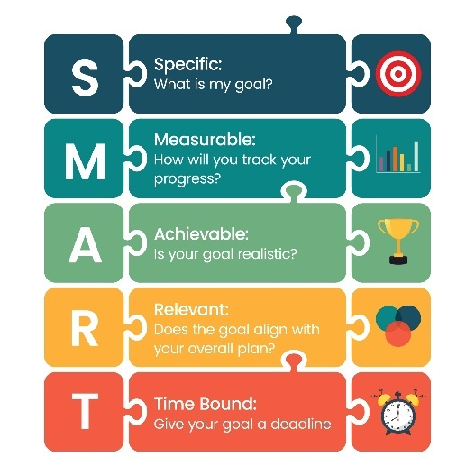
Goal setting
Specific – use action verbs.
Measurable – ensure targets can be measured, e.g. portions, BMI, waist circumference.
Achievable/agreed – ensure goals are realistic and that the individual can achieve them, and that they agree to work towards these.
Relevant – ensure the goals relate to the individual’s objectives.
Time framed – state a date for the target to be completed.

Slide 50
Goal setting questions
What would you like to achieve?
When would you like to achieve this?
Who could help you to achieve this?
What support may you need?
Why is this important?
How will you know when you have achieved it?

Slide 51
Other motivational strategies
Praise and encouragement.
Track progress, e.g. could be review and checks or could be using devices like apps.
Affirmative statements – accentuate the positive.
Rewards.
Preparation for relapse support strategies.
What are examples of rewards?
How do this build motivation?

Slide 52
Overview of strategies
In early stages of the change process - reframe thinking and remove barriers and obstacles (including their own limiting beliefs).
When a decision to change is made – support action for behaviour change.
Strategies:
Share information – leaflets, conversations
Decisional balance
Likert Scales
Goal setting
Reviews
Rewards
Relapse support strategies.

Slide 53
Social support systems
Engaging social support can provide an extrinsic source of motivation.
Sources of support may include:
family members
friends
Other athletes, team members, sports coaches etc
buddy systems (if others have similar goals).

Slide 54
Rewards and incentives
Rewards and incentives are another source of external motivation:
Progress reviews to affirm how they have improved.
External rewards, such as prizes or treats for achieving a certain goal.
Internal rewards, such as the ‘feel-good’ factor for achieving goals.

Slide 55
Termination
permanently left cycle – behaviour has changed.
Relapse or lapse
returned to old behaviour and left the cycle.
can happen at any of the previous stages.
  A lapse is a short-term setback
  A relapse is a more challenging setback
Termination, lapse or relapse
Pair task:
What are some examples of lapse and relapse?
How would you support someone?

Slide 56
Planning for lapse or relapse
Lapse and relapse are part of the change process that many people will experience.
‘Normalise’ and discuss during the consultation process.
Opportunities for the person to learn about themselves.
Can be useful to discuss factors that may ‘trigger’ slips back into an old habit or give up on making a change before they happen, so that strategies to manage these can be put in place (contingency planning).

Slide 57
Summary - stages and support strategies
Stages of change | Processes | Support strategies
Pre-contemplation | Consciousness raising. | Establish rapport and build trust. Explore the reasons for and against maintaining current lifestyle.
Contemplation | Self-liberation, social liberation and counter conditioning. | Conversations to explore motivation and build commitment. Explore self-efficacy and expectations. Use decisional balance and readiness scales to explore motivation, importance, and confidence. Build intrinsic motivation. Elicit self-motivational statements of intent and commitment from the client. Provoke ideas regarding the client’s perceived self-efficacy and expectations.

Slide 58
Summary - stages and support strategies
Stages of change | Processes | Support strategies
Preparation | Social support, stimulus control, counter conditioning. | Offer a menu of options for change or treatment. Help the individual enlist social support. Prompt the individual to explore what has worked in the past either for them or others they know.
Action | Self-revaluation, environmental re-evaluation, contingency reinforcement management. | Support a realistic view of change through small steps. Assist the individual in finding new reinforcers of positive change. Acknowledge challenges for the individual in the early stages of change.

Slide 59
Summary - stages and support strategies
Stages of change | Processes | Support strategies
Maintenance | Self-revaluation, environmental re-evaluation, contingency reinforcement management. | Affirm the individual’s resolve and self-efficacy. Maintain supportive contact. Review long-term goals.
Relapse and lapse | Stimulus control, self-revaluation. | It should be recognised that lapses or relapses happen to most people. Look at what triggered the relapse/lapse. Explore ways to overcome the triggers in future. Build motivation to re-enter the cycle.
Termination | Old behaviour changed. | The end.

Slide 60
Potential barriers
Time – work demands, family commitments, hobbies, the available time they have for committing to making changes to improve their lifestyle, e.g. meal planning, shopping or cooking.
Money – they may perceive leading a healthier lifestyle as being more expensive, e.g. healthier foods are more expensive.
Family and children – as well as presenting a time constraint there are other barriers, children may request a parent to buy ‘less healthy’ foods. A parent may pick at the children’s leftovers or even skip dinner themselves because they are too busy.
Motivation – why is their current lifestyle unhealthy? Why have previous attempts at changing their diet failed? How could you help them change this?
Lack of education – do they know enough about a healthier lifestyle or the benefits of a healthy diet? Do they know what foods they should or should not be eating for a healthy and balanced diet?

Slide 61
Overcoming barriers
When working with barriers, it is important to:
Show empathy
Be curious
Use reflective listening and empathy
Encourage freedom of choice to empower the individual
Build self-responsibility and autonomy
Avoid ‘expert’ mode
Use MI skills to guide the conversation towards building motivation and the reasons for doing something.

Slide 62
One approach to creating helpful, relational and collaborative conversations to support lifestyle change.
A highly skilled approach - practice and experience required to use effectively.
Key principles include:
  Processes – engage – focus – evoke – plan
  Core skills - OARS
  RULE
Motivational interviewing
Further training recommended.
Stephen Rollnick and William Miller

Slide 63
Motivational interviewing
MI is particularly helpful when there is:
High ambivalence – the person is undecided about whether to make a change.
Low self-efficacy – they lack confidence or belief in their ability to make changes.
Low desire – they lack motivation for making a specific change.
Low importance - the desired behaviour is not seen as being important or a priority.
(Motivational Interviewing Network of Trainers (MINT. 2021)

Slide 64
Ambivalence
Change talk – all the reasons for making changes
Motivators
Sustain talk – all the reasons not to make changes
Barriers
These present as barriers and motivators for change.

Slide 65
Motivational interviewing processes
Engage
Start the conversation and build rapport
Focus
Identify and agree the purpose of the conversation.
Evoke
Increase motivational language used by the person.
Plan
Establish their commitment and plan the next steps.

Slide 66
The four main processes within MI conversations are:
Engage – start a conversation and build the relationship.
Focus – identify and agree the purpose of the conversation.
Evoke – increase the person’s use of motivational language (change talk).
Plan – establish their commitment and plan the next steps.
Motivational interviewing processes
This may take several conversations

Slide 67
MI skills - OARS
Open questions - start the conversation, gather information, establish focus and keep the conversation flowing.
Affirming statements (positive statements) - build self-efficacy and confidence.
Reflective statements - demonstrate active listening and accurate empathy.
  A simple reflective – use their words
  A complex reflective – interpret their words – best guess
Summaries draw together several themes that have been discussed.

Slide 68
RULE acronym
Resist the righting reflex - not trying to fix the person at every opportunity.
Understand and explore the individual’s motivations.
  What they want to achieve.
  Importance and their confidence.
Listen with empathy, curiosity, and acceptance.
  Hear the barriers (sustain talk) without placing too much importance on these.
  Affirm the change talk.
Empower the person – their choice.

Slide 69
Evoking - skills
Encourage the person to speak about WHY (the reasons for change).
WHY builds motivation.
To elicit change talk, use.
Open questions
Affirming statements
Reflective statements
Summaries
Tools - decisional balance and Likert scales

Slide 70
Planning stage skills
This can only happen when a person is ready and when they are predominantly using change talk, and much less sustain talk.
Planning next steps may include:
Setting goals if more change talk is being used.
Making future appointments to discuss the change further.
Signposting information can be shared as part of the planning stage and without needing the individual to use more change talk.
The person has a choice; they can follow up on the information or not.

Slide 71
Activity - trio task
Each person selects a letter – A, B or C.
Person A – to speak about something they would like to change in their diet.
Person B – to listen.
Person C – to observe and make notes to identify:
  Examples of change talk and sustain talk
  The person’s self-efficacy and intrinsic motivation
  Barriers that need to be overcome
  Think about how to create a ‘summary’ of the conversation to capture the main themes.
Can repeat the task and swap roles.

Slide 72
Communication methods, scope of practice, reflective practice and continuing professional development

Slide 73
Communication methods
Share your thoughts and ideas:
What communication methods and tools are available?
What determines the communication methods and tools used?

Slide 74
Communication methods, skills and tools
Face-to-face or online communications (Zoom or Teams)
  verbal communication (language, tone, speed, volume, etc.)
  non-verbal communication (body language, eye contact, etc.)
Written - email, letter, text, poster, handout, infographic, information leaflet
Social media page/ post – various platforms
  Website
  Podcast
  Social media video
  Blog
It is important to consider which is the most appropriate method and tool for the target audience and the purpose of the interaction.

Slide 75
Considerations
Type of communication methods – what and how
Purpose of communication – why
  Consultation – gathering information or sharing outcomes of consultations and assessments.
  General information sharing - evidence-based healthy eating guidelines and nutrition information.
Who the communication is for – who
  sports person (individual), team (group), workforce (training and coaching team and all involved).
    Some workplaces may have specific guidelines to follow.
Limits of own knowledge and competence
  When to seek further information/support.

Slide 76
Communication methods
Consultations – face-to-face (in person or online) to gather information and discuss results.
General information sharing - information resources and posters, podcasts, or social media posts using written and visual content.
For all communications, the language used should be accessible, easy to understand and not too technical.
Information also needs to be delivered in a way that supports client motivation and builds a ‘can do’ attitude.
For example, showing a client some of the simple things they could do and could choose (like food swaps or cooking methods), without shaming or blaming any of their current choices.

Slide 77
Communicating consultation results with clients
When communicating about eating behaviours and body composition, it is important to employ sensitivity and diplomacy. Things to consider:
Support all analysis with data from recognised charts or information sources, where available.
Ensure privacy with just the client in earshot of any assessment results.
Prepare an action plan for positive changes where necessary.
Allow sufficient time for understanding and questioning by the client.
No personal judgement – focus only on facts.

Slide 78
Activity
Find a social media post about nutrition from a fitness professional, sports coach or personal trainer.
To what extent is the information provided:
Within scope of practice?
Accurate?
Evidence-based?
Non-biased?
Useful?
Easy to understand?

Slide 79

Scope of practice
Share your thoughts and ideas:
What guidance is within scope?
What guidance exceeds scope?
To whom, would you signpost a client, with needs or requests that exceed scope?
Why is maintaining scope of practice important?

Slide 80
Importance of scope of practice
Work within boundaries of own competence.
Keeps clients safe.
Keeps advisor safe.

Slide 81
Scope of practice
Often a big focus towards writing meal plans and diets – this exceeds scope.
There is so much more helpful and educational information that can be provided that IS within scope.
Information within scope supports client autonomy and independence.

Slide 82
Advice and guidance within scope of practice
Healthy eating guidelines – reliable, evidence-based
Food groups and sources of nutrients to support food choices in relation to healthy eating guidelines.
How gender, age and physical activity level affect dietary needs.
Regular eating patterns and their importance.
Portion sizes.
Food labels and interpretation.
Food preparation and cooking techniques.
The limitations of ‘fad’ diets and potential risks.

Slide 83
Advice and guidance within own scope of practice
Food or drink swaps that could alter calorie intake for specific goals.
The benefits and importance of physical activity and exercise
The need to eat to fuel and recover from exercise sessions.
The importance of maintaining adequate hydration and the best sources for hydration.
The risks associated with some supplements and performance aids.

Slide 84
Scope of practice
Can:
Ask clients to complete a food diary.
Analyse the information provided to support a more balanced diet or guidance on recommended portion sizes.
Use evidence-based behaviour change techniques like SMART goal setting, self-monitoring of eating behaviours and reviewing progress by monitoring outcomes like weight or body composition change to help clients achieve their goals.
Provide mini lectures, workshops, or question and answer sessions.

Slide 85
Role boundaries - needs and wants exceeding scope of practice
Individuals with health conditions e.g. diabetes.
Individuals who want specific diets or meal plans prepared for them.
Individuals with specific performance goals.
Individuals who are pregnant or breastfeeding.
Individuals with eating disorders.
Individuals with allergies or food intolerances.
Individuals with substance misuse issues (alcohol, caffeine or other).
Individuals wanting advice on supplements for health or performance enhancement.

Slide 86
Signposting
Signposting means suggesting to an individual that they may benefit from speaking to another professional for advice.
When signposting, it is important that any sources recommended are credible such as:
The Association for Nutrition (AfN), which has lists of:
  Associate nutritionists
  Registered nutritionists
The Federation of Nutritional Therapists
The British Association for Applied Nutrition and Nutritional Therapy
The Health and Care Professions Council (HCPC)

Slide 87
Dietitians
Dietitians are the only nutrition professionals to be regulated by laws.
The title of Registered Dietitian (RD) is protected by law, and practitioners must be registered with the Health & Care Professional Council (HCPC)
The professional association for registered dietitians in the UK is the British Dietetic Association (BDA)
Dieticians are the only health professionals qualified to assess, diagnose and treat diet and nutrition problems at an individual and wider public health level

Slide 88
Nutritionist
The title of Registered Nutritionist is granted to registrants with the UK Voluntary Register of Nutritionists (UKVRN).
The professional association for registered nutritionists is the Association for Nutrition (AfN).
Nutritionists create and apply scientific knowledge to promote an understanding of the effects of diet on the health and wellbeing of humans, to provide information about food, diet and healthy eating.
The term nutritionist is not protected by law, so it is important to check the qualifications and training of anyone claiming to be a nutritionist.

Slide 89
Credible sources of information
British Dieticians’ Association
Association for nutrition
British Nutrition Foundation
Department of Health
NHS Choices
NHS Eatwell
The Eatwell Guide

Slide 90
Activity – pairs or small groups
Read the Association for Nutrition (AfN) Code of Practice.
Present back the key principles of the code.

Slide 91
Reflective practice and continuing professional development
Share your thoughts and ideas:
Why is reflective practice important?
Why is continuing professional development important?

Slide 92
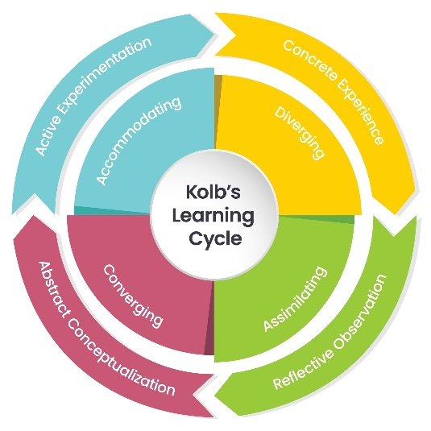
Kolb model
Do something, e.g. analyse a diary or deliver an information session.
Think about it, e.g. consider and evaluate what works and what does not work.
Consider how to make improvements, e.g. changes that could be made to own knowledge or skills to support the individual.
Put learning into practice – experiment.
Repeat the process.

Slide 93
Continuing professional development (CPD)
Reading journals, articles, or books from reputable sources about specific conditions or approaches to support behaviour change.
Engaging with other healthcare professionals, e.g. sports coaches, dietitians
Attending relevant and related workshops with reputable organisations.
Independent research.
Mentoring and coaching from other professionals.
Gaining additional training and qualifications, for example, behaviour change, motivational interviewing.

Slide 94
The importance of reflective practice and maintaining professional competence
Understanding own development needs and making continuing improvements.
Maintaining competence within the role and field of practice.
Keeping knowledge and skills up-to-date to ensure safe and effective practice.
Professional practice.

Slide 95
Pair task
What are two main take away points from this lesson?
How will you apply these to your practice?

Slide 96
Lesson summary
How to select, collect, and use information gathered to improve performance through dietary changes.
The use of different strategies to support dietary change to improve performance.
How to select and apply appropriate communication methods to meet different needs.
Advice and guidance that can be offered within own scope of practice.
Limitations and boundaries of the scope of practice when providing nutritional advice and guidance.
How to use and store information in accordance with appropriate data protection legislation.
The importance of maintaining professional competence:
  Reflective practice
  Continuing professional development (CPD).

Slide 97
Case study – skills criteria
5.1. Consult with clients and gather information about their eating behaviours and dietary requirements using appropriate methods and tools
5.2. Use appropriate communication methods to meet different needs and ensure safe practice
5.3. Analyse information gathered to identify areas for dietary change and improve performance
5.4. Make recommendations for appropriate nutritional strategies to meet different physiological and performance goals.
5.5. Make recommendations for hydration and fluid intake appropriate to the individual’s requirements.
5.6. Provide advice and guidance within own scope of practice to support any recommendations given
5.7. Signpost clients to other professionals when needs and requirements exceed the scope of practice
5.8. Use and store information in accordance with appropriate data protection legislation.
5.9 Reflect on practice and information gathered and make recommendations to improve own skills and knowledge

Slide 98
Level 4 Applied Nutrition for Health, Wellness, Weight Management, and Sports Performance (610/2287/1)
Applying the principles of nutrition

