Slide 1
Level 4 Applied Nutrition for Health, Wellness, Weight Management, and Sports Performance (610/2287/1)
Nutritional needs for different types of athletes and sports people

Slide 2
Lesson content
The nutritional requirements and dietary needs of the younger athlete.
The nutritional requirements and dietary needs of the older athlete.
How cultural and religious dietary practices will impact dietary needs and performance.

Slide 3

Part 1: Younger athletes and sports people
Share your thoughts and ideas:
How may nutritional requirements differ for younger athletes?

Slide 4
Younger athletes
Growing and may need higher energy intake.
Energy needs are greater during growth spurts and through puberty
  Physical and hormonal changes increase metabolic rate, ability to increase lean mass, and creation of body tissues.
Young people are typically more active throughout the day outside of their sports activities and training.
  It can further increase energy requirements.
The daily calorie requirement is calculated based on the age, sex, and activity status of the child (Faizan, 2024).

Slide 5
Average energy requirements – higher levels of physical activity
Age (years) | Boys (kcals/day) | Girls (kcals/day)
6-7 | 1,800 | 1,650
7-8 | 1,950 | 1,775
8-9 | 2,100 | 1,950
9-10 | 2,275 | 2,125
10-11 | 2,475 | 2,300
11-12 | 2,700 | 2,475
12-13 | 2,925 | 2,625
13-14 | 3,175 | 2,725
14-15 | 3,450 | 2,855
15-16 | 3,650 | 2,875
16-17 | 3,825 | 2,875
17-18 | 3,925 | 2,875
Adapted from Smith et al (2015)

Slide 6
Fuel consumption and usage
Not ‘mini-adults’.
Lower muscle mass
  Bias towards aerobic metabolism and limited anaerobic capacity.
Lower blood lactate concentration
  Immature anaerobic glycolytic energy pathway and lower muscle glycogen storage.
Increased risk for hypoglycaemia
  Adequate carbohydrate intake before and during prolonged training or exercise is recommended.
Need a well-balanced and healthy diet – whole food sources and low in ultra-processed foods and drinks.
Poor quality diets increase the risk of micronutrient deficiency, especially calcium, vitamin D, and iron.

Slide 7
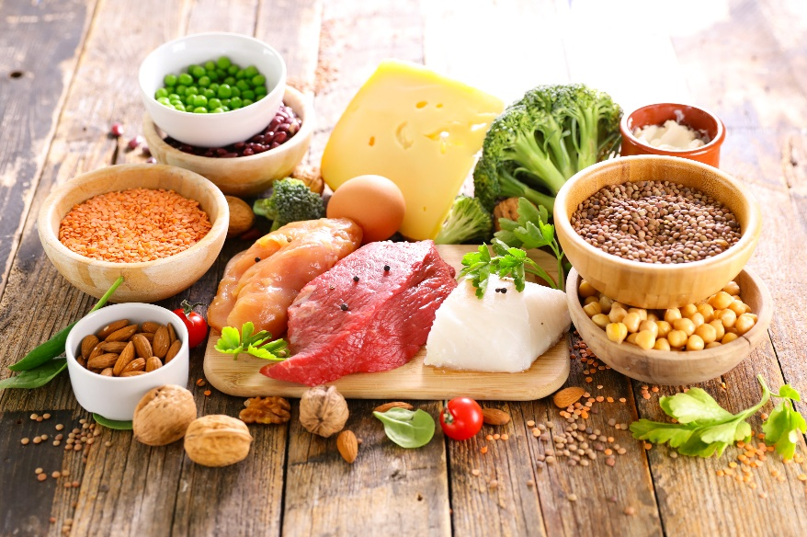
Macronutrient
Macronutrient balance for 4–18-year-olds :
Carbohydrates - 45%-65%.
Protein should comprise 10%-30%.
Fats should comprise 25%-35%.

Slide 8

Hydration
Hydration recommendations (Purcell. 2013):
400- 600ml of water two to three hours before activity.
150- 300 ml of water every 15-30 minutes during training/exercise.
Continuing to drink to replace fluid losses, around 1.5 L of fluid per kg bodyweight lost.
Electrolyte and carbohydrate-containing sports drinks should only be consumed by athletes performing sessions longer than one hour in duration and should not be used by others, as they contribute to excess sugar and energy intake.

Slide 9
Energy availability and REDs
RED-S is a potential result of low energy availability (LEA) in athletes.
The amount of energy consumed in the diet is not sufficient to meet all their body’s needs for training and adaptation.
RED-S occurs when this LEA impairs adaptation to training, reduces performance capacity and has negative health impacts.
Calculation:
Energy availability (EA) = energy intake (EI) – exercise energy expenditure (EE) / Fat free mass (FFM).

Slide 10

Activity
Can you remember some of the short-term and long-term risks of LEA?
Can you remember the signs and symptoms of REDs?

Slide 11
Health implications – LEA
Short-term effect | Long-term effects
Reduced blood glucose | Eating disorders
Reduced leptin levels | Reduced appetite
Disrupted cycle of gonadotrophin-releasing hormone, luteinizing hormone, thyroid hormones, cortisol | Continued endocrine disruption including: reduced growth hormone, luteinizing hormone, oestrogen/testosterone, reduced insulin, IGF-1, leptin, P1CP, osteocalcin increased cortisol, PYY, ghrelin
Fatigue | Reproductive dysfunction
Mood changes | Impaired bone health
Low sex drive | Dyslipidaemia
Reduced muscle protein synthesis | Low heart rate (bradycardia), Low blood pressure (hypotension)
 | Low blood glucose (hypoglycaemia), Low resting metabolic rate
 | Suppressed immune function, Increased injury risk
 | Impaired performance
 | GI distress/disorders

Slide 12
Relative energy deficiency in sport (REDs)
Signs and symptoms
Physiological | Performance | Psychological and behavioural
Three missed periods | Persistent fatigue | Disrupted sleep
Low libido | Poor recovery | Mood changes
Digestive issues | Recurring illnesses and injury | Reduced social interaction
Poor muscle mass development | Reduced performance | Problematic relationship with food and/or training
Bean (2022)

Slide 13
Healthy eating
Young athletes need to maintain a healthy, balanced diet.
Overall food intake will need to be higher to meet their energy requirements.
May require more energy-dense, lower fibre foods to be consumed to maintain a healthy body composition, support adaptation to training, fuel optimal performance and prevent RED-S.
Does not mean they can ‘eat whatever they like’.

Slide 14

Supplementation
Only used on the recommendation of an appropriately qualified and experienced sports nutritionist or dietician.
Most ergogenic supplements have only been tested on adults.
Efficacy for performance enhancement in youth is untested and may not have any benefit.

Slide 15
Protein
Pre-puberty does not need to be any higher than for others in their age group.
  It can be met through a balanced wholefood diet.
During and after puberty, overall energy needs increase, so absolute protein intake increases commensurately.
  Does not mean that young athletes need a high-protein diet.
  Normal percentage ranges for macronutrient consumption are sufficient.
A focus on consuming adequate carbohydrates at regular intervals to fuel and support recovery from exercise will spare protein for its role in growth and repair.

Slide 16
Pre-exercise and event
Primary aim - increasing energy stores in the form of glycogen without making the young athlete feel hungry or too full.
A high carbohydrate meal - more digestible and provides more energy for high-intensity exercise.
  Can contain 10-25% protein
  Not composed of simple or highly refined sugars - reactive hypoglycaemia and a dip in energy availability at the start of competition.
Timing of the meal - tailored for the individual, but usually 90 minutes before is a good guide.
  Morning event - early breakfast so that the second eating occasion is 90-120 minutes before the event.
  Later events - eat every 2.5-3 hours during the morning, then have a snack around 90-120 minutes before the event.
Eating closer to not advisable, no food for at least 30 minutes before the event.

Slide 17
During and post-event
For events longer than 60 minutes
Sports drinks may be of value.
Only non-carbonated isotonic sports drinks with around 6% sugar content.
Drinking is encouraged from the beginning of a long event.
150- 250ml per 15 minutes is a suitable target to offset dehydration.
Post-event – recovery
Foods high in carbohydrate with moderate protein content but low in fat and fibre.
Begin within 30-60 minutes after the event, and regular snacks and healthy, balanced meals can follow.

Slide 18
Pair task
What are two main take away points from this lesson?
How will you apply these to your practice?

Slide 19

Part 2: Older athletes and sports people
Share your thoughts and ideas:
At what age does one become an ‘older athlete’?
How may nutritional requirements differ for older athletes?

Slide 20
ACSM definitions – older adults
The American College of Sports Medicine (ACSM. 2022) classify and define the older adult population as:
  Individuals who are aged 65 and over.
  Individuals who are aged over 50 with chronic health conditions.
For athletics and sporting events - different classifications.
‘Masters’ competition categories - refers to those aged over 40.
From a nutritional perspective, requirements are not going to change much until individuals are over 50 or over 65.

Slide 21
‘Masters’ sports
Starting age will vary by sport:
25 years for swimming
30 years for track and field
35 years for weightlifting
40 years for long-distance running
50 years for senior games.
Endurance athletes - peak performance is usually considered to be between the ages of 25 and 35.
Ultra-marathons – some say athletes aged 50 are at their peak for 48-hour ultra-marathons.
Senior athletes – some say that the age threshold for senior athletes is 50.

Slide 22
Effects of ageing on performance
Lower/slower | Higher/longer
Maximum heart rate | Resting blood pressure
Maximum cardiac output | Exercising blood pressure
Maximum oxygen uptake | Lung residual volume
Lung vital capacity | Body fat percentage
Reaction time | Recovery time
Flexibility
Bone mass
Muscle mass
Glucose tolerance

Slide 23
Sarcopenia
“A progressive and generalised skeletal muscle disorder that is associated with increased likelihood of adverse outcomes including falls, fractures, physical disability and mortality.” (Cruz-Jentoft et al., 2019).
Measures:
grip-strength test using a dynamometer
chair-stand test or timed-chair test
Prevention:
achieving a peak muscle mass in early adulthood (up to age 40) and maintaining muscle mass into older life to prevent or delay.
Older athletes are at lower risk than the general population.
Female endurance athletes may have a lower muscle mass.

Slide 24
Differences – biological males and females
At the same level of competition, male athletes outperform female athletes.
Male
Larger, more muscular bodies, larger hearts and lungs, greater muscle mass.
Greater glycolytic capacity, greater breakdown of ATP and an increase in ATP byproducts after maximal exercise.
Female
Higher proportion of type 1 muscle fibres, blood flow differences favour greater delivery of oxygen to working muscles.
Smaller airways, fewer alveoli and different lung geometry, which influence the efficiency of breathing.
Menstrual cycle - neuroendocrine interaction has the potential to influence muscle activation.

Slide 25
Body composition and age
Category | 20-29 years |  | 30-39 years |  | 40-49 years |  | 50-59 years |  | 60-69+ years
Sex | F | M | F | M | F | M | F | M | F | M
Dangerously low % | <14 | <8 | <14 | <8 | <14 | <8 | <14 | <8 | <14 | <8
Very lean % | 14-16.5 | 8-10.5 | 14-17.4 | 8-14.5 | 14-19.8 | 8-17.4 | 14-22.5 | 8-19.1 | 14-23.2 | 8-19.7
Lean % | 16.6-19.4 | 10.6-14.8 | 17.5-20.8 | 14.6-18.2 | 19.9-23.8 | 17.5-20.6 | 22.6-27 | 19.2-22.1 | 23.3-27.9 | 19.8-22.6
Average % | 19.5-22.7 | 14.9-18.6 | 20.9-24.6 | 18.3-21.3 | 23.9-27.6 | 20.7-23.4 | 27.1-30.4 | 22.2-24.6 | 28-31.3 | 22.7-25.2
High % | 22.8-27.1 | 18.7-23.1 | 24.7-29.1 | 21.4-24.9 | 27.7-31.9 | 23.5-26.6 | 30.5-34.5 | 24.7-27.8 | 31.4-35.4 | 25.3-28.4
Dangerously high % | >27.2 | >23.2 | >29.2 | >25 | >31.9 | >26.7 | >34.6 | >27.9 | >35.5 | >28.5
Adapted from: www.medicalnewstoday.com

Slide 26
Nutritional requirements
Energy requirements - stable for most of adult life and are primarily determined by body mass, lean mass, and exercise energy expenditure for athletes.
Protein intake - guidelines for younger athletes are generally appropriate for athletes and active people over the age of 65.
Masters strength or power athletes - four to five food intakes per day containing relatively equal doses of protein in the region of 0.3-0.37g/kg could be used to provide a daily intake of 1.5-1.6g/kg.
Masters endurance athletes - when undergoing a phase of high-volume training, there is a benefit of increasing protein towards the upper limits of the recommended range, in the region of 1.7-1.8g/kg per day to support recovery.

Slide 27
Nutritional requirements
Carbohydrate - primary energy substrate.
Insufficient intake increases the use of protein as an energy source, which negatively impacts recovery and post-exercise adaptation.
Pre-event - match carbohydrate content of pre-exercise meals to the anticipated energy demand of the training session or competitive event.
Intra-event – for ultra-endurance events, use carbohydrate drinks, gels to maintain glycogen stores and prevent glycogen depletion during competition.
Recovery - consume combined protein-carbohydrate snacks/meals.
  Post-workout recovery slows with age, and training frequency may need to be reduced.
Consider - greater propensity for weight gain and gradual decline in metabolic rate above the age of 60.
  Older athletes may wish to manipulate carbohydrate to balance fuelling with managing body composition

Slide 28
Hydration
Ensure sufficiently hydrated, particularly before exercising.
Low body fluid will impair performance and increase the risk for cardiovascular events, dehydration symptoms - dizziness/fainting, headache, and increased risk for musculoskeletal injury.
Standard recommendations of six to eight glasses, 1.5-2 litres per day of fluids, PLUS additional fluid to replace exercise fluid losses, typically one litre per hour of vigorous exercise.
Drinking behaviour may be impacted by:
  urinary incontinence
  including pelvic floor exercises

Slide 29

Supplements
Any advice must be provided by a qualified dietitian or sports nutritionist.
Iron absorption - linked to a deficiency of vitamin B12 – B12 injections.
Increased susceptibility to infections – may benefit from supplements - vitamin C, D and zinc.
Glucosamine and chondroitin are taken by some to support the maintenance of healthy joints.
Increased CVD risk - omega-3 or fish oil.

Slide 30
Pair task
What are two main take away points from this lesson?
How will you apply these to your practice?

Slide 31

Cultural and religious practices
Share your thoughts and ideas:
What practices are linked with different religions?
How may cultural and religious practices influence nutritional needs?

Slide 32
Islam
Only consume halal meat.
Do not consume pork.
Holy festival of Ramadan
  Fast between sunrise and sunset
  Diet may become imbalanced, and risk of undernutrition.
  Annual training programmes should be planned.
    An Imam may grant an athlete an exception from needing to fast if there is a reason why this would not be safe.
    Following an alternative schedule of very early training sessions to allow training and eating before dawn.

Slide 33
Hinduism and Buddhism
Generally, follow a vegetarian or vegan diet.
May be at risk of iron and B12 deficiency.
Vegetarians and vegans need to eat a wide variety of plant products to ensure they obtain all the essential amino acids in their diet.
With a well-planned vegetarian or vegan diet, there is no reason for an athlete to be deficient in any nutrients.
Requires more planning and may mean that the use of protein supplements and omega-3 supplements is more common as a convenient way to meet these needs.

Slide 34
Judaism and Sikhism
Judaism
Kosher meat.
Meat and dairy foods must not be prepared or eaten together.
Sikhism
Do not eat halal or kosher meat.
Do not eat beef or pork.
Avoid foods or drinks that harm the body, including alcohol.

Slide 35
Eastern Orthodox Christianity
Weekly fasts include abstention from meat, fish, eggs, dairy, and sometimes other foods such as olive oil and alcohol.
May make it harder to meet protein requirements on days animal products are not eaten.
  To offset risks - ensure a variety of plant protein sources, and a greater number of grains eaten.
Short duration of fasting/abstention - no longer-term risk for deficiencies if a balanced and varied diet is consumed most of the time.

Slide 36
Christian festivals
Christmas and Easter
  Many people overindulge or may choose to eat more of specific foods associated with these events.

Slide 37
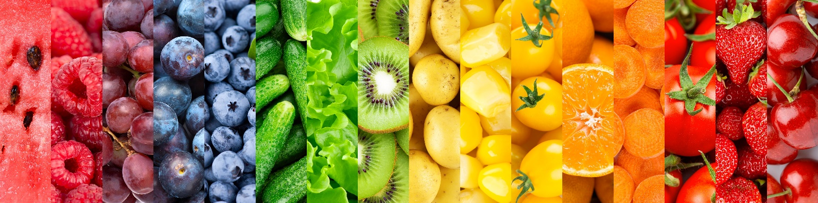
Other cultural factors
Family and convenience - families resorting to convenience foods as time for food preparation limited.
Educating athletes, and particularly the parents of young athletes about healthy eating and the importance of a balanced diet containing mostly wholefoods for recovery and performance is an important part of the role of any coach or trainer.

Slide 38
Other cultural factors
Budget and financial status - making multiple recipes with the same basic family of ingredients, purchasing less expensive prepared, processed, and canned foods.
Food availability - certain times of year may result in a greater level of fresh food being available, or locality may mean bulk purchases of frozen or canned and packaged foods.
Allergies and intolerances - Athletes with food intolerances need to be cautious when travelling or staying away from home for training and competitions.
  Greater planning, to take a good supply of regularly eaten products with them to ensure that there is an adequate supply of safe foods available to fuel and recover from sessions and competition.

Slide 39
Pair task
What are two main take away points from this lesson?
How will you apply these to your practice?

Slide 40
Lesson summary
The nutritional requirements and dietary needs of the younger athlete.
The nutritional requirements and dietary needs of the older athlete.
How cultural and religious dietary practices will impact dietary needs and performance.

Slide 41
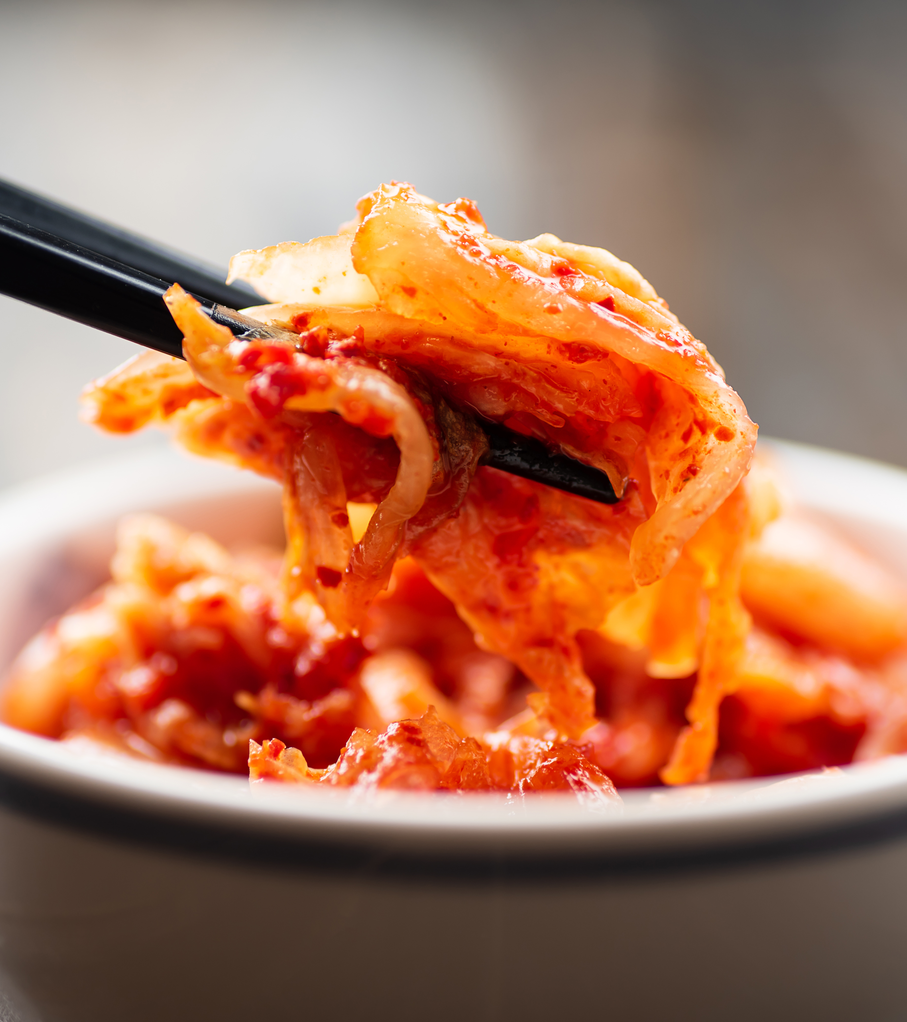
For next lesson
Pair or small group task – tutor to allocate one group:
How may nutritional requirements differ for:
  younger athletes, or
  older athletes, or
  different cultural or religious needs.
Present information and discuss with rest of group.

Slide 42
Level 4 Applied Nutrition for Health, Wellness, Weight Management, and Sports Performance (610/2287/1)
Nutritional needs for different types of athletes and sports people

