Slide 1
Level 4 Applied Nutrition for Health, Wellness, Weight Management, and Sports Performance (610/2287/1)
Nutritional guidance for vegetarian and vegan athletes

Slide 2
Lesson content
How to apply nutritional guidance to support the needs of vegetarian and vegan athletes and sports people.

Slide 3
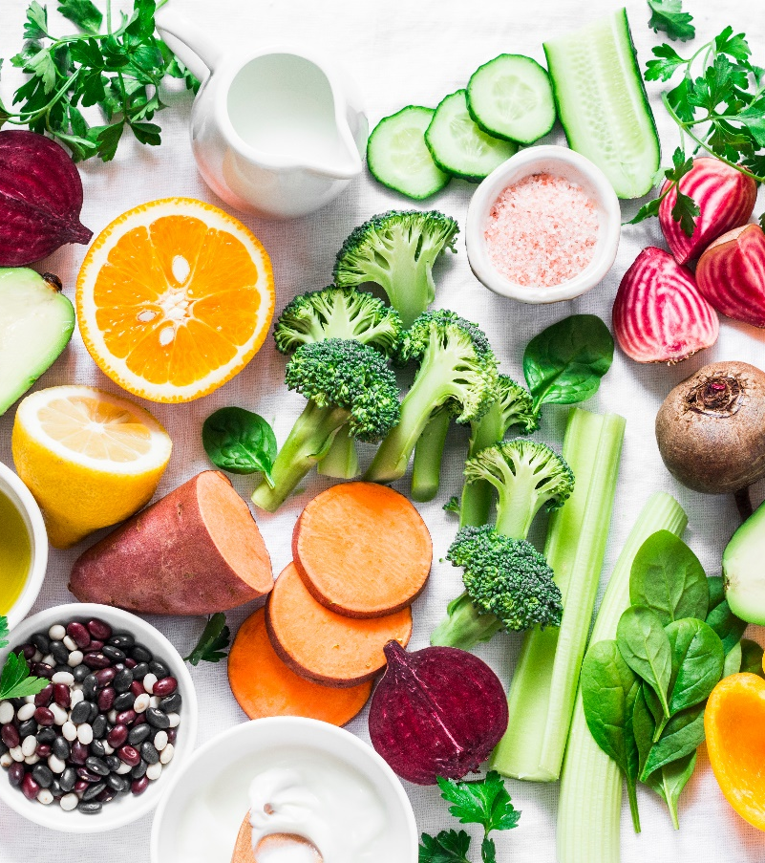
Nutritional requirements for vegetarian and vegan athletes
Share your thoughts and ideas:
What are the differences between a vegetarian and vegan diet?
Why may people choose a vegetarian and vegan diet?
What are the key nutritional requirements?
What is within scope of practice?

Slide 4
Vegetarian diet
Generally accepted as one that excludes meat but includes other animal products like dairy and eggs.
More specific terms:
Lacto-ovo vegetarian diet – includes eggs and dairy but not meat or fish.
Lacto-vegetarian diet – includes dairy products but not eggs, meat, poultry or fish.
Ovo-vegetarian diet – includes eggs but not dairy products, meat, poultry or fish.
Pescatarian diet – includes fish but not meat from mammals or birds.
Flexitarian diet – includes mostly plant-based eating but allows some meat and animal products to be consumed occasionally. Not truly a vegetarian diet but may represent the way many people eat.

Slide 5
Vegan diet
A stricter type of vegetarian diet.
Excludes consumption of any animal products and may also involve other lifestyle choices consistent with these ethics, such as not wearing clothes made from animal products and boycotting brands that test products on animals.
If an athlete is following a strict vegan diet, this excludes a lot of foods that are not simply animal flesh, including some of the vitamin fortification/supplements that would be valuable to counter the risk of deficiency.
This means greater care needs to be taken when planning their meals to avoid becoming deficient in key nutrients.

Slide 6
Foods vegetarians may eat but vegans will not
Dairy products, including eggs.
Other products that may contain dairy, such as:
  crisps or tortilla chips
  margarines/vegetable oil spreads
  non-dairy creamers for coffee
  fresh pasta
  dark chocolate
  other vegetarian products.
Products fortified with omega-3’s - usually sourced from fish oils.
Bananas (unless organic) where pesticides used that includes shrimp and crab shells.

Slide 7
Foods vegetarians may eat but vegans will not
Some added/table sugar that has been refined using bone char in the industrial processing methods.
Some fruit that is coated in wax, like oranges or lemons.
Wines and beers that use finishing agents from seafood.
Honey, chewing gum and marshmallows.
Bread or bagels containing L-cysteine, which is normally derived from hair of pigs or even dogs.
Some jams, jellies, preserves and packaged nuts, which may contain gelatine.
Cereals fortified with vitamin D3, which is sourced from lanolin (the oil that coats sheep wool).

Slide 8
Reasons for choosing a vegetarian and vegan diet
Common reasons may include:
Religious requirements.
Concerns for animal welfare or the ethics of consuming or using animal products.
Concerns for the climate, environment, and sustainability of food chains.
Concerns about health and the quality of meat produced through industrial agriculture.
Concerns about specific long-term conditions like cardiovascular disease.
Concerns about the cost of meat.

Slide 9
Effects on performance and recovery
Can be a wide variation in nutritional quality.
  If the diet is balanced and all macro and micronutrients are included may be no impact on performance.
  If the diet is imbalanced or restrictive, this will have an impact on performance and recovery.
Most consume a higher carbohydrate intake - meals contain protein sources like beans, nuts, and seeds.
Lacto-vegetarians - more dairy foods like yoghurt and milk all contain natural sugars or starchy carbohydrates, which boost carbohydrate intake overall.
Plenty of fuel for high-intensity training and competition and may improve performance if they were previously following a lower carbohydrate diet that did not meet their energy or glycogen replacement needs.

Slide 10
Effects on performance and recovery
Challenges for athletes and heavy exercisers:
Ability to meet increased protein needs to support recovery.
Including eggs and dairy makes this much easier but can make weight management more challenging.
Excluding eggs and dairy from a vegan diet makes meeting protein requirements more challenging.
The body cannot absorb protein from plant sources as easily
  Plus, it usually comes with more carbs, fat, and calories
  That can make things tricky in sports with weight classes.
Certain micronutrients are found in high quantities and are easily absorbed from animal products.
Not as abundant in, or as easy for the body to absorb from, plant protein sources.

Slide 11
Common deficiencies
Omega-3 essential fatty acids – the best source is oily fish.
Other sources - nuts (particularly walnuts), seeds (flax/linseed/chia), soybeans, and oils (rapeseed/flaxseed oil).
Supplements from algae contain the marine omega-3 sources and may be acceptable to vegetarians.
Iron deficiency or anaemia.
Iron that is not from animal products is harder for the body to absorb.
Plant sources - pulses, dark green leafy vegetables, fortified wholegrain bread, cereals, dried fruits, nuts & seeds.
Consuming foods or drinks high in vitamin C alongside iron-containing foods to boost uptake.

Slide 12
Common deficiencies
Iodine – fish and dairy are good sources.
If both are excluded higher risk of deficiency.
Soy and other dairy alternatives are not often fortified with iodine.
Selenium - abundant in meat, eggs, and fish.
Essential for good immune function and cell health.
Other sources - nuts (brazil/cashew nuts), sunflower seeds, fortified breakfast cereals, e.g. shredded wheat, and dark green leafy vegetables like kale, watercress, and rocket.

Slide 13
Common deficiencies
Vitamin B12 - only found naturally in animal products
B12 is needed for healthy blood, nervous, and immune systems.
Options - use supplements or ensure regularly consume fortified yeast extract, fortified breakfast cereals, or fortified dairy alternatives (where vitamin B12 added).
Vitamin D – need sunlight. Oily fish and eggs are good sources.
Important for healthy bone development and maintenance as it aids absorption of minerals like calcium and phosphorous.
Other sources - fortified cereals and spreads, some dairy alternative products.
Supplements available, however, some not suitable for vegetarians or vegans, so check the label.

Slide 14
Protein needs
If the diet is well planned diet protein requirements can be met from plant sources.
  Muscle creatine stores will be lower in vegetarian and vegan athletes, as this is only found in animal products.
  The need for creatine supplementation may be greater for vegetarian/vegan athletes.
Baroni et al. (2023) developed the ‘VegPlate for sports’ model.
  Complex dietary model.
  Defines types and amounts of different plant-based foods to consume at three main meals, plus specific, different compositions for pre- and post-training meals.

Slide 15
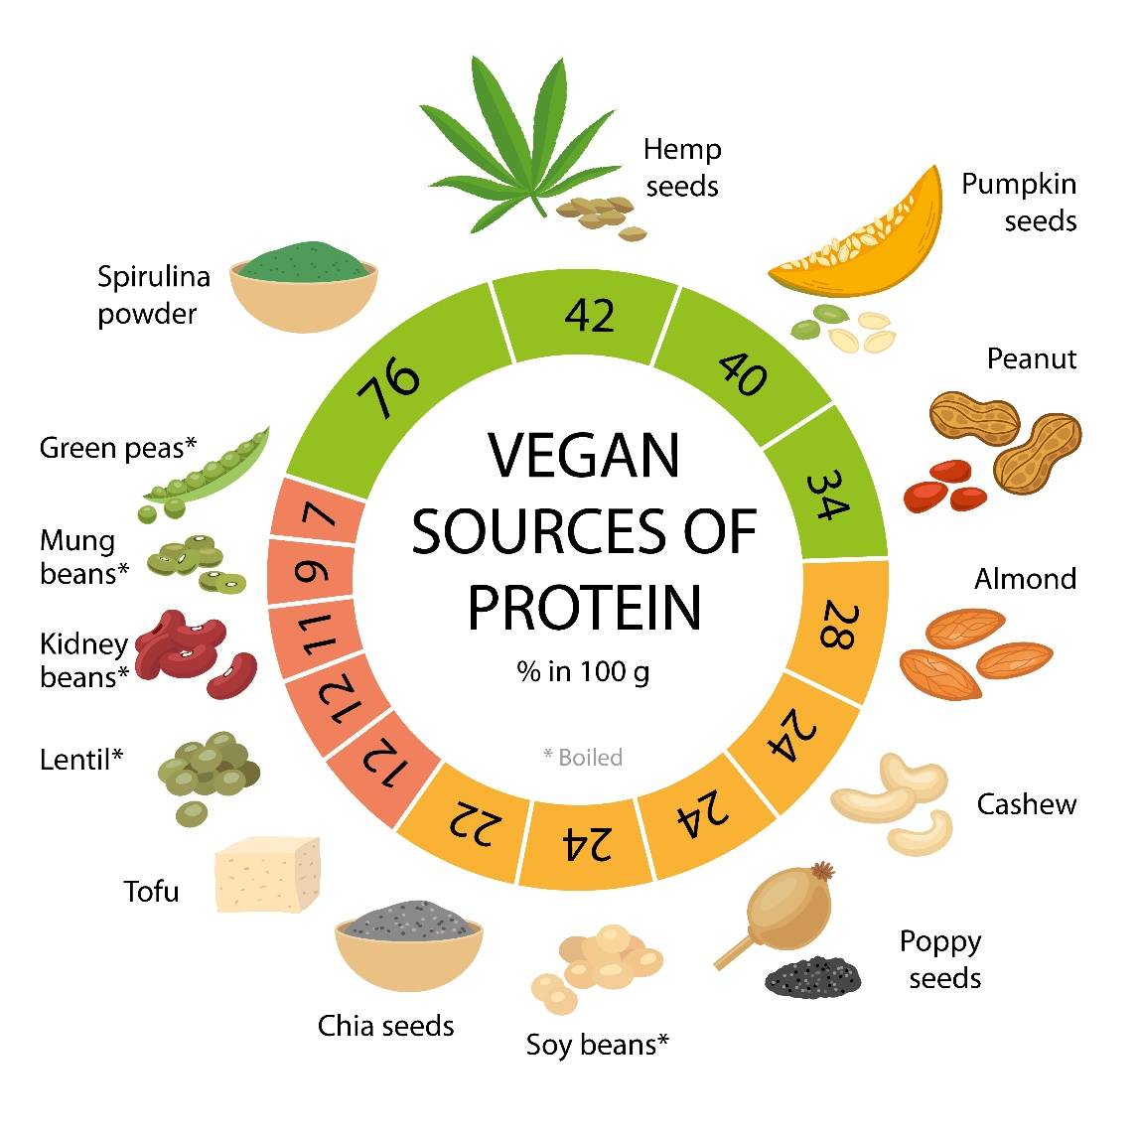
Vegan sources of protein
Individuals who do not eat animal products should aim to consume as wide a variety of plant-based sources as possible and in the right amounts to ensure they consume a balanced quantity of the essential amino acids.

Slide 16
Meal plans – vegans
Vegan burritos – tortilla wraps (corn or wholewheat for extra protein and fibre) with black bean, kidney bean, onion and spice mix, avocado and tomato and vegan cheese.
Tofu, miso and udon soup – made with silken tofu, udon noodles, mushrooms, sliced vegetables e.g. carrot, spring onion, spinach, and ginger.
Chickpea curry with jacket sweet potato – made with chickpeas, chopped tomatoes, onion, and spices served on a jacket sweet potato.
Vegan kale pesto pasta with pine nuts – pesto made with kale, basil, garlic, pumpkin seeds, olive oil, nutritional yeast and a lemon, blitzed into a paste, then stirred through wholewheat pasta with pine nuts sprinkled to top it.
Vegan katsu curry – with tofu fried in breadcrumbs to make it golden, curry sauce made with onion, garlic, oil, ginger, coconut milk, and spices. Served with rice, which could have additional beans added for more protein. And a side of ribbons of carrot and cucumber.

Slide 17
Meal plans – vegetarians
Vegetarian lasagne – made with wholewheat pasta, white sauce with milk and cheese and chopped ragout vegetables in tomato passata.
Lentil and chickpea dahl served with wholewheat rice, or a rice-quinoa mix.
Huevos rancheros – Mexican breakfast egg recipe with eggs and vegetables in a spicy tomato sauce, which could be served with wholewheat or corn tortilla.
Tofu or tempeh stir-fried with thinly sliced vegetables and served with egg noodles or wholewheat noodles.
Roast vegetable and goats cheese pizza on a wholewheat pizza base, served with a side salad.

Slide 18
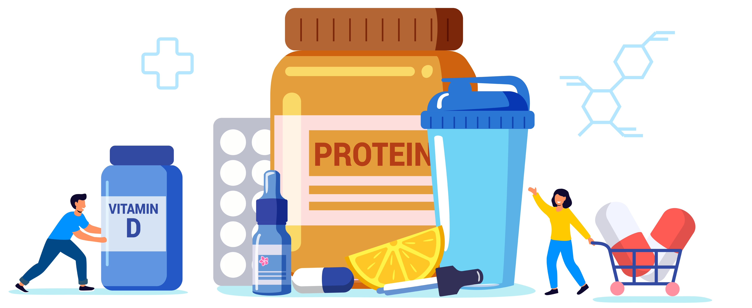
Supplements
May be required due to an increased risk of deficiency for certain nutrients.
Appropriate supplements can support performance, recovery and health.
Always signpost to a qualified dietician or registered nutritionist.

Slide 19
Supplements – risks
Potential risks:
Wrong supplement(s) or dose could impair performance and put health at risk by exacerbating an imbalance or deficiency that may exist.
May not contain what is stated on the label:
  May not be truly vegetarian/vegan
  Could contain fewer or more of the nutrients than claimed.
May contain banned substances, which could lead to disqualification or a ban from competition.
Allergic reactions to some ingredients.

Slide 20
Pair task
What are two main take away points from this lesson?
How will you apply these to your practice?

Slide 21
Lesson summary
How to apply nutritional guidance to support the needs of vegetarian and vegan athletes and sports people.

Slide 22
For next lesson
Pair task:
What are the key nutritional requirements for vegetarian and vegan athletes?
Create a presentation and share information with rest of group.

Slide 23
Recommended reading
Bean, A. (2023). The Complete Guide to Sports Nutrition. 9th edition. London, UK: Bloomsbury Publishing

Slide 24
Level 4 Applied Nutrition for Health, Wellness, Weight Management, and Sports Performance (610/2287/1)
Nutritional guidance for vegetarian and vegan athletes

