Slide 1
Level 4 Applied Nutrition for Health, Wellness, Weight Management, and Sports Performance (610/2287/1)
The role of hydration in exercise and sports performance.

Slide 2
Session content
Terminology definitions – Euhydration, Dehydration, Hypohydration, Hyperhydration.
The benefits, limitations, and suitability of different types of sports drinks (iso, hypo and hypertonic).
Hydration recommendations and requirements when engaging in exercise and sport.
The effects of differing levels of dehydration.
Hydration and fluid intake guidelines for different activity levels and environments.
The effects of alcohol on hydration, health, and sports performance.

Slide 3
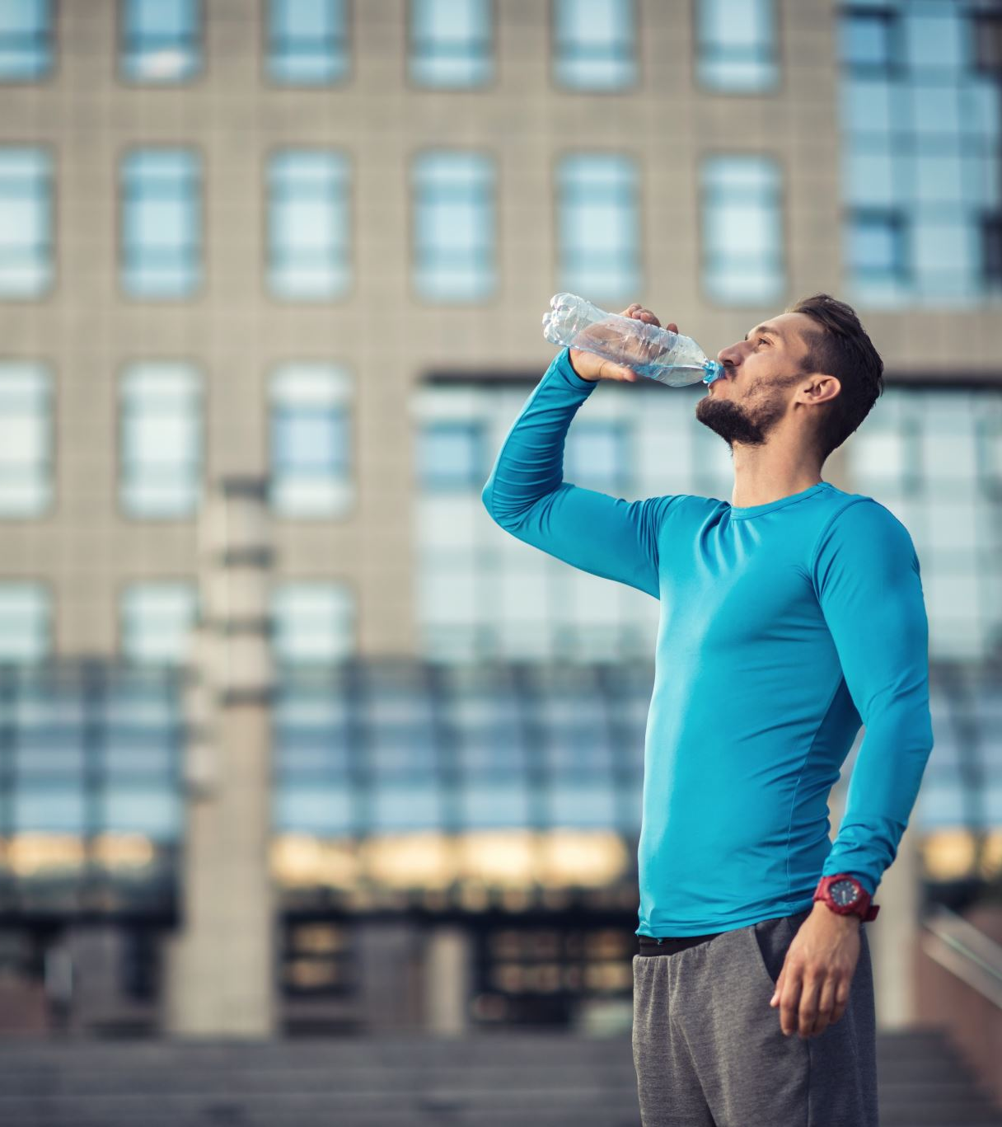
Terminology
Share your thoughts and ideas:
What is meant by the following terms?
Hydration
Euhydration
Dehydration
Hypohydration
Hyperhydration

Slide 4
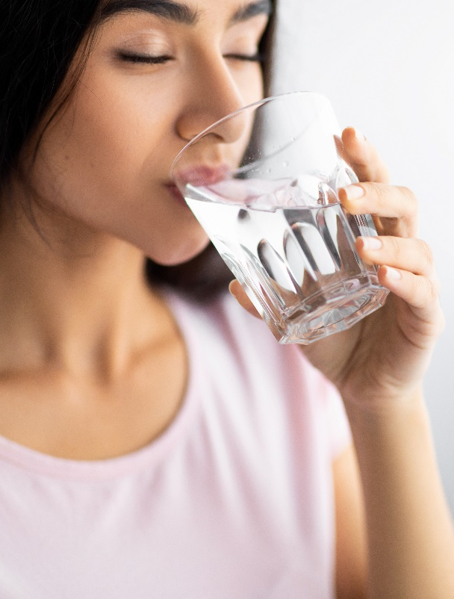
Hydration
Hydration: Process of replacing water in the body.

Slide 5
Definitions
Dehydration – the process of losing water.
Euhydration – a state of normal hydration.
Hypohydration – a state of reduced body water (dehydrated), usually a deficit of >2% of bodyweight.
Hyperhydration – a state of increased body water.
Source: Bean (2022)

Slide 6
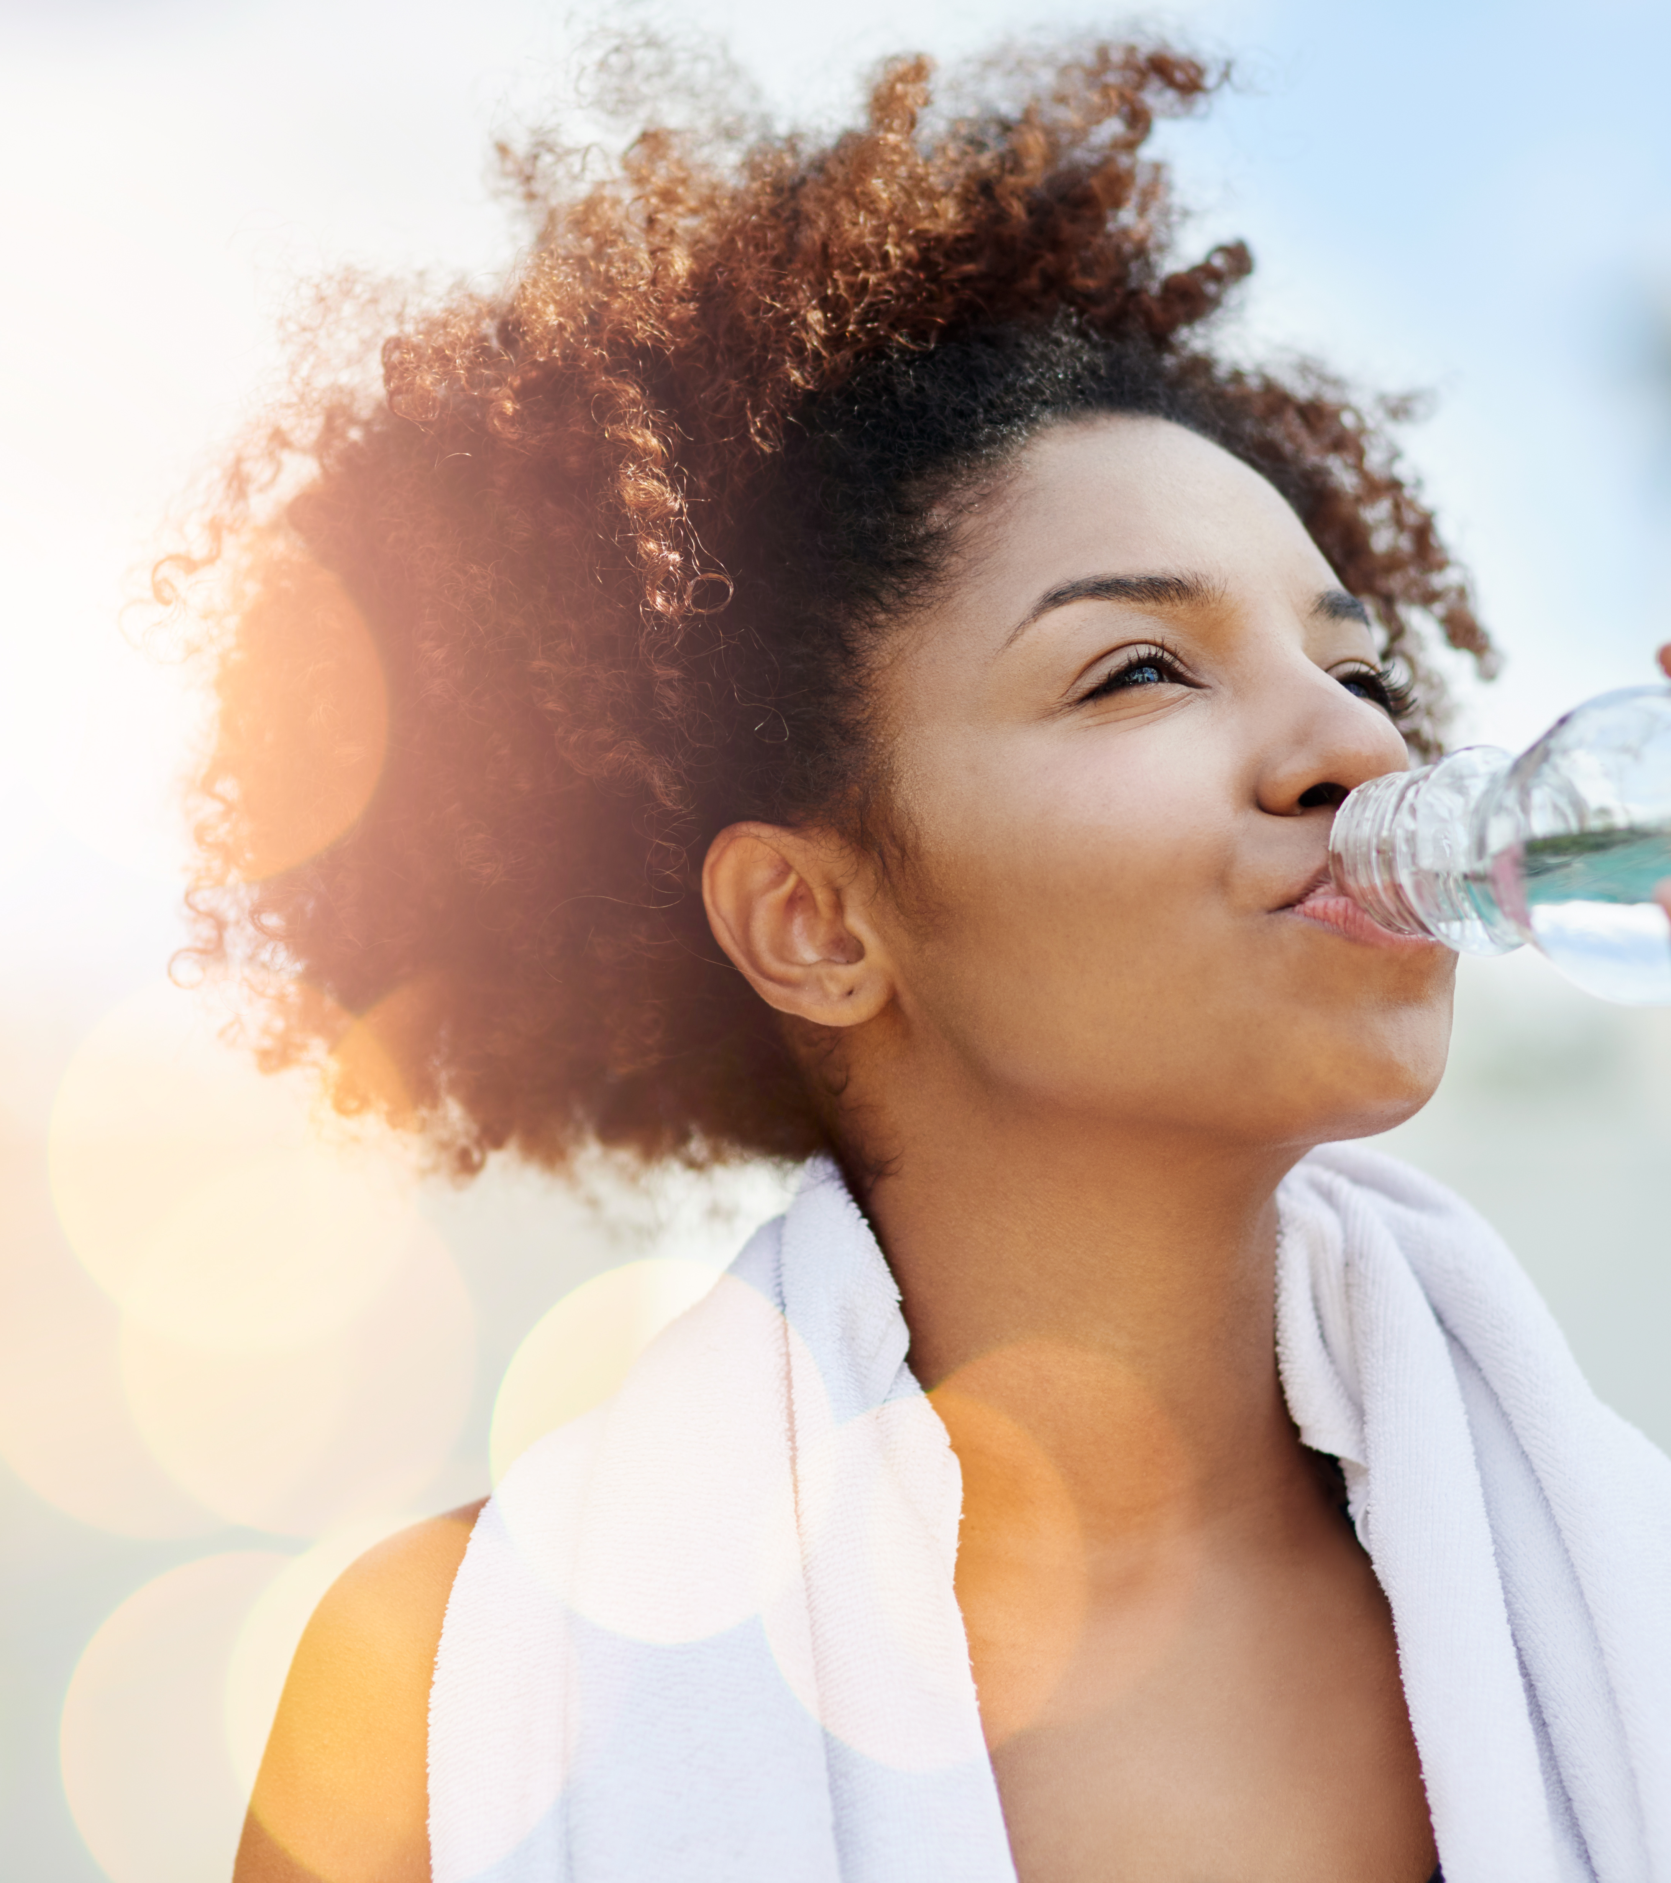
Importance of hydration
Share your thoughts and ideas:
Why is adequate hydration important?

Slide 7
Importance of hydration
Water is the main component of cells and blood. The body is nearly two-thirds water.
Adequate hydration is essential for:
Regulating the body temperature, known as thermoregulation.
Maintaining blood plasma volume.
Supporting transportation of nutrients and the removal of waste products via the blood.
Maintaining cell activity and homeostasis.
Supporting brain and body functioning.
Maintaining joint lubrication.
Supporting both physical and mental performance.

Slide 8
How is water lost?
Even without moving, you can lose 2–2.5 litres of water per day.
When exercising or participating in sport, water loss increases.
Water is lost in several ways:
  Urine and faeces
  Evaporation from the skin as sweat
  Expired breath.
Lost water must be replaced:
  Approximately 50% of fluid loss can be replaced from food.
  Still essential to drink plenty of fluids.

Slide 9
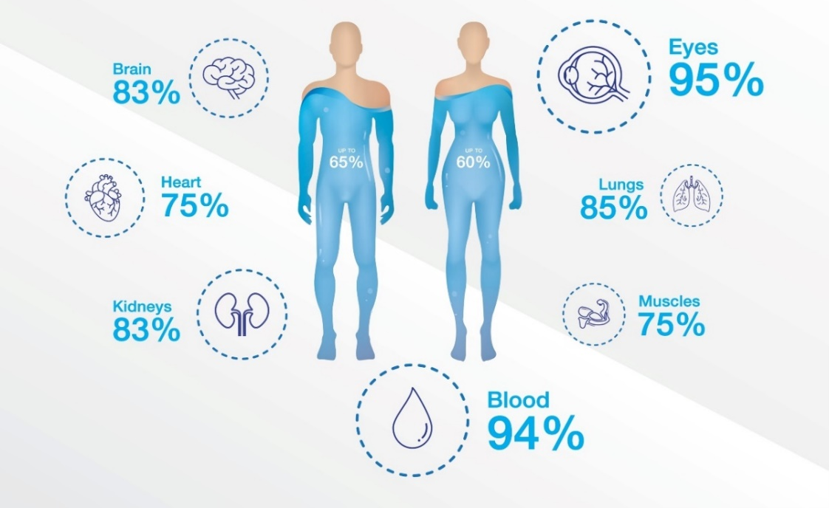
How water is lost

Slide 10
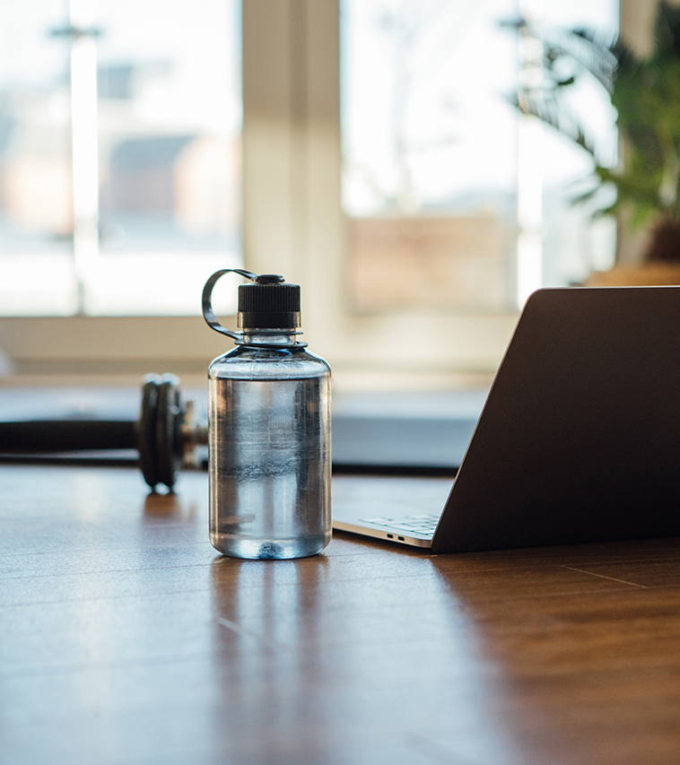
Hydration recommendations and guidance
Share your thoughts and ideas:
What are general hydration guidelines?
What are guidelines for exercise and sport?

Slide 11
General hydration guidelines (Eatwell guide)
Drink 6-8 glasses of fluid every day.
Water – best option
Lower-fat milk and sugar-free drinks, tea and coffee.
Fruit juice and smoothies - but consider sugar.
  Sugary drinks - main contributors to excess sugar consumption.
Limit alcohol - lots of calories and other health effects.

Slide 12
Drinks that may have a dehydrating effect
Some drinks and fluids may have a net dehydrating effect on the body.
These include fluids that contain:
  alcohol
  high levels of sugar
  caffeine.
This can include some sports and energy drinks.

Slide 13
Hydration – exercise and sports guidelines
Need to drink much more than the recommended amounts
Up to 4-5 litres of water can be lost in sweat in a day
  Even more in hot environments
Excess water loss without being replaced affects:
  the building of body tissues
  temperature regulation
  metabolic rate.
A sound hydration strategy begins long before an exercise session or event.
Drinking adequate fluid throughout the day to maintain optimal hydration is essential, so that the athlete is fully hydrated at the start of each exercise session.

Slide 14
Factors affecting hydration and fluid needs
Factors that influence the actual amount a fluid an individual needs include:
The weather.
The humidity of the environment.
The intensity, type, and duration of physical activity, exercise, and sport.
Other individual differences like the age of the person and their body size.

Slide 15
Pre-exercise or pre-event
Pre-exercise or pre-event
Aim to drink 5- 10ml/kg between two and four hours before a session or event.
This would be between 300 and 600 ml of water for a 60kg person.
This will allow for adequate hydration and urination.

Slide 16
During exercise or event
During exercise or an event
A general guideline offered by UK Coaching (2023) is to drink 400- 800ml/hr of fluid divided into equal amounts at around 20-minute intervals to avoid digestive system discomfort.
Equivalent to a few gulps.
Fluid replacement during exercise is to offset fluid losses caused by the exercise.

Slide 17
Post-exercise or event
Post-exercise or event
Aim to replace the fluid you have lost during the session, plus half again to account for the thermal effect of exercise.
  Drink around 750 ml of water for every 0.5kg of body weight lost during exercise.
  If fluid loss is not assessed, continuing to drink at a rate of 400-800ml/hr is suggested, with urine colour used as a guide to indicate rehydration has been achieved.
Athletes will experience some degree of fluid loss from extended periods of exercise (longer than an hour).
Fluid replacement needs to continue after exercise or competition until hydration is returned to baseline.

Slide 18
Hypohydration – how to identify?
Athletes have different sweat rates, affected by the environment, clothing worn, and intensity of activity.
Individual sweat rates can be calculated by:
weighing an athlete before a standardised aerobic exercise session of one hour duration.
having them exercise at a set intensity, e.g. 70% HRmax, for one hour in a controlled environment, e.g. a 16-degree air-conditioned laboratory or gymnasium, with no fluid or food intake.
weighing them at the end of the session to measure the difference in weight lost from fluids.

Slide 19
Benefits of calculating sweat rates
Provides a baseline indicator of an individual’s fluid replacement needs.
Can be used to calculate the recommended amount to sip every 10-15 minutes of activity.
Will need to be adjusted for increased temperatures and higher exercise intensities.
Fluid replacement calculators will help with this process and are available online.
One example, from the Gatorade Sports Science Institute: https://www.gssiweb.org/toolbox/fluidloss/calculator

Slide 20
Sweat suits – weight loss and competition
Some athletes need to lose weight rapidly to ‘make weight’ for a competition.
Wearing a sweat suit and doing light exercise to increase sweat rates and reduce body weight used.
Potentially dangerous.
Increased risk of hyponatraemia if electrolytes are not replaced.
Sweatsuits as a weight loss strategy - not advisable.
Weight loss will be from fluid and not fat.
It is likely that less fat would be used than if the exercise were performed without the suit, as it could be sustained for longer or performed at a higher intensity with more calories expended.

Slide 21
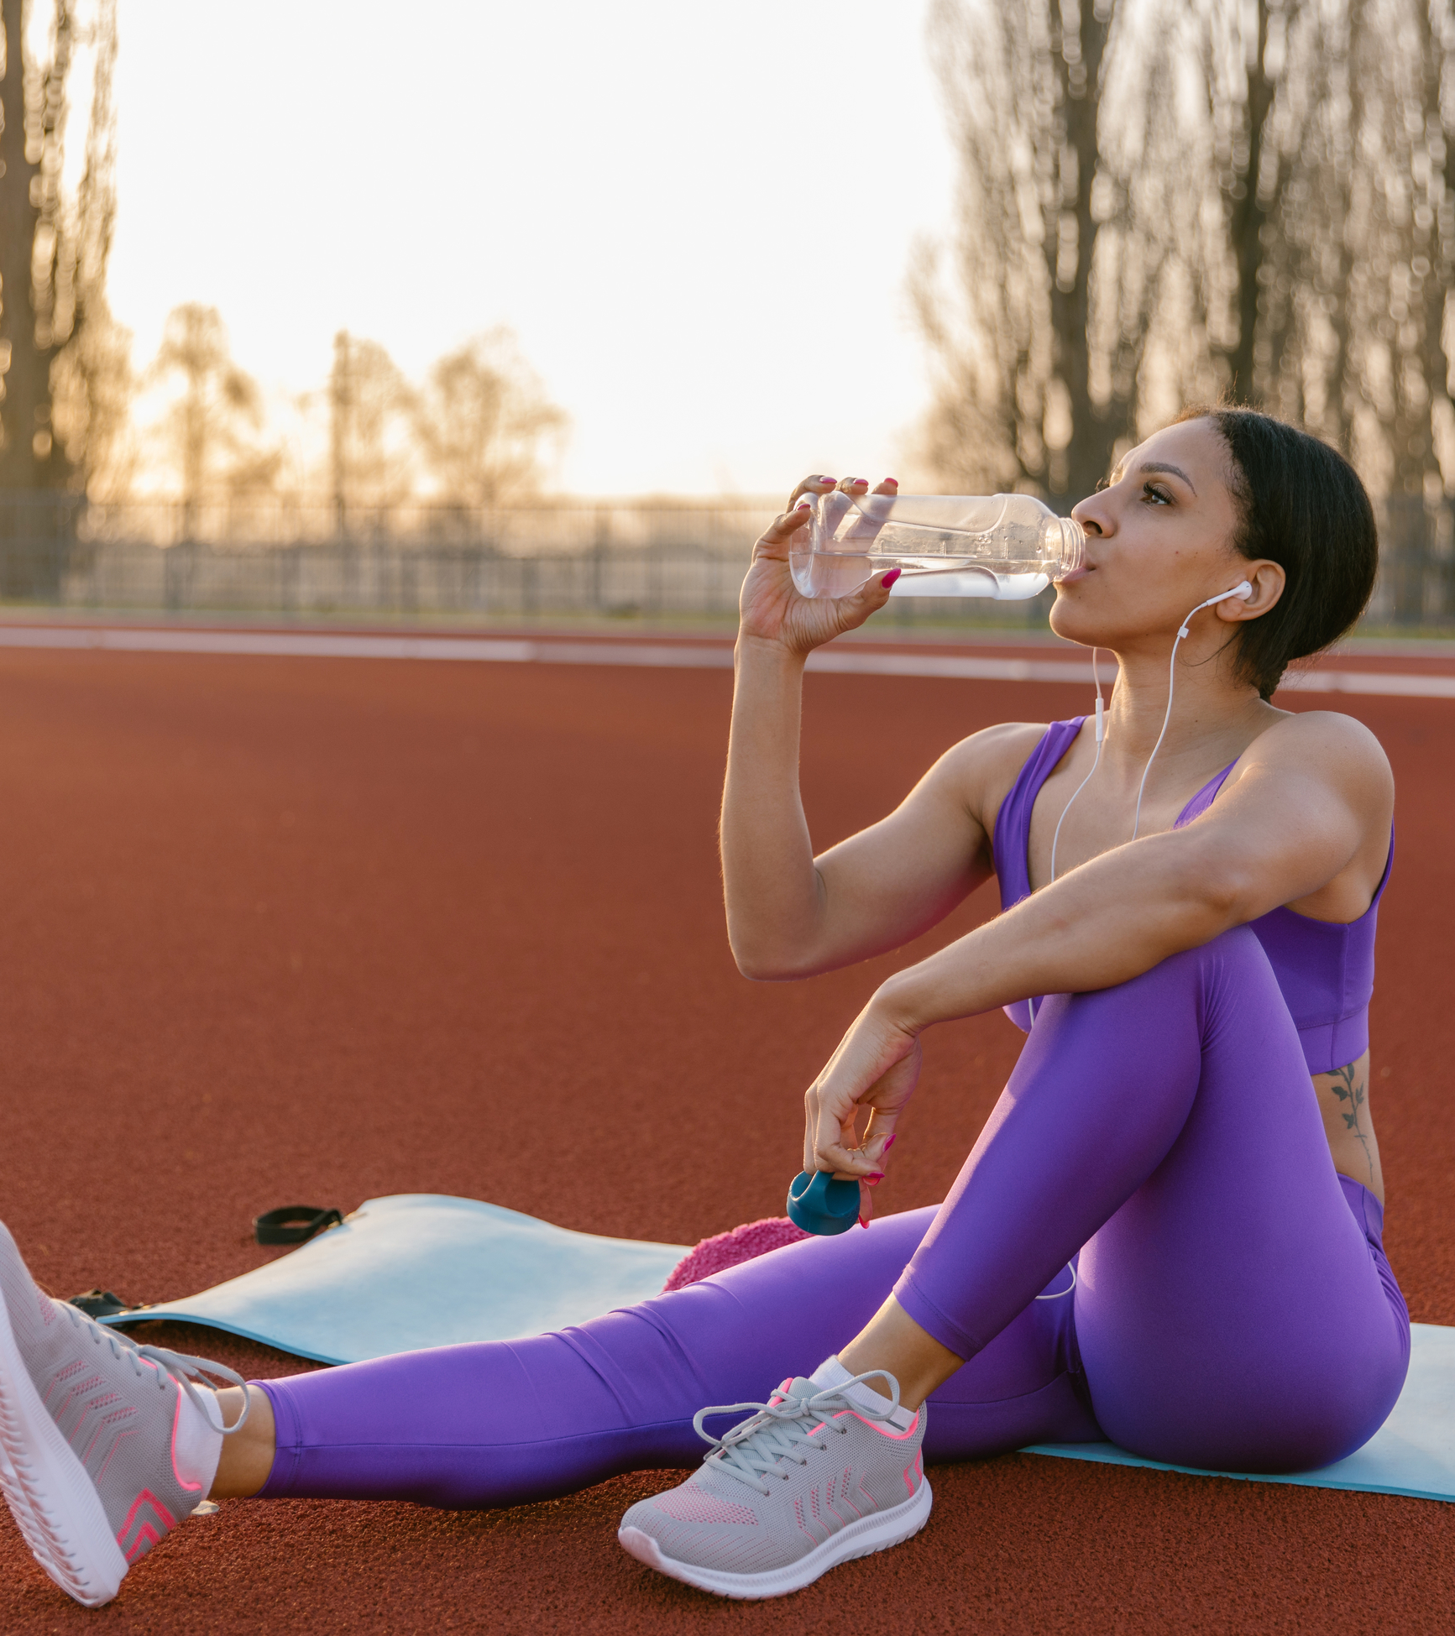
Sports drinks
Share your thoughts and ideas:
What are different types of sports drinks?
When may be these used and what for?

Slide 22
Hydration – sports drinks
Sports drinks contain:
  Water – to replace lost fluid.
  Carbohydrates – to replenish energy stores.
  Electrolytes – sodium, magnesium and potassium, to prevent hyponatraemia.
Sports drinks are NOT necessary if exercise lasts less than one hour.
In most instances drinking water is the best option.

Slide 23
Sports drinks
Isotonic drinks - similar concentration of electrolytes to body fluids.
Rehydrate at a similar rate to water.
Most useful for prolonged activity or when perspiration levels are high, e.g. hot or humid weather.
The main benefit is their sugar and electrolyte content:
  Sugar replenishes blood sugar levels – an additional source of fuel for long-duration sporting events.
  Electrolyte content (minerals) assists water retention and increases the rate at which water is absorbed in the gut, helping to offset fluid loss more quickly and maintain hydration.

Slide 24
Sports drinks
Hypotonic drinks contain electrolytes and a lower concentration of sugar than body fluids.
Increases the uptake of the fluid from the gut.
May rehydrate at a faster rate than drinking pure water.
Hypertonic drinks contain higher levels of sugar and may also contain electrolytes.
May support recovery after exercise.
May be useful for those participating in multiple training sessions in a day.

Slide 25
Sports drinks
In most instances, sports drinks are not needed, and drinking water is the best option.
Exception:
During long-distance endurance events, the body can lose up to 1 litre of fluid every hour (equivalent of 1kg of bodyweight).
In hot and humid conditions may be even higher.
Hydration requirements will be higher.
It may be that a sports drink containing electrolytes will be useful to maintain hydration, top up glycogen stores, and minimise the risk of hyponatraemia.

Slide 26
Hyponatraemia
In situations where fluid is lost rapidly from the body due to increased perspiration, there is a risk of hyponatraemia if only water is consumed and no food is eaten.
A rare condition, but it can happen when endurance events are performed in hot conditions.
Hyponatraemia means sodium levels in the blood are less than normal.
Can cause abnormal heart rhythms and even heart attacks.
The use of an electrolyte replacement such as a sports drink may be useful.

Slide 27
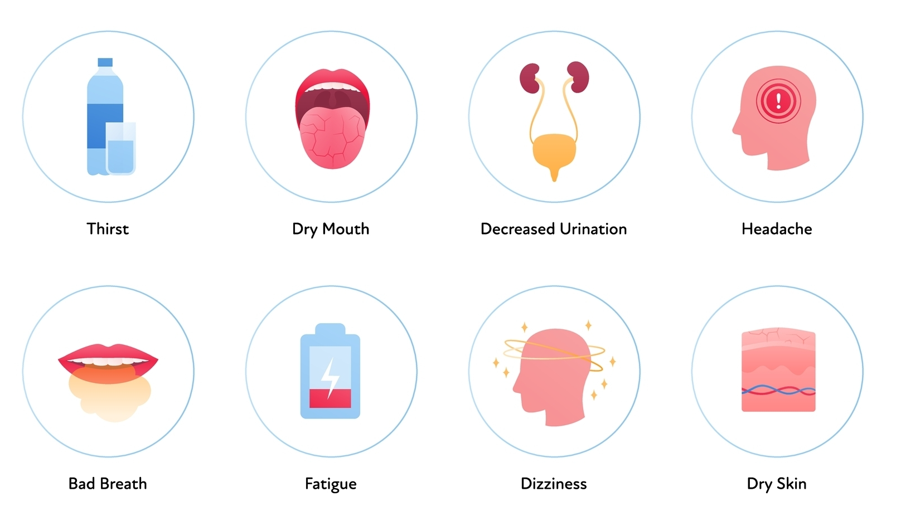
Dehydration
Share your thoughts and ideas:
What are the different stages of dehydration?
What are the signs and symptoms of different stages?
How does dehydration affect health?

Slide 28
Dehydration – Stages, signs and symptoms
Mild dehydration
Feeling thirsty – an early sign.
Feeling hot.
Nausea.
Flushed and clammy skin.
Lacking energy.
Loss of alertness and concentration.
Advanced dehydration
Headache.
Dizziness.
Shortness of breath.
Coma and death.

Slide 29
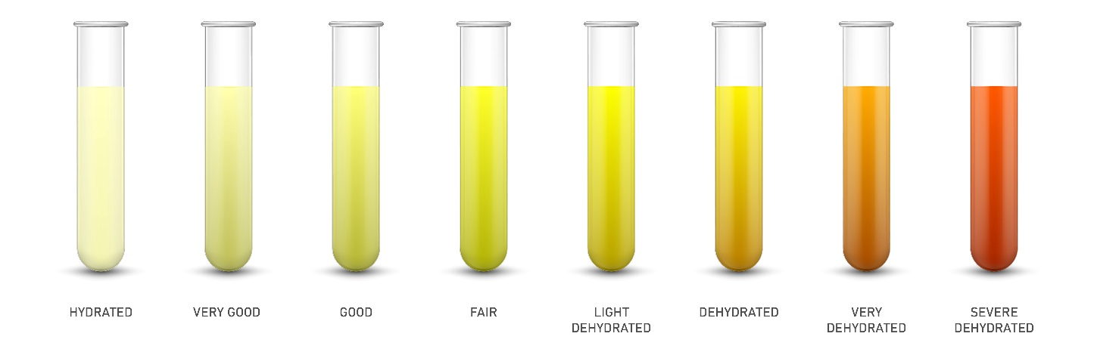
Hydration and urine colour
Urine colour is one way to gauge hydration levels. The darker the urine, the more dehydrated the body is.

Slide 30
Dehydration – risks and health impact
A loss of body fluids, AT:
3% - reduced blood volume, blood flow, inefficient kidney function, reduced exercise performance, dry mouth and headache.
4% - capacity for hard muscular work declines by 20–30%.
5% - heat exhaustion, requiring medical attention.
7% - physical and mental function severely affected, hallucinations.
10% - heat stroke, circulatory collapse and death.

Slide 31
Alcohol
Share your thoughts and ideas:
How may alcohol affect:
Hydration
Health
Sports performance.

Slide 32
Alcohol – energy
Sedative
7 kcal per gram – increase calories, weight gain
No nutritional value!

Slide 33
Responsible drinking guidelines
The UK guidance for lower-risk drinking for men and women is:
A maximum of 14 units of alcohol a week.
Spread these evenly over 3 or more days.
Have a few drink-free days each week.

Slide 34
Alcohol content
– common drinks
How many empty calories?

Slide 35
Risks of excess alcohol
One of the three biggest lifestyle risk factors for disease and death in the UK (after smoking and obesity).
Regularly drinking more than 14 units a week for 10-20 years increases the risk of:
  Brain damage
  Cancers of the mouth, throat and breast
  Damage to the nervous system
  Heart disease
  Liver disease
  Stroke

Slide 36
Risk of excess alcohol
Physical | Psychological
Cardiovascular disease (coronary heart disease, heart attack and stroke) | Alcohol dependence and addiction
Cirrhosis of the liver | Alcoholic psychosis
Depression and anxiety | Anxiety
High blood pressure | Depression
Osteoporosis | High stress levels
Pancreatitis | Dementia
Reduced fertility | Risk of suicide
Risk of falls | Inability to function in daily activities
Stomach ulcers | Inability to hold down a job
Various cancers | Anger issues
Weight gain | Paranoia

Slide 37
Effects of alcohol on performance
Reduces performance and reaction time.
Can effect adenosine triphosphate (ATP) production.
Dehydration – loss of minerals that help maintain nerve, muscle action, coordination (calcium, potassium, zinc, magnesium).
Heat loss.
Can impact muscle building and repair.
Can cause fatigue, muscle cramps.
Masks pain and can hinder injury recovery (vasodilator).
Affects sleep.
Best not to drink alcohol 48 hours before any sporting activity.

Slide 38
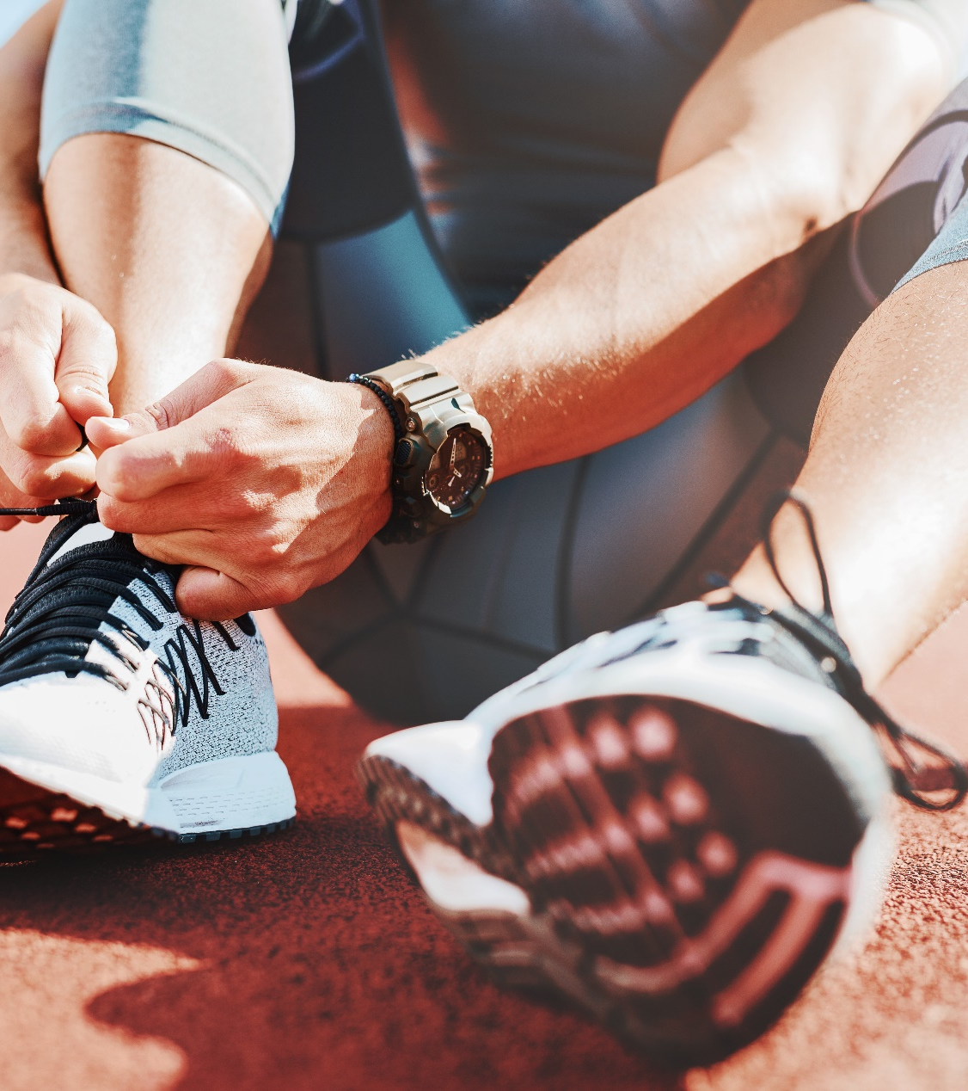
Activity: For next lesson
Research task and presentation

Slide 39
Small group activity
Select three different sports or activities.
Consider how the level of participation may impact hydration recommendations (e.g. recreational versus professional).
Consider how the training environment may impact hydration recommendations:
  Indoor or outdoor
  Low temperature or high temperature
  Low altitude or high altitude.
Research and find out more about how professional athletes prepare for events in different environments.
Share information with the group.

Slide 40
Lesson summary
Terminology definitions – Euhydration, Dehydration, Hypohydration, Hyperhydration
The benefits, limitations, and suitability of different types of sports drinks (iso, hypo and hypertonic).
Hydration recommendations and requirements when engaging in exercise and sport.
The effects of differing levels of dehydration.
Hydration and fluid intake guidelines for different activity levels and environments.
The effects of alcohol on hydration, health, and sports performance.

Slide 41
Level 4 Applied Nutrition for Health, Wellness, Weight Management, and Sports Performance (610/2287/1)
The role of hydration in exercise and sports performance.

