Slide 1
Level 4 Applied Nutrition for Health, Wellness, Weight Management, and Sports Performance (610/2287/1)
The safe use of supplements and ergogenic aids for performance

Slide 2
Lesson content
What is meant by the terms ‘sports supplements’ and ‘ergogenic substances’?
The evidence, uses, limitations and risks related to the use of dietary supplements & ergogenic substances as aids to performance.
Scope of practice and conflicts of interest surrounding sports supplements and ergogenic substances to support performance.
Dietary alternatives to the use of sports supplements and ergogenic substances to support performance.

Slide 3

Sports supplements and ergogenic aids
Share your thoughts and ideas:
What are sports supplements and ergogenic aids?
Why may they be used?

Slide 4
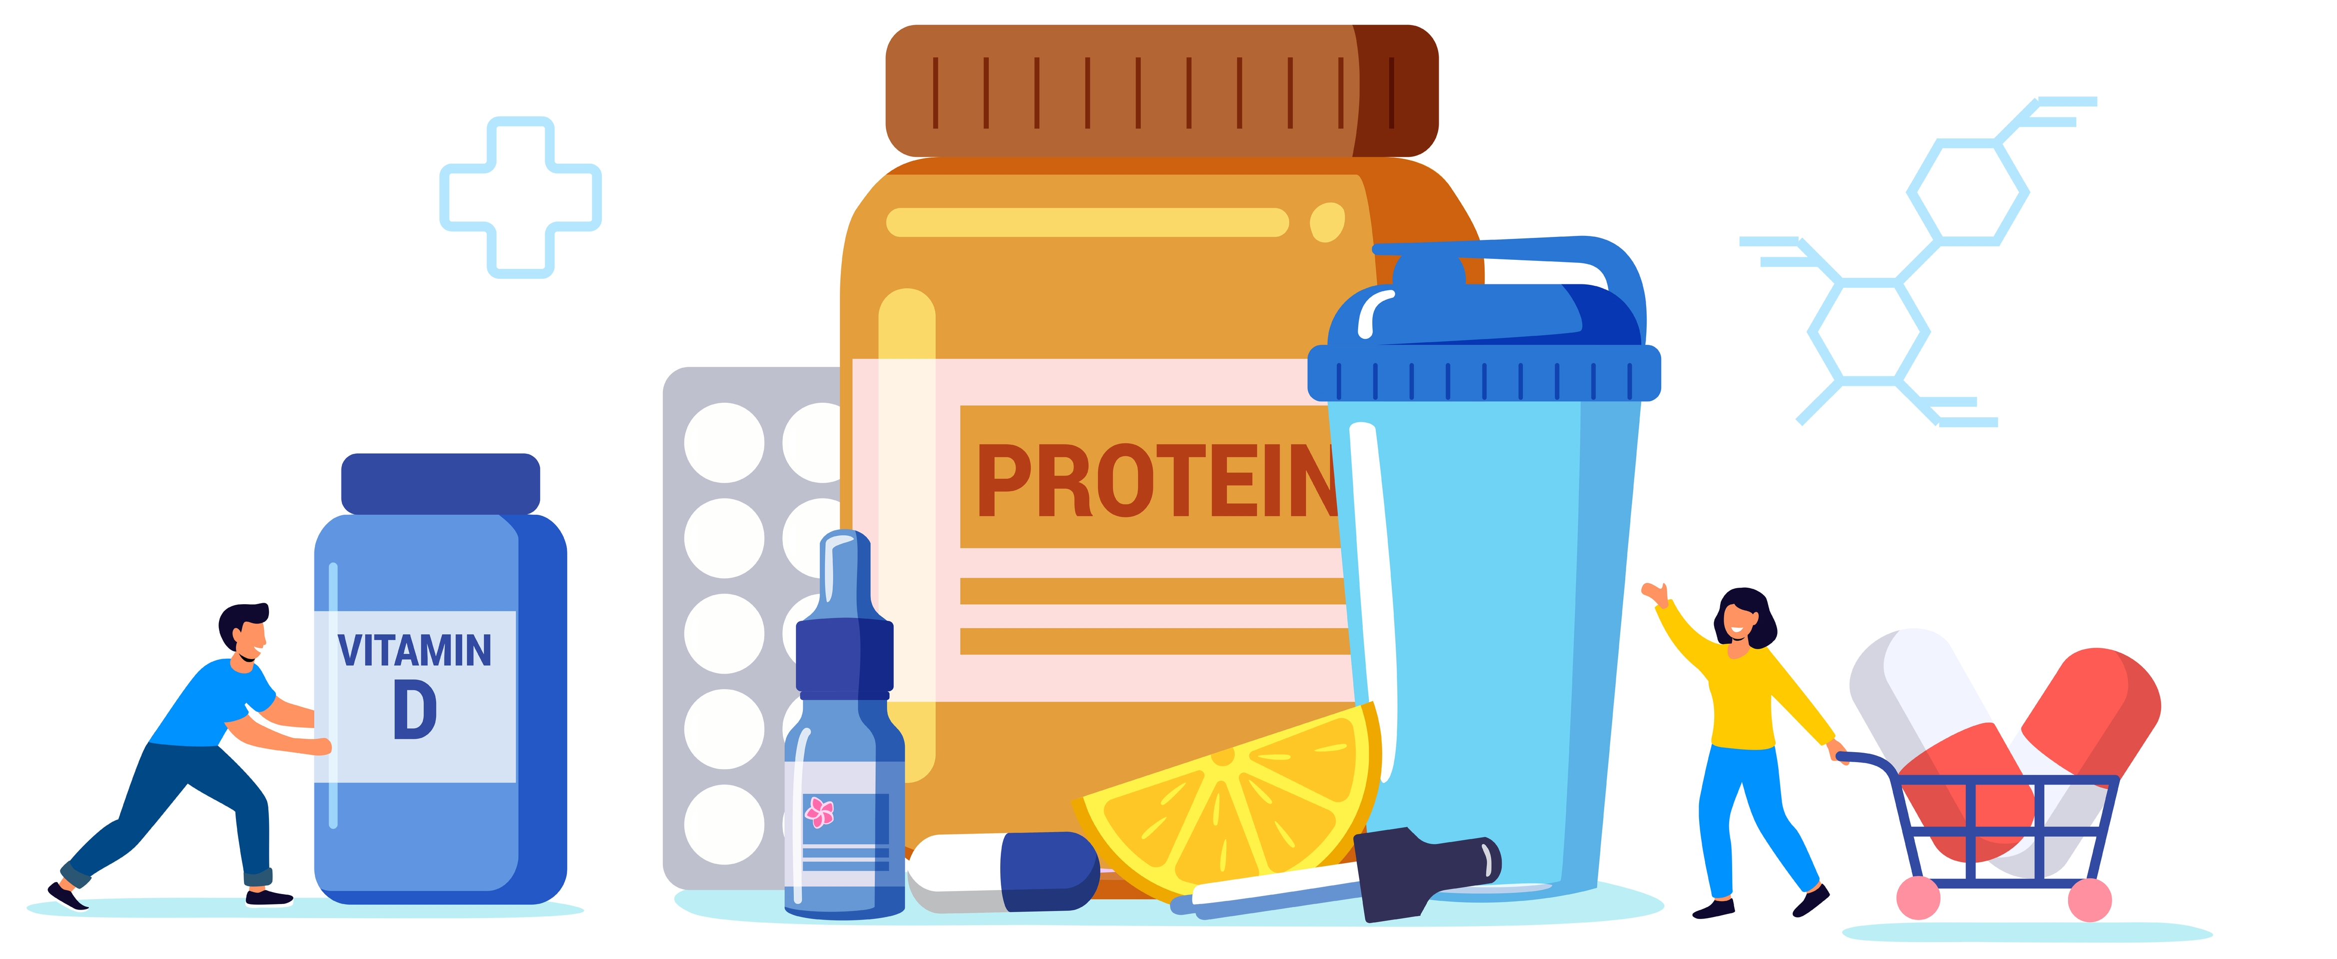
Sports supplements
May be used to complement the regular diet with the specific aim being to improve health, wellbeing, and/or performance.
Not replacements for healthy eating.
Various products and forms:
  Tablets
  Bars
  Powders
  Drinks

Slide 5
Sports supplements
May be used to:
build muscle mass
improve strength
gain weight
lose weight
support fat loss
assist recovery
support hydration and rehydration
improve endurance
manage nutrient deficiencies.

Slide 6
Ergogenic aids
Substances used specifically to enhance sporting performance and improve recovery.
Some have a strong evidence base, but most have not.
Caffeine - found in various ergogenic products and energy bars.
Selective androgen receptor modulators (SARMS)
  promoted as a safer alternative to steroids
  limited research and some studies indicate risks of liver damage, like that observed with steroid misuse.

Slide 7
Ergogenic aids
Some products contain banned stimulant substances:
  ephedrine
  synephrine
  yohimbine
  methylhexanamine.
These have been linked with kidney failure, seizures, stroke, and death.

Slide 8
Scope of practice
Share your thoughts and ideas:
What is your scope of practice?

Slide 9
Scope of practice
In scope:
  Providing guidance on the limitations and risks associated with some supplements and performance aids may help clients make more informed choices.
Exceed scope:
  Advising or recommending clients to use any supplements and performance aids.
  Selling or promoting the use of supplements and performance aids.
Signposting:
  Always signpost clients to a qualified dietician or registered sports nutritionist.
Liability:
  Providing advice or recommendations that exceed scope (and insurance) could lead to risk of uninsured liability.

Slide 10
Key issues
The supplement industry is not regulated - claims may be inaccurate or non-evidence-based.
Some supplements may contain banned substances, including stimulants, steroids, or steroid precursors. A significant impact on athletes and sportspeople who are competing.
Supplements (including vitamins and minerals) will not offset the impact of an imbalanced diet. Sourcing nutrients from natural food is always the preferred solution.
Most supplements are for most people; they are an unnecessary expense rather than something that is needed.
Supplements are not appropriate for individuals with health conditions - unless prescribed as part of a nutrition plan by their dietitian.

Slide 11
Activity
Visit the following websites
  UK Anti-doping (UKAD) : https://www.ukad.org.uk/
  World Anti-doping Agency (WADA) : https://www.wada-ama.org/en.
Find out about their guidance regarding the use of certain substances:
  Substances that are evidenced as safe
  Substances that are illegal and banned.

Slide 12
Dietary recommendations vs supplements
Whole foods.
Balanced dietary intake.
Regular meals.
Seek guidance from an appropriately qualified nutritional professional for specific dietary advice, including the use of supplements.

Slide 13
Supplements or aids
What do you know about the following supplements or aids?
Vitamin and mineral supplements
Fat burners
Protein supplements
Caffeine
Cannabidiol (CBD)
Creatine
Androgenic anabolic steroids (AAS)

Slide 14

Vitamin and mineral supplements
Most vitamin and mineral supplements are approved for the general population.
May be some benefits for supporting a restricted diet or an intense training programme.
Sourcing nutrients from natural food is always preferable.

Slide 15
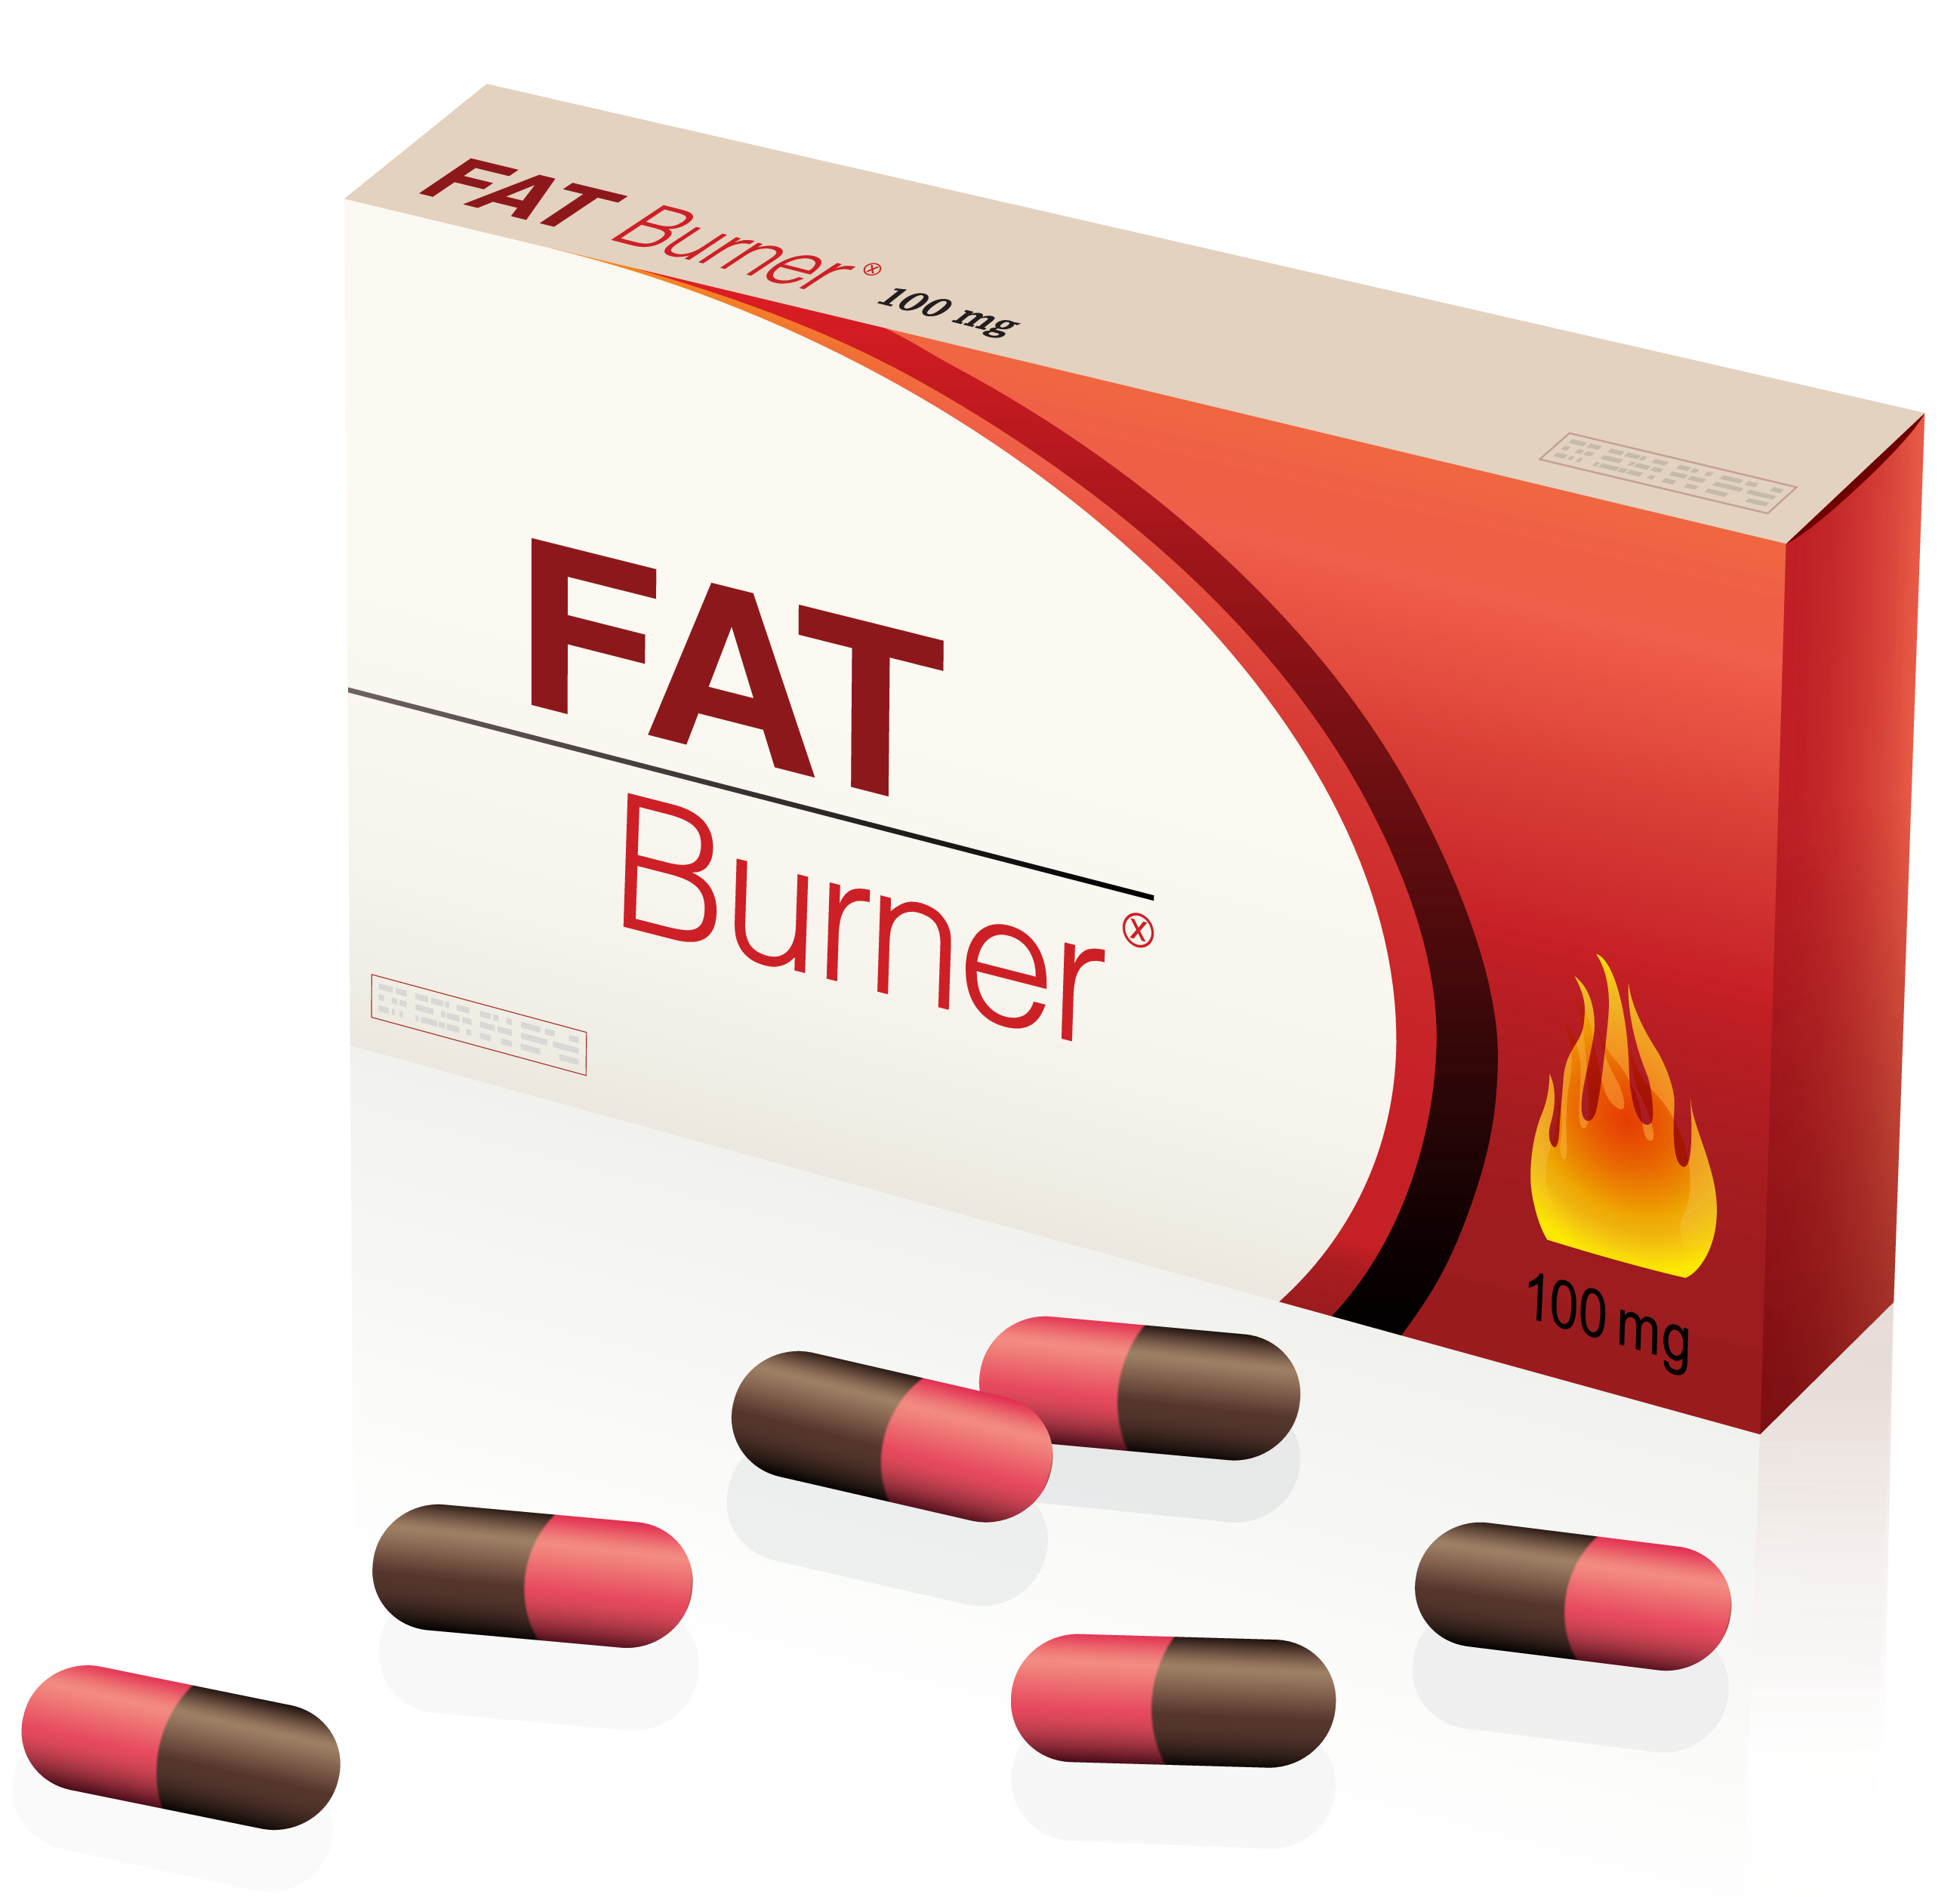
Fat burners
Most contain caffeine and green tea extract.
  May elevate metabolism slightly.
  No evidence to have a significant impact on weight loss.
Some contain banned chemicals - dexaprine or sibutramine.
  Serious side effects like muscle loss and death, especially if the stated doses are exceeded.
Substances are still found in some supplements at doses higher than the old prescribed amounts and sometimes are not even listed on the ingredients label!
‘If it sounds too good to be true’, it probably is.

Slide 16
Protein supplementation
For most people, a balanced diet provides adequate protein.
Supplementation is often unnecessary and expensive.
Supplementation may be beneficial if:
  Individuals are regularly failing to meet their required protein intake.
  The demand of the sport or discipline requires a high protein intake that is hard to meet through food alone, e.g. bodybuilding, strength athletes.
  Individuals are struggling to eat adequate protein due to dietary restrictions, e.g. vegans and vegetarians.

Slide 17
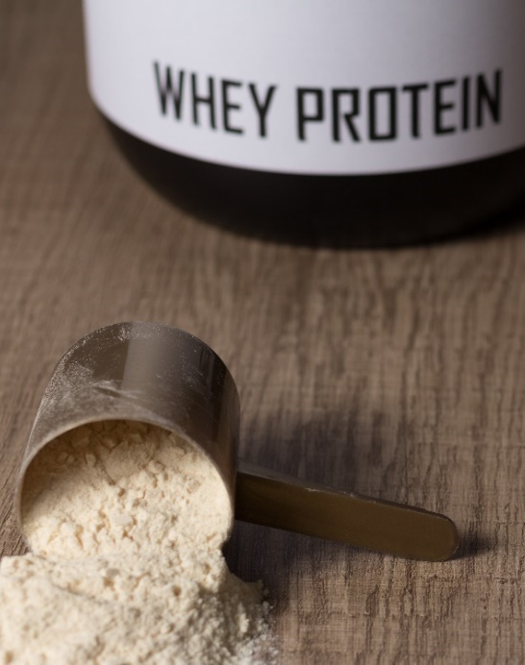
Protein supplementation
Casein and whey are milk proteins
  Casein is absorbed more slowly than whey.
  Drinking milk or a milkshake after training will provide a balance of rapidly absorbed and longer-acting proteins.
For vegans and others who avoid dairy.
  Soy protein contains a complete amino acid profile.
  Can have a similar effect on muscle protein synthesis to whey, although a slightly larger serving of 30g compared to 20-25g of whey is needed to provide the same effect on muscle protein synthesis rates.

Slide 18
Protein supplementation
Older research suggested that the quicker amino acids could be made available post-exercise, the better for muscle growth and recovery.
More recent studies have shown that for whole-body muscle protein synthesis, it makes little difference when protein is consumed within a 2-hour window of the workout.
So, a high-protein snack or meal 30 or even 60 minutes after training can be just as effective.

Slide 19
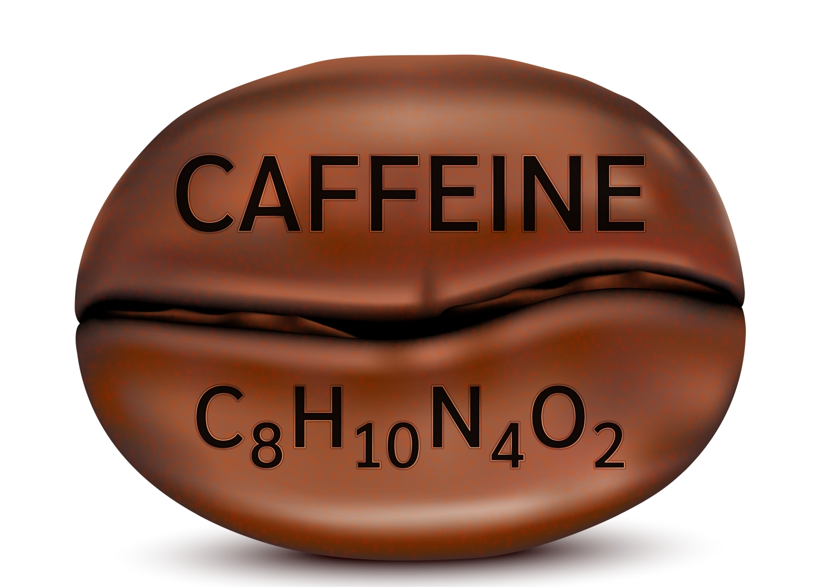
Caffeine
Caffeine is a stimulant drug.
Mildly addictive - one of the world’s most widely used drugs
Found in:
  Coffee
  Tea
  Cola-based drinks
  Energy drinks
  Chocolate
  Diet pills

Slide 20
Caffeine – benefits
Increases alertness.
Alters perception of effort of fatigue - increasing endorphins.
Increases fatty acid oxidation - may help preserve glycogen stores during endurance sports.

Slide 21

Caffeine – side effects and risks
Dizziness and light-headedness
Anxiety
Shaking
Nausea
Diuretic – may cause dehydration
Rapid heartbeat
Very high levels may cause arrhythmia.

Slide 22
Caffeine – side effects and risks
Interferes with iron absorption (avoid at mealtimes for risk of iron deficiency).
Stimulates the central nervous system (increasing heart rate and blood pressure).
Stomach irritation (causing headaches and insomnia).
NOTE:
High caffeine levels are banned in some sports competitions.
Athletes need to be careful about how much and when they use or consume caffeine.

Slide 23
Caffeine
Limit intake - no more than 400mg per day:
  4-6 instant coffees
  6-8 cups of tea
  3 shots of espresso
It should be avoided after 1pm as it takes about 10 hours for caffeine to leave the system, which means the quality of sleep may be affected.

Slide 24
Cannabidiol (CBD)
CBD is one of the hundreds of chemical compounds found in cannabis.
  Cannabis is an illegal drug in the UK
  It is a banned substance for competitors in any sport where drug testing is used.
CBD does not have the same effects, so it is not associated with ‘getting high’.

Slide 25
Cannabidiol (CBD)
Lots of research and public interest over the last decade for the potential use of CBD for treating many medical conditions, particularly chronic pain.
Anecdotal reports:
Anxiety.
Insomnia.
Chronic pain due to inflammation.
Treating addiction and reducing cravings for other substances.

Slide 26
Cannabidiol (CBD) – WADA
CBD is not currently listed on the WADA Prohibited List.
However, UKAD position:
The use of any CBD product is at the athlete’s own risk.
CBD products should be considered in the same way as all other dietary supplements.
If an athlete did use a CBD product that led to an adverse analytical finding for tetrahydrocannabinols (THC) or any other prohibited substance, their use of this product would not mitigate their fault.
Source: UKAD website (2024).

Slide 27
Creatine
Creatine has been shown to:
Increase intramuscular creatine concentrations (up to a saturation point).
Improve high-intensity exercise performance.
Enhance post-exercise recovery.
Improve tolerance of heavy training volumes.
Aid injury prevention.
Improve thermoregulation – heat tolerance during exercise.
Provide protection from concussion or spinal cord injury by inhibiting ischaemic brain injury.
Enhanced rehabilitation from injury by preventing atrophy.
Improved metabolism of glucose and cognitive function.

Slide 28
Creatine
Well-researched.
A widespread consensus in the scientific community that creatine supplementation can serve as an effective nutritional ergogenic aid that may benefit athletes involved in numerous sports as well as individuals involved in exercise training (Kreider et al, 2017).
There seems to be little reason for people of any age, with or without long-term conditions, not to take creatine.
The greatest challenge is the purity of creatine products available.
Look for products with the ‘creapure’ guarantee.
Athletes need to be particularly careful to choose supplements that have been through third-party testing.

Slide 29
Androgenic anabolic steroids (AAS)
Hormone-mimicking drugs.
Used by some to support hypertrophy or recovery from intense training and enable quicker adaptation to the training stimulus.
Issues:
Multiple health risks are associated with use.
The amounts of AAS used are very high.
Numerous side effects.

Slide 30
Androgenic anabolic steroids (AAS)
AAS cycles, stacks and post-cycle therapy
When used as ergogenic aids, anabolic steroids are taken in high doses.
Bodybuilders seek the hypertrophic effects, it is common practice to ‘stack’ different types of steroids, along with other anabolic agents and anti-oestrogenic drugs, to maximise muscle growth from training.
Due to health impacts of side-effects, it is not possible to use steroids continually.
The common practice is to use ‘cycles’ of different anabolic agents to peak for competitions. It is also not safe to suddenly stop steroid use, withdrawal effects including fatigue, muscle atrophy, and depression are common, so post-cycle therapy is needed to ease the transition off a cycle of steroids safely.

Slide 31
Androgenic anabolic steroids (AAS)
Physical effects (males) | Physical effects (females)
Hair loss | Facial hair growth and body hair
Reduced sperm count | Problems with periods
Breast development | Loss of breasts
Infertility | A deepened voice
Erectile dysfunction | An increased sex drive
Shrunken testicles | Swelling of the clitoris
Stomach pain | Severe acne
Increased risk of prostate cancer
Severe acne
Source: NHS (2024)

Slide 32
Androgenic anabolic steroids (AAS)
Health risks:
heart attack or stroke
liver and/or kidney problems or failure
high blood pressure (hypertension)
blood clots
fluid retention
high cholesterol.
Psychological or emotional risks:
aggressive behaviour
mood swings
paranoia
manic behaviour
hallucinations and delusions
addictive – withdrawal symptoms.

Slide 33
Androgenic anabolic steroids (AAS)
UKAD has a major campaign warning athletes about the side effects and health risks of steroid misuse.
The UKAD website (https://www.ukad.org.uk/anabolic-steroids) also has informative videos and provides links to the Global Drug Reference Online (DRO) medications directory for athletes to check whether any medications they are considering taking may contain banned anabolic steroids and the informed sport website for a list of supplements that can be trusted not to contain prohibited substances as many supplements on the market are untested and could lead an athlete to unintentionally consume a prohibited substance.
The WADA website (https://www.wada-ama.org/en/prohibited-list?page=0&q=steroid&all=1) has an extensive, but not exhaustive list of over 60 specific AAS that are prohibited, but, as more variants are being produced all the time, includes the caveat that “other substances with a similar chemical structure or similar biological effect(s).” are also prohibited.

Slide 34
Androgenic anabolic steroids (AAS)
Athletes looking to maximise testosterone levels naturally are advised to:
perform regular heavy strength training.
prioritise seven to eight hours of quality sleep each night.
consume a balanced diet (including animal products like fish, chicken, and red meat).
not smoke or use tobacco products.

Slide 35
Next lesson: Small group activity
Critically evaluate the benefits and limitations of the supplements or ergogenic aids allocated by your tutor.
What is the purpose of use?
What evidence is there to support this claim and the products effectiveness?
What are the risks/ limitations/ side effects associated with this product?
Share your findings with rest of group.

Slide 36
Products list – tutor to allocate
Energy bars or gels
Ephedrine/ma huang/’fat burners’
Glutamine
HMB (Beta hydroxy/beta methyl butyrate)
Hydrogel energy drinks
Ketones
Leucine
Omega 3 fatty acids
Polyphenols
Probiotics
Protein supplements
Prohormones /testosterone boosters
Taurine
Zinc monomethionine aspartate (ZMA)
Arginine
Antioxidant supplements
Branched chain amino acid supplements
Beta-alanine
Beetroot juice (nitrate)
Bicarbonate
Caffeine and ketogenic drinks
Cannabidiol (CBD)
Cherry Juice
Conjugated linoleic acid
Collagen
Colostrum
Creatine

Slide 37
Pair task
What are two main take away points from this lesson?
How will you apply these to your practice?

Slide 38
Lesson summary
What is meant by the terms ‘sports supplements’ and ‘ergogenic substances’?
The evidence, uses, limitations and risks related to the use of dietary supplements & ergogenic substances as aids to performance.
Scope of practice and conflicts of interest surrounding sports supplements and ergogenic substances to support performance.
Dietary alternatives to the use of sports supplements and ergogenic substances to support performance.

Slide 39
Recommended reading
Bean, A. (2023). The Complete Guide to Sports Nutrition. 9th edition. London, UK: Bloomsbury Publishing

Slide 40
Level 4 Applied Nutrition for Health, Wellness, Weight Management, and Sports Performance (610/2287/1)
The safe use of supplements and ergogenic aids for performance

