Slide 1
Nutrition for physical activity and exercise
Educating clients about healthy food choices

Slide 2
Session content
Communication methods
Evidence-based information within scope of practice
Role of dieticians and nutritionists
Nutrition requirements for different goals

Slide 3
Learning task
Pair task:
Discuss – what are some methods of communicating the benefits of healthy eating to clients?

Slide 4
Communication methods
Poster
Handout
Information leaflet
Social media page/ post
Podcast
Social media video
Blog
It is important to consider which is the most appropriate method for your target audience

Slide 5
Communicating the benefits of healthy food choices
Information needs to be delivered in a way that builds client motivation and supports a ‘can do’ attitude
The language used should be clear, concise and accessible so it is easy to understand and not too technical
Be engaging and educational – use appropriate images to support written or audio
Contain accurate evidence-based information within your scope of practice – include links to credible sources of information to gather additional information
Some workplaces may have specific guidelines for you to follow when communicating nutrition information.

Slide 6
Scope of practice
Any advice and information provided should always align with evidence-based guidance that is available in the public domain
The ‘Eatwell Guide’ is the current model outlining national healthy eating guidelines that are supported by UK Government
This guidance relates to the requirements for healthy adults.

Slide 7
Learning task
Trio task:
Make a list of information that can be provided to clients within scope of practice.
Make a list of clients whose needs and wants will mean they need to be signposted for more specific dietary advice

Slide 8
Within scope of practice
Healthy eating guidelines to individuals at risk of developing health conditions based on their current eating habits
Guidance on energy balance, energy intake, energy expenditure
Health risks associated with weight loss and fat loss diets
Healthy food swaps
Need to eat to fuel and recover from exercise sessions
Importance of maintaining adequate hydration
Risk associated with supplements and performance aids
Healthier cooking methods
Healthy food preparation e.g. less salt, sugar, fat

Slide 9
Within scope of practice
Importance and functions of each macronutrient
Food sources of each macronutrient
How to understand food labels
Portion sizes
In practice:
Conduct nutritional consultations
Analyse a clients food diary
Use behaviour change techniques e.g. SMART goals
Provide seminars, workshops and Q&A sessions on healthy eating

Slide 10
Needs and wants exceeding scope of practice
Individuals with health conditions e.g. diabetes
Individuals who want specific diets or meal plans prepared for them
Individuals with specific performance goals
Individuals who are pregnant or breastfeeding
Individuals with eating disorders
Individuals wanting advice on supplements for health or performance enhancement

Slide 11
Learning task
Trio task:
Find some social media posts about nutrition from fitness professionals and personal trainers.
Do you think the information is:
Accurate?
Evidence-based?
Within scope of practice?
Non-biased?
Useful?
Easy to understand?

Slide 12
Communication – summary
Provide relevant healthy food choices information that would benefit them.
Use current research, creating handouts and newsletters for clients and information boards in the facility.
Lead information sessions or seminars on the benefits of healthy eating
Determine what information is relevant to the individual, using details of communications and information collected.
Provide credible information to the individual that is relevant to them, their goals, and aspirations.
Signpost individuals to relevant products and services that may increase their capability or opportunity to make healthy eating choices
Explain how to include healthy food choices as part of a client’s lifestyle to complement exercise sessions and physical activity

Slide 13
Question
What is the difference between a dietician and a nutritionist?

Slide 14
Dieticians
Dieticians are the only nutrition professionals to be regulated by laws. The title of Registered Dietitian (RD) is protected by law, and practitioners must be registered with the Health & Care Professional Council (HCPC)
The professional association for registered dieticians in the UK is the British Dietetic Association (BDA)
Dieticians are the only health professionals qualified to assess, diagnose and treat diet and nutrition problems at an individual and wider public health level.

Slide 15
Nutritionist
The title of Registered Nutritionist is granted to registrants with the UK Voluntary Register of Nutritionists (UKVRN)
The professional association for registered nutritionists is the Association for Nutrition (AfN)
Nutritionists create and apply scientific knowledge to promote an understanding of the effects of diet on health and wellbeing of humans to provide information about food, diet and healthy eating.
The term nutritionist is not protected by law, so it is important to check the qualifications and training of anyone claiming to be a nutritionist

Slide 16
Nutrition requirements for different goals
Healthier eating – direct client to recommendations of the Eatwell guide. Encourage maintaining a regular eating pattern.
Weight loss – create a sustainable calorie deficit e.g. 200-500kcal per day through decreased calorie intake and increased physical activity. Ensure adequate intake of all micro- and macro- nutrients. No adjustment to macronutrient contribution.
Fat loss – create a sustainable calorie deficit. Ensure adequate intake of essential nutrients is maintained as overall energy intake is reduced. Ensure adequate protein intake to prevent muscle atrophy. Increase resistance training and high intensity CV.

Slide 17
Nutrition requirements for different goals
Improving sports performance – outside scope of practice, refer to nutritionist or dietician
Hypertrophy– increase total kcal intake by 20%, ensure adequate protein take. More detailed analysis - outside scope of practice, refer to nutritionist or dietician

Slide 18
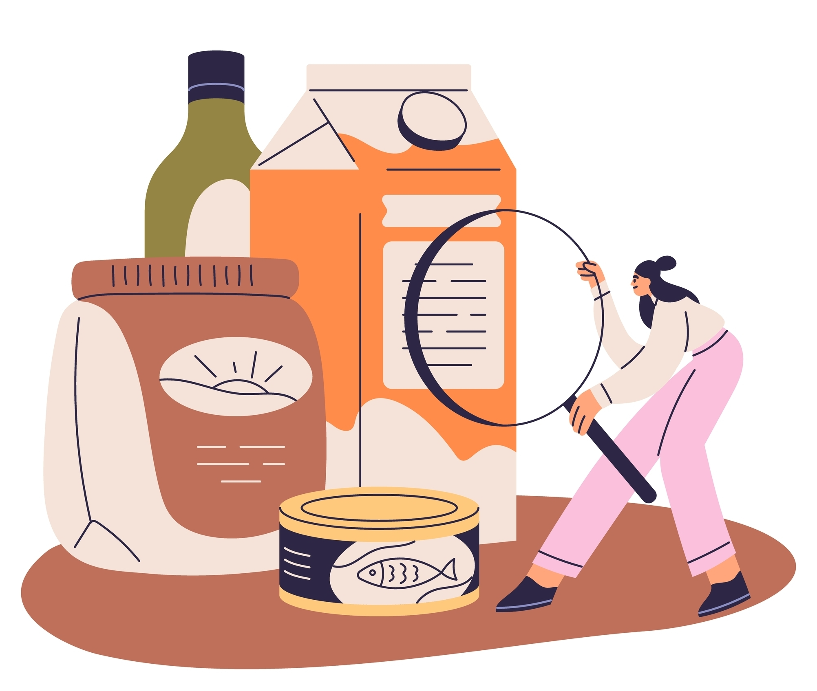
Question
How can understanding food labels support clients making healthy eating choices?

Slide 19
Food labelling
Food labels can help consumers make informed and healthy food choices, for example:
Nutritional information - displaying clear and accurate information about calories, serving size and the amount of key nutrients such as fat, sugar, salt
Ingredients list – assists consumers in making healthy choices by identifying any less healthy ingredients e.g. hydrogenated fats
Traffic lights systems – allows consumers to quickly identify the total calorie, fat, sugar and salt contents of foods
Health claims – foods which are labelled with specific health claims must meet specific nutritional criteria e.g. high fibre
Serving size information – helps consumers understand portion sizes

Slide 20
Learning outcome
Are you able to:
Identify different methods of communicating healthy food choices to clients
Explain evidence-based information within scope of practice
Describe the role of dieticians and nutritionists
Describe the nutrition requirements for different goals including healthy eating, weight loss and fat loss

Slide 21
Nutrition for physical activity and exercise
Energy requirements

Slide 22
Session content
Calculating individual energy requirements
Energy balance
The importance of maintaining a balanced diet

Slide 23
Energy requirements
The Eatwell Guide suggests that the daily calories requirement is:
2000 Kcal for women
2500 Kcal for men
Actual energy requirements can vary depending on:
Body mass
Body composition
Age
Gender
Physical activity levels

Slide 24
Key terms
Terminology relating to the main components of energy expenditure.
Total daily energy expenditure (TDEE).
Resting energy expenditure (REE)
Basal metabolic rate (BMR) or resting metabolic rate (RMR).
Thermic effect of food (TEF).
Non-resting energy expenditure (NREE).
Non-exercise activity thermogenesis (NEAT).
Exercise activity thermogenesis (EA) – physical activity, exercise and sports.
Metabolic Equivalent of Task (MET)

Slide 25
Questions
What are some factors that affect energy expenditure?

Slide 26
Factors that affect energy expenditure
Daily activity
Physical activity
Amount and type of exercise
Amount and type of food eaten
Age, gender, weight
Individual biology
Long-term conditions
Medications taken

Slide 27
Physical activity and exercise
Physical activity can be subdivided into:
Non-exercise thermogenesis (NEAT) – all lifestyle movement that isn’t planned or structured
Exercise activity thermogenesis – ‘structured and planned physical activity performed to improve fitness’

Slide 28
Schofield calculation
Males | Females
10-17 years BMR – 17.7 x W + 657 SEE = 105 | 10-17 years BMR = 13.4 x W + 392 SEE = 112
18 – 29 years BMR = 15.1 x W + 692 SEE = 156 | 18– 29 years BME = 14.8 x W + 487 SEE = 120
30– 59 years BMR = 11.5 x W + 873 SEE = 167 | 30 – 59 years BMR = 8.3 x W + 846 SEE = 112
W – weight in kg SEE = standard error in estimation

Slide 29
Physical activity guidance
Inactive – desk-based job, little or no exercise
Moderately active – more physically demanding job and/or moderate exercise or sport 3-5 times per week
Very active – hard exercise or sport 6-7 times per week, or very physically demanding job and performs some structured exercise

Slide 30
Harris-Benedict equation
Males | Females
Inactive: BMR x 1.4 | Inactive: BMR x 1.5
Moderately active BMR x 1.7 | Moderately active: BMR x 1.6
Very active: BMR x 1.9 | Very active: BMR x 1.9

Slide 31
Learning task
Calculate your own estimated energy requirements

Slide 32
Calorie expenditure
Estimated Kcal per minute for different activities
Activity | Kcal/ minute
Weightlifting (low/ moderate intensity) | 3.25
Hatha yoga | 4.25
Brisk walking | 6.0
Indoor cycling (low/ moderate intensity) | 6.0
Powerlifting | 6.5
High intensity aerobics | 7.5
Light jogging | 8.5
Running | 10.5
Indoor cycling (high intensity) | 11.00
Manore and Thompson (2002)

Slide 33
Recap
What can you recall about:
Nutrition requirements and hydration needs of clients engaged in exercise and physical activity?
The effects of different types of training on the production of fuel for exercise?

Slide 34
Nutrition for physical activity and exercise
Individual requirements will depend on the type, intensity and duration of exercise.
General guidelines:
Pre-exercise – consume a balanced meal carbohydrate, protein and small amount of fat 2-3 hours before exercise
During exercise – for prolonged exercise consider consuming easily digestible carbohydrates to maintain blood glucose levels
Post-exercise – consume a combination of carbohydrates and protein within 2 hours of exercise
Clients required detailed sports fueling advice should be referred to a nutritionist

Slide 35
Fluid requirements for exercise
Pre-exercise or event
Aim to drink 5-10ml/kg between 2 and 4 hours before session of event
~300ml-600ml for a 60kg person
During event:
Aim to drink 400ml-800ml per hour, divided into equal amounts at around 20-minute intervals
Unlikely to be able to absorb more than 1litre per hour – sweat rates may outstrip fluid absorption leading to dehydration

Slide 36
Fluid requirements for exercise
Post exercise or event:
Aim to replace 1.5 x fluid lost in session within 2-3 hours
1 litre of fluid is equivalent to 1kg body weight
Aim to drink 750ml for every 0.5kg of body weight lost during exercise
If fluid loss is not assessed continue to drink to 400-800ml per hour

Slide 37
Fuel and exercise
Anaerobic exercise – predominantly carbohydrate
Aerobic exercise - mixtures of fat and carbohydrate depending on intensity
Fat used in presence of oxygen and alongside carbohydrates
General rule - higher intensity, lower the fat consumption, even when aerobic
Implications for fat loss programmes
For most people,
the ratio of fat to carbohydrate used is about 50:50.
ratio improves with training and improved fitness

Slide 38
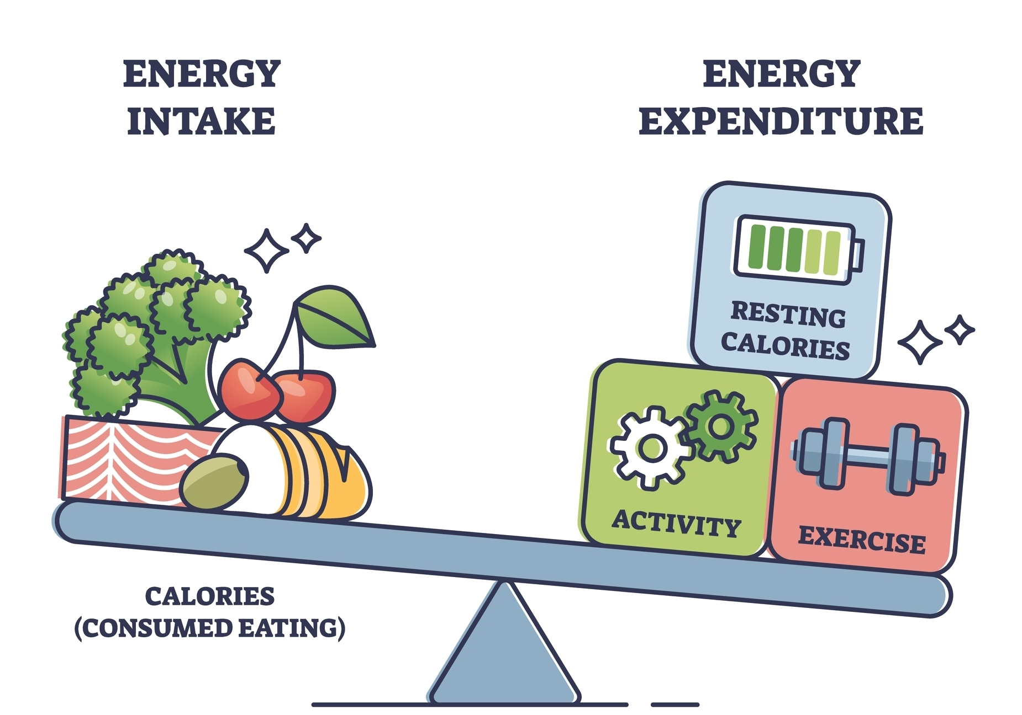
Question
Can you recall the energy balance equation?

Slide 39
Energy balance equation
Calories (energy) taken in versus calories burned as energy (out)
Neutral energy balance - calories in are equal to calories expended.
Positive energy balance - more calories are taken in than expended - weight is gained.
Negative energy balance (energy deficit) – consuming fewer calories than the number of calories expended – weight is lost.

Slide 40
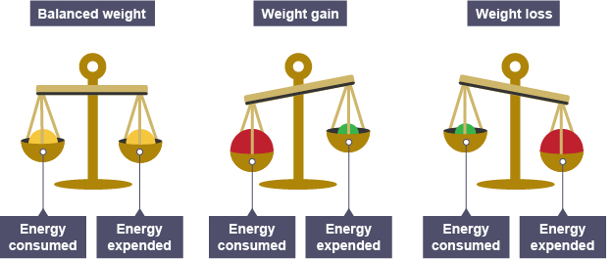
Energy balance equation

Slide 41
Energy balance
The body will remain the same weight when calorific intake equals calorific expenditure
If intake exceeds output, the excess is stored as fat weight
If output exceeds input the result is weight loss
Energy in > energy out = weight gain
Energy in < energy out = weight loss
Energy in = energy out = weight maintenance

Slide 42
Energy balance
To lose fat weight, a deficit must be achieved.
The recommended strategy is a deficit of 3,500 kcals to lose 1 lb of stored fat.
Generally, best achieved through increased physical activity and a reduction in daily consumption of calories.

Slide 43
Guidance for weight loss and weight gain
Weight loss
calorie intake should be reduced by 15%
(BMR x PAL) x 0.85
A calorie deficit of ~500Kcal per day should achieve a weight loss of ~0.5kg per week
Weight gain
Calorie intake should be increased by 20%
(BMR x PAL) x 1.2
Combined with progressive resistance programme an increase of 0.25 - 0.5kg lean muscle is realistic. Surplus weight gain is likely to be as fat.

Slide 44
Learning task
Calculate your own estimated calorie requirement if you goal was:
Weight loss (BMR x PAL) x 0.85
Weight gain (BMR x PAL) x 1.2

Slide 45
Importance of maintaining a balanced diet
When increasing or decreasing total kcal intake for a body composition goal, it is important to maintain a balanced diet to:
Ensure adequate nutrient intake
Maintain energy levels
Prevent disease
Ensure digestive health
To promote overall health and wellbeing

Slide 46
Learning outcomes
Are you able to:
Calculate individual energy requirements
Explain energy balance and how to adjust total calorie intake to achieve weight loss or weight gain
Explain the importance of maintaining a balanced diet

Slide 47
Nutrition for physical activity and exercise
Collecting and interpreting client information

Slide 48
Session content
Methods of collecting nutritional information
How to measure body composition

Slide 49
Question
What are some methods you could use to collect nutritional information from clients?

Slide 50
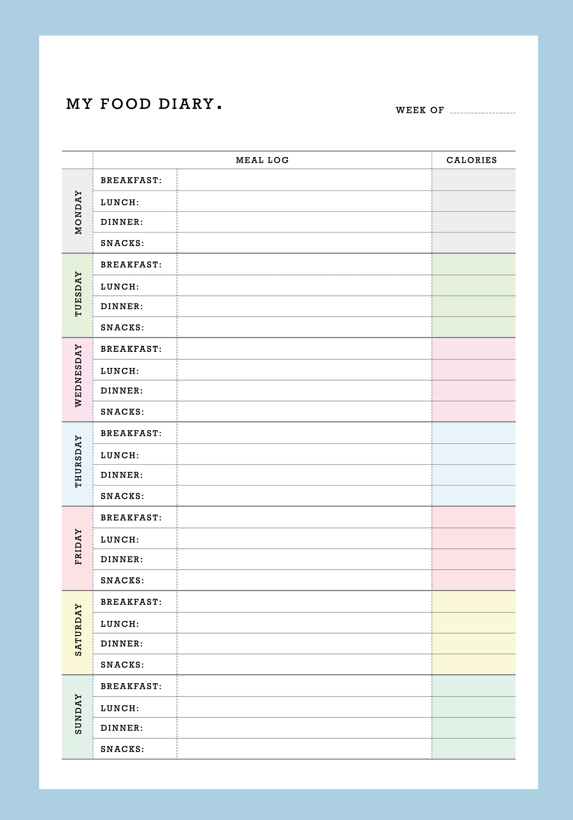
Methods of collecting nutritional information
Food diary
24 hour food recall
Food frequency questionnaire

Slide 51
Learning task
Pair task:
Discuss the advantages and disadvantages of each method:
Food diary
24 hour recall
Food frequency questionnaire

Slide 52
Food diary
Completed by the client
Usually for a minimum of 3 days, aiming to include 1 weekend day
7 days recommended to give a realistic indication of clients’ ‘normal’ eating habits

Slide 53
Food diary – information to be included
Timing of meals and snacks and any condiments used
Type of food and drink consumed
Portion sizes
Reason for eating (if desired)

Slide 54
Food diary
Advantages:
Increase clients’ awareness of food intake
Help identify patterns in unhelpful eating behaviours
Give a good picture of clients eating habits
Disadvantages:
Subjectivity – relies on clients honesty and accuracy
Requires client to have a good understanding of portion sizes
Time consuming
Client may feel self-conscious – both reporting food and tracking in social situations

Slide 55
Food diary
Information from food diary:
Food likes and dislikes
Eating habits e.g. snacking/ rituals/eating times and mood
Social life and eating habits e/g restaurants, pub food, takeaways
Indication of total calorie intake
Quantity and quality of food choices
Portion size for different food groups
Fluid intake
Alcohol intake
Variation in food and drink intake at weekends or during holidays

Slide 56
24-hour recall
Requires client to recall all the food and drink they have consumed over the previous 24-hour period

Slide 57
24-hour recall
Advantages:
Quick and easy
Recent memory
Minimal burden on clients
Disadvantages:
May lack accuracy due to individuals' inability to remember
Only valid for one 24-hour period which may not reflect true eating habits
Difficult to quantify portion size, especially if client not used to use of portion sizes
Clients may alter report to providing responses they believe are more acceptable and desirable

Slide 58
Learning task
Recall all the food and drink you consumed yesterday.
Breakfast
Mid-morning
Lunch
Mid afternoon
Dinner
Evening
Other snacks
Other drinks

Slide 59
Food frequency questionnaire
A food frequency questionnaire (FFQ) is a dietary assessment tool used to gather information about clients long-term eating habits which ask clients to report the frequency a portion size of various food and drinks

Slide 60
Food frequency questionnaire
Advantages:
Can capture long-term eating habits
Easy to administer
Easy for clients to complete
Disadvantages:
Memory and recall bias
Portion sizes are based on estimates and could potentially vary significantly
Lacks detail on eating times and food preparation methods
Not able to estimate daily calorie intake

Slide 61
How to analyse a client's nutritional intake
Compare the client's food diary with healthy eating guidelines
Quantity:
  How many portions of each food group is the client consuming?
  Should they increase, decrease or stay the same
Quality
  Are the clients food choices good quality?
  Identify good quality, nutrient dense sources from each food group.
  Identify less-good quality sources from each food group and recommend an alternative e.g. swap whole milk for skimmed, swap white bread for wholegrain

Slide 62
Learning task
Analyse your own 24-hour food recall
Identify the number of portions, good quality food sources and recommend swaps for less-good sources of each food group:
Starches
Fruit and veg
Proteins
Dairy and dairy alternatives
Fats
(Food high in fat, salt and sugar)

Slide 63
Question
What are some methods you could use to measure clients body composition?
What are some factors that may affect the accuracy of measurements?

Slide 64
Methods to assess body composition
Bioelectrical impedance analysis (BIA)
Skinfold calipers and analysis
Underwater weighing
DEXA scan
BMI
Waist circumference

Slide 65
Accuracy of different assessments
Multiple variables can impact the reliability of information gathered, including:
Time of day measurement is taken
Competence of the person taking measurement (human error)
Accuracy of calculations
Quality of the equipment
Calibration of equipment

Slide 66
Bioelectrical impedance analysis
BIA is commonly used in fitness settings for assessing body composition
BIA measures the impedance (resistance) of electrical flow through body tissues and uses this to estimate the distribution of different components such as fat and lean tissue
BIA is convenient and non-evasive method of measuring body composition and tracking changes
Hydration levels, food intake a skin temperature can affect the accuracy of the measurements

Slide 67
Skinfold calipers
Skinfold calipers are used to measure skinfold thickness to estimate subcutaneous fat
Skinfold calipers are a cost-effective, ,mildly-invasive and portable method of estimating body fat
There is a high level of skill required to take accurate measurements
The accuracy of this method reduce with higher levels of body fat, therefore it is more suitable for athletes than the general population

Slide 68
Underwater weighing
Underwater weighing is considered one of the most accurate methods for assessing body composition
It provides separate measures of fat and fat free mass
This equipment is typically found at sports and medical research facilities
Not widely use as equipment is large and expensive, and the procedure itself is stressful

Slide 69
DEXA scan
Only available in healthcare settings
Have replaced underwater weighing in scientific research
High accuracy
Due to expense, not commonly used in general population fitness

Slide 70
Body fat – normative data
Gender | Age (year)
 | Essential | Minimal | Athletic | <34 years | 35-55 years | >56 years
Male | 3-5 | 5 | 5-13 | 8-22 | 10-25 | 10-25
Female | 8-12 | 8-12 | 12-22 | 20-35 | 23-38 | 25-38
(ACSM 2014)

Slide 71
BMI
Used to identify if someone is within a suitable weight range
Originally intended to assess population health, not individuals
Does not account for body composition

Slide 72
BMI- normative data
Classification | BMI
Overweight | 25–29.9 kg/m²
Obesity l | 30–34.9 kg/m²
Obesity ll | 35–39.9 kg/m²
Obesity lll | Greater than or equal to 40 kg/m²

Slide 73
Waist circumference
The National Institute for Health and Care Excellence (NICE) guidance is to keep waist measurement to less that half our height measurement
Guidance from ACSM (2018) recommended:
  Men < 102cm
  Women <88cm

Slide 74
Communicating results with clients
It is important to employ sensitivity and diplomacy when communicating about eating behaviours and body composition to client. Make sure you:
support all analysis with data from recognised charts, where available
ensure privacy with just the client in earshot of any assessment results
prepare an action plan for positive changes where necessary
allow sufficient time for understanding and questioning by the client
provide no personal judgement – focus only on facts.

Slide 75
Learning outcomes
Are you able to:
Identify different methods of collecting nutritional information
Evaluate the strengths and limitations of different methods
Identify different methods to measure body composition
Evaluate the strengths and limitations of different body composition measurements

Slide 76
Nutrition for physical activity and exercise
Behaviour change

Slide 77
Session content
Transtheoretical model of behaviour change
Strategies to support behaviour change

Slide 78
Question
What is behaviour change?

Slide 79
Behaviour change
Behaviour change is the process and strategies individuals use to intentionally change their habits.
Key components include:
Awareness – recognising the need for change
Motivation – finding internal and external motivation to change
Action - taking steps to introduce new behaviours or modify existing ones
Consistency – maintaining the change over time

Slide 80
Transtheoretical model (TTM)
Prochaska and DiClemente (1983)
Originally developed to assist in smoking cessation programmes
The stages of change model comprise three elements:
Stages of change
Process of change
Self-efficacy

Slide 81
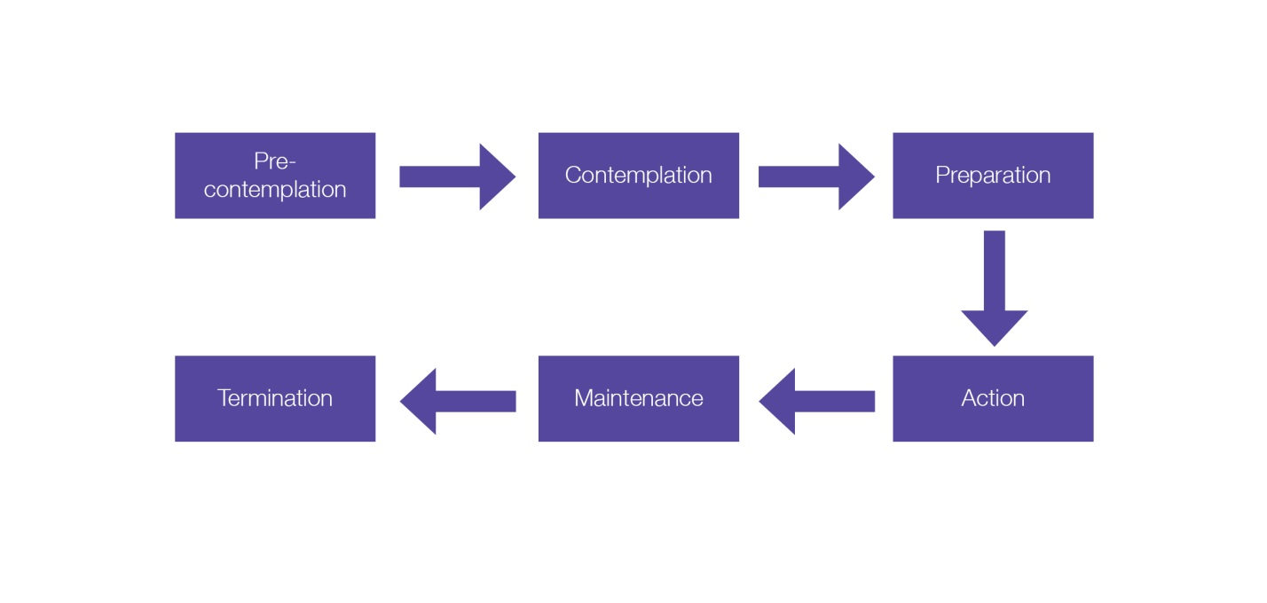
Transtheoretical model (TTM)
Pre-contemplation
Contemplation
Preparation
Action
Maintenance
Termination
Relapse

Slide 82
Stages of change
Pre-contemplation: Not considering becoming active within the next six months.
Contemplation: Considering becoming active within the next six months.
Preparation: Started to prepare (eg, gym membership, trainers), intend to become more active within the next month.
Action: Engaging in physical activity, but only started within the last six months.
Maintenance: engaging in activity on a regular basis for at least six months.
Termination: Old behaviour (inactivity) terminated. New behaviour permanent.
Lapse and relapse – a short or longer-term return to old behaviour, can happen anytime through cycle.

Slide 83
Learning task
Pair task:
Discuss a behaviour you want to change.
Identify the stage you are currently in.
Do you believe you will successfully make the change?
What would improve the chances of you making the change?

Slide 84
Processes of change
The processes of change are ways to support individuals, depending on where they are in the cycle or process of making change
During early stages, helpful support is that which helps the person reframe their thinking and remove barriers and obstacles that prevent them moving forward
Once the decision to make a change is made and the person is taking some action, then strategies that support their action and behaviour change are helpful

Slide 85
Learning task
Trio task:
Research different behavioural change strategies that could be useful in real-life situations.
Consider which strategies support clients in pre-contemplation, contemplation, action and maintenance

Slide 86
Behaviour change strategies
Raising awareness – education
Decisional balance sheet – pros and cons
Overcoming barriers
Goal setting
Positive reinforcement – rewards and incentives
Social support

Slide 87
Psychological readiness scales
Scales can be used to identify:
Goals – what they want to achieve
Self-efficacy – how confident they feel in taking steps to achieve goal
Importance – the value the individual places on goal
Motivation – their readiness to take action
What is working/not working – monitoring and reviewing progress
Individuals are asked to rate each question on a scale of 1-10
Responses can help identify the most appropriate behavioural change strategy to support each individual

Slide 88
Decision balance sheets
Benefits of making a change
Benefits of staying the same
Disadvantages of making a change
Disadvantages of staying the same
Decisional balance sheets are a visual tool that can be used to help individuals explore their reasons for making changes and not making changes
What are the benefits of making a change?
What are the benefits of staying the same?
What are the disadvantages of making this change?
What are the disadvantages of making this change?

Slide 89
Potential barriers
Time – Work demands, family commitments, hobbies, the available time they have for committing to making changes to improve their lifestyle e.g. meal planning
Money – They may perceive leading a healthier lifestyle as being more expensive, e.g. healthier foods are more expensive or taking part in exercise requires a gym-membership.
Family and children – As well as presenting a time constraint there are other barriers, children may request a parent buy ‘less healthy’ foods; a parent may pick at the children’s leftovers, or even skip dinner themselves because they are too busy.
Motivation – Why is their current lifestyle unhealthy? Why have previous attempts at changing their diet failed? How could you help them to change this?
Lack of education – Do they know enough about a healthier lifestyle or the benefits of a healthy diet? Do they know what foods they should or should not be eating for a healthy and balanced diet?

Slide 90
Overcoming barriers
When working with barriers it is important to:
Show empathy
Be curious
Use reflective listening and empathy
Encourage freedom of choice to empower the individual
Build self-responsibility and autonomy
Avoid ‘expert’ mode
Use MI skills to guide the conversation towards building motivation and the reasons for doing something

Slide 91
Goal setting
Goals set may be:
Process goals – focus on the processes to be followed to reach the desired end result.
- are more effecting at helping with behaviour change because they focus on things which the person can be accountable for, and are measure objectively
Outcome goals – focus on the end result only.
- can be affected by various factors that cannot be controlled

Slide 92
Short-medium and long-term goals
Short-term goals | One day up to one month
Medium-term goals | One month up to six months
Long-term goals | Six months up to a year or over several years

Slide 93
SMART
Specific- use an active verb
Measurable – state frequency or volume
Achievable/agreed – check within client’s potential
Realistic and relevant - matches client aims and ability
Time-bound – set a deadline for achievement (can be staged – short-, medium-, longer-term)

Slide 94
Learning task
Based on your own goals and analysis of your own 24-hour food diary set some long, medium and short-term SMART goals for yourself.

Slide 95
Reviewing and revising goals
Review sessions should be planned in advance:
Show support and encouragement.
Include re-testing or re-taking of measurements to measure progress.
Identify progress.
Give an opportunity to celebrate progress.
Identify any plateaus or regression occurring.
Boost a client’s motivation when they see their performances improve.
Identify goal achievement or if goals need to be reviewed and realigned.

Slide 96
Rewards and incentives
Rewards and incentives can be a source of external motivation which can support the change process.
Examples include:
Progress reviews to affirm how they have improved
External rewards e.g. prizes or treats for achieving goals
Internal rewards e.g. ‘feel good factor’ for achieving goals

Slide 97
Social support systems
Encouraging social support can provide an extrinsic source of motivation to support the change process.
Example of social support include:
Family members
Friends
Buddy systems

Slide 98
Stages of change
Stages of change | Characteristics | Strategies
Pre-contemplation | The client has little awareness of inactivity and the consequences of inactivity. | Establish rapport and build trust. Explore the pros and cons of maintaining current lifestyle. Explore the meaning of the actions the client undertakes.
Contemplation | The client balances the potential benefits against the potential costs (time, money, effects on others). | Start to change the extrinsic motivations to intrinsic ones. Elicit self-motivational statements of intent and commitment from the client. Provoke ideas regarding the client’s perceived self-efficacy and expectations regarding treatment.

Slide 99
Stages of change
Preparation | The client prepares to act and then increases physical activity. | Offer a menu of options for change or treatment. Help the client enlist social support. Prompt from the client what has worked in the past either for them or others they know.
Action | The client has recently become active on a regular basis. | Support a realistic view of change through small steps. Assist the clients in finding new reinforcers of positive change. Acknowledge difficulties for the client in early stages of change.

Slide 100
Stages of change
Maintenance | The client has been regularly physically active for at least six months. | Affirm the client’s resolve and self-efficacy. Maintain supportive contact. Review long-term goals with the client.
Termination | The client no longer engages in the old behaviour. | Behaviour has changed.

Slide 101
Self-efficacy
Self-efficacy refers to an individual’s belief in their own capability to successfully perform a particular task or achieve a specific goal
Another component of self-efficacy is whether they see the possible actions as making a difference to their current circumstances
Self-efficacy will impact the individual’s willingness to consider and contemplate making a change and their perseverance to follow through and take action to make the change happen

Slide 102
Self-efficacy
Self efficacy can be promoted through:
Accurately reflecting on their past successes
Reframe any past failures and see these as lessons and opportunities for learning
Use positive self-talk and affirmations to develop a growth mindset
Visualise and focus on success
Break tasks and actions into manageable steps and take one step at a time

Slide 103
Learning outcomes
Are you able to:
Explain different strategies to support behavioural change and meet healthy eating guidelines

Slide 104
Nutrition for physical activity and exercise
Educating clients about healthy food choices
-

