Slide 1
Nutrition for physical activity and exercise.
Nutritional terminology and healthy eating guidelines

Slide 2
Session content
Key nutritional terminology
Current recommendation for health eating to meet individual needs
The Eatwell guide
Using the Eatwell guide to support different goals

Slide 3
Learning task
Pair task:
Research what each of the following key nutritional terms mean. Provide a definition for each term:
Diet
Healthy eating
Nutrition
Healthy, balanced diet
UK dietary reference value (DRV)
Recommended daily allowance (RDA)
Recommended daily intake (RDI)
Glycaemic index (GI)

Slide 4
Nutritional terminology
Diet:
The kinds of food a person habitually eats.
It can also reflect a special course of food which a person restricts themselves, either to lose weight, gain weight or for medical reasons
Healthy eating:
Eating a variety of foods that give you the nutrients to maintain your health, feel good and have energy

Slide 5
Nutritional terminology
Nutrition:
The process of obtaining the food necessary for health and growth
Balanced diet:
A diet consisting of a variety of different types of food and provide

Slide 6
Nutritional terminology
UK dietary reference value (DRV):
Values intended as guidelines and not recommended for healthy eating.
Intention of the DRVs is to promote the concept of health and not just the avoidance of disease
Guidelines are provided for:
  Energy
  Fats (saturated, mono and polyunsaturated)
  Protein
  Carbohydrate (sugars, starches, and non-starch polysaccharides)
  Vitamins and minerals

Slide 7
Nutritional terminology
Recommended daily allowance (RDA):
The average daily dietary intake level that is sufficient to meet the nutrient requirements of nearly all (approximately 98%) healthy adults
Recommended daily intake (RDI):
The amount sufficient, or more than sufficient, for the nutritional needs of practically all health people in the UK
Glycaemic index:
A ranking of carbohydrates on a scale from 0 to 100 according to the extent to which they raise blood sugar (glucose) levels after eating

Slide 8
Nutritional terminology
Macronutrients:
The nutrients that provide the body with energy:
  Fats
  Carbohydrates
  Protein
  Water
Micronutrients:
Nutrients that are vital to proper functioning of all your body’s systems:
  Vitamins & minerals

Slide 9
Learning task
Flashcard recall:
Create flashcards for the key nutritional terminology covered and quiz each other:
Diet
Healthy eating
Nutrition
Healthy, balanced diet
UK dietary reference value (DRV)
Recommended daily allowance (RDA)
Recommended daily intake (RDI)
Glycaemic index (GI)

Slide 10
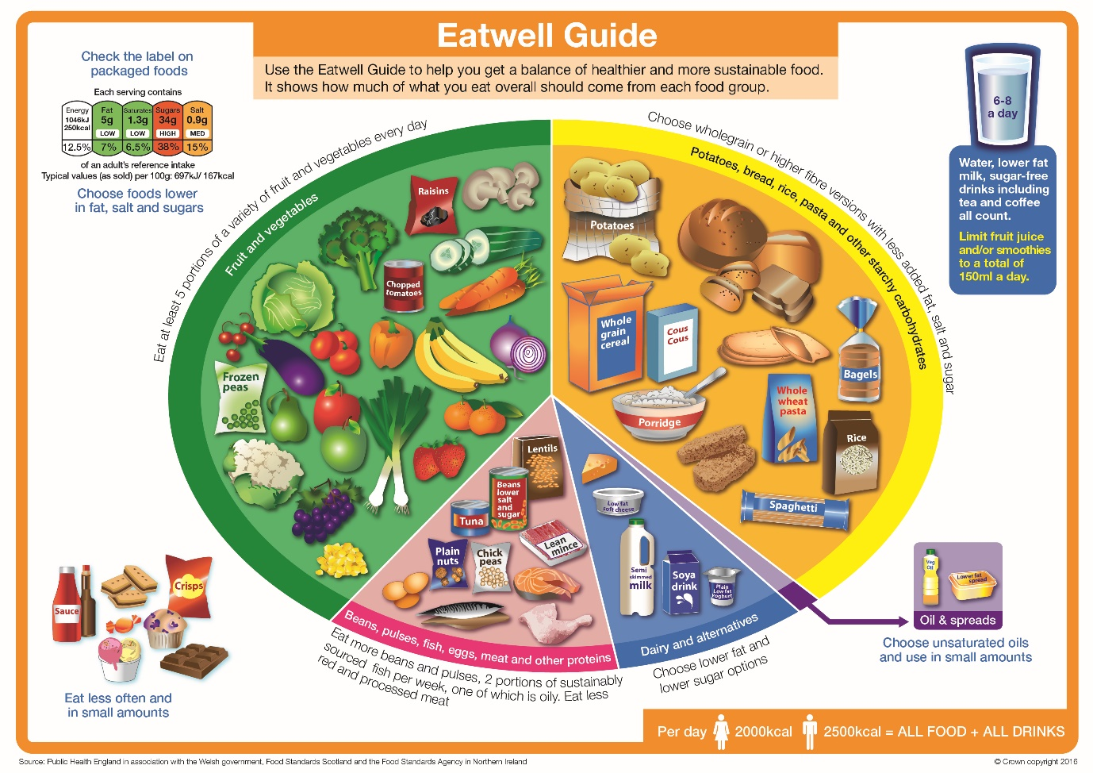
National food guide

Slide 11
Eatwell guidance
At least 5 portions fruit and vegetables every day
All meals based around starchy carbohydrates
Some dairy or dairy alternatives - lower fat and sugar options
Some beans, pulses, fish, eggs, meat and other proteins
Two portions of fish every week (1 should be oily)
Choose unsaturated oils and spreads and eat in small amounts
Drink 6 to 8 cups/glasses of fluid a day
Small and infrequent consumption of food/drinks high in fat, salt or sugar

Slide 12
Eatwell guide

Slide 13
Eatwell guidance
Divides food into five main groups.
Variety from each group ensures a wide range of nutrients are consumed.
Foods high in fat, salt and sugar are placed outside of the main image as these foods are not essential in the diet and most individuals need to cut down on these.
Unsaturated fats from plant sources are healthier, eg, vegetable oil or olive oil.

Slide 14
The importance of healthy eating
Maintain overall health and general wellbeing.
Assist weight management.
Growth and repair of tissues, including recovery/healing of soft tissue injuries.
Improved mood and mental wellbeing.
Improved sports performance.

Slide 15
Learning task
Trio task:
Each group to take one section of the Eatwell Guide
Use manual or online to find key information
Present findings back to whole group

Slide 16
At least 5 a day – sources include fresh, frozen, canned, dried or juiced.
Eatwell guidance – fruit and vegetables
Examples of fruit and vegetables portions 80g or any of these
An apple | A pear | An orange
3 heaped spoons of vegetables | A desert bowl of salad | 30g dried fruit*
150ml fruit juice* | 150ml smoothie* | *Only counts as 1 portion even if more are eaten

Slide 17
Eatwell guidance – starchy carbohydrate
Should make up just over a third of food eaten.
All meals based around them
  Sources - potatoes, bread, rice, pasta
Higher-fibre, wholegrain varieties are best choices
  Whole-wheat pasta, brown rice, leaving skins on potatoes

Slide 18
Eatwell guidance – protein sources
Some beans, pulses, fish, eggs and meat.
Sources of protein, vitamins and minerals.
At least two portions of fish each week and one portion should be oily fish.
Choose lean cuts of meat and remove fat and skin.
Upper limit of red or processed meat each day is 70g.
Avoid processed meat, eg, sausages, bacon, cured and reformed meat products.

Slide 19
Eatwell guidance – food high in fat and sugar
Should only be consumed in small amounts.
Eaten occasionally.
Not essential in diet.
Examples - chocolate, cakes, biscuits, full-sugar soft drinks, butter, ice-cream, pastries, cheese, sausages or fatty cuts of meat
Cut down on saturated fat - lower cholesterol and reduce risk of CVD.
  Men - no more than 30g saturated fat a day
  Women – no more than 20g

Slide 20
Eatwell guidance – food high in sugar
Increases risk of obesity and tooth decay
No more than 5% of energy consumed should come from added sugars
UK adults consuming 2-3 times that amount
Added sugar per day should be no more than 30g (7 sugar cubes)
Many packaged foods and drinks contain high amounts of sugars including some breakfast cereals, yoghurts and fruit juice drinks

Slide 21
Eatwell guidance – food high in salt
Too much salt can raise blood pressure
Increases the risk of developing heart disease or stroke
Adults - no more than 6g of salt (teaspoon) a day
Most salt eaten is already in foods such as bread, breakfast cereal, pasta sauce and soup rather than the salt we add to foods
Replace salt with pepper, herbs and spices to add flavour.

Slide 22

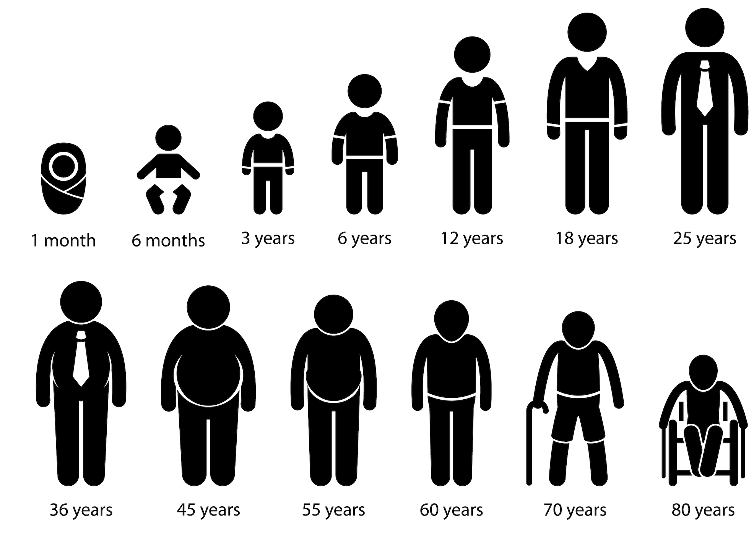
Factors affecting dietary requirements

Slide 23
Question
What factors do you think will influence dietary requirements, nutritional needs ad metabolic rates?

Slide 24
Factors affecting dietary requirements
Gender:
Men – generally have a higher calorie and protein requirement due to typically having more lean muscle mass
Women – may have higher iron needs, especially during menstruation and pregnancy

Slide 25
Factors affecting dietary requirements
Age:
Children and adolescents – require higher amounts of nutrients for growth and development. Calcium, vitamin D and iron are particularly important.
Elderly – may need more calcium, vitamin D, B12 and fibre. There may be changes in metabolism and nutrient absorption.

Slide 26
Factors affecting dietary requirements
Physical activity levels:
Sedentary individuals – require fewer calories than those with higher activity levels.
Active individuals – have a higher energy requirement, particularly for carbohydrates to fuel physical activity. Adequate protein is essential for muscle repair and recovery.
Athletes – may have an increased need for carbohydrates, protein and certain micronutrients depending on intensity and type of training.

Slide 27
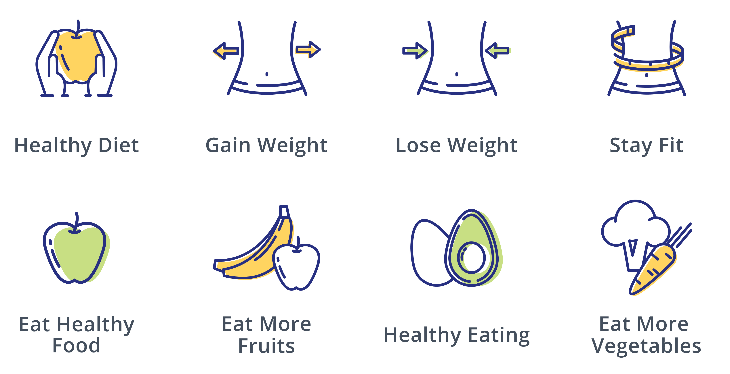
Using the Eatwell guide to support different client goals

Slide 28
Question
What are some nutrition aims or goals clients may want support achieving?
What advice would you give clients wanting to achieve these goals?

Slide 29
Nutritional goals
Examples of client goals:
Healthier eating
Weight loss
Fat loss
Improving sports performance
Hypertrophy
Would these goals fall within your scope of practice?

Slide 30
Scope of practice
As a fitness professional it is only share evidence-based guidance on healthier eating that is available to the public – primarily the Eatwell guide.
It is also important to work within your scope of practice.
  Exercise professionals are only qualified to give basic nutrition advice to apparently healthy adults
  The following individuals should be referred to a qualified nutritionist or dietician:
    Pregnant or breast feeding
    Medical conditions which require specialist dietary advice e.g. diabetes
    Requiring detailed meal plans or dietary prescriptions e.g. athletes

Slide 31
Supporting nutritional goals
Healthier eating – direct client to recommendations of the Eatwell guide. Encourage maintaining a regular eating pattern.
Weight loss – create a sustainable calorie deficit e.g. 200-500kcal per day through decreased calorie intake and increased physical activity. Ensure adequate intake of all micro- and macro- nutrients. No adjustment to macronutrient contribution.
Fat loss – create a sustainable calorie deficit. Ensure adequate intake of essential nutrients is maintained as overall energy intake is reduced. Ensure adequate protein intake to prevent muscle atrophy. Increase resistance training and high intensity CV.

Slide 32
Supporting nutritional goals
Improving sports performance – outside scope of practice, refer to nutritionist or dietician
Hypertrophy– outside scope of practice, refer to nutritionist or dietician

Slide 33
Importance of regular eating patterns
Regular healthy eating patterns can help support weight loss or weight management though:
Maintaining stable blood sugar levels
Preventing overeating
Preserving lean muscle mass
Balancing hormones
Improving energy levels
Establishing healthy habits
Reducing emotional eating
Adhering to calorie goals

Slide 34
Learning outcomes
Are you able to:
Define key nutritional terminology
Describe the current recommendation for health eating to meet individual needs
Explain the Eatwell guide
Explain how to use the Eatwell guide to support different goals

Slide 35
Nutrition for physical activity and exercise.
Macronutrients

Slide 36
Session content
Function of fat
Sources of fat
Dietary role of fibre
The role of fat in ATP production
The role of cholesterol

Slide 37
Question
What is fat used for in the body?

Slide 38
Function of fat
One of the main fuels the body uses for energy
Provides a protective layer around internal organs
Supports development of myelin sheath that insulates nerve cells
Uptake and storage of fat-soluble vitamins - A, D, E and K
Component of cell membranes
Storage and modification of steroid hormones e.g. testosterone and oestrogen
Source of essential fatty acids
Thermoregulation

Slide 39
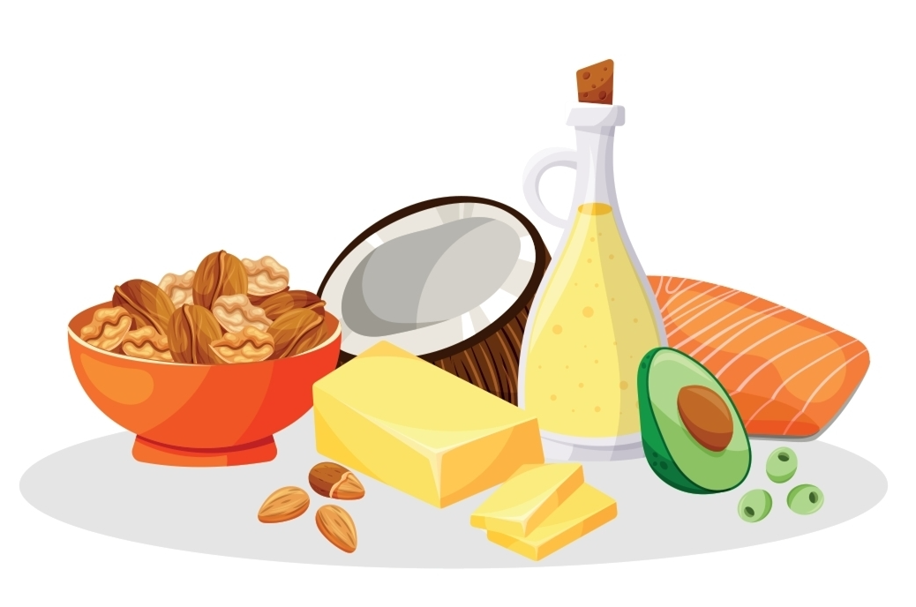
Fat in the diet
30% of total calorie intake
9kcal per gram

Slide 40
Classification of fat
Saturated – mainly from animal sources, solid at room temperature
Unsaturated – mainly from non-animal sources, liquid at room temperature
  Monounsaturated
  Polyunsaturated
Trans fats – not naturally occurring, produced through hydrogenation

Slide 41
Learning task
Pair task:
Create a list of dietary sources of fat.
Include:
Saturated
Unsaturated
  Polyunsaturated
  Monounsaturated
Essential fatty acids

Slide 42
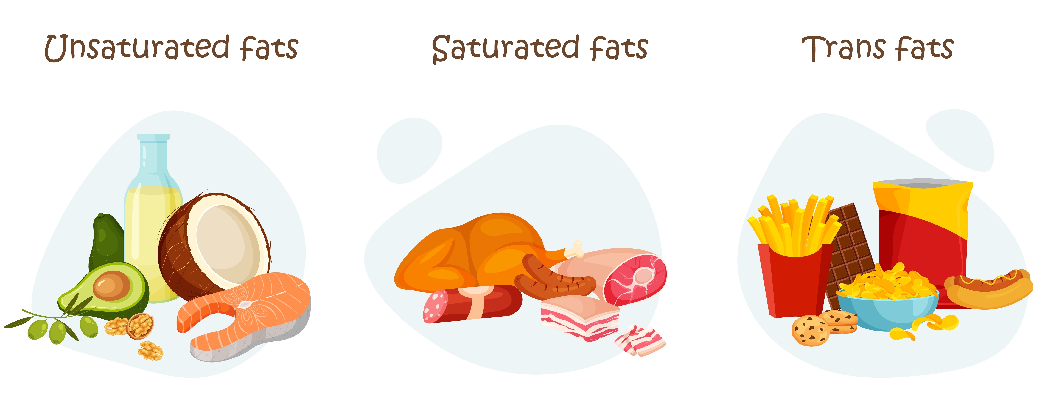
Types of fat

Slide 43
Saturated fat
Functions:
Supports the uptake of calcium by bones
Assists functioning of immune system
Protects liver from effects of alcohol
Role in signaling messengers for hormone production
Sources:
Meat
Meat products
Butter
Lard
Cream
Eggs
Palm oil
Coconut oil

Slide 44
Trans fats
Produced when unsaturated vegetable oils are heated to a very high temperature in industrial or commercial settings
Effects :
Harmful to health
Increase risk of CVD and some cancers
Increase LDL (bad) cholesterol
Decrease HDL (good) cholesterol
  Sources
  Some vegetable spreads
  Baked products (cakes, biscuits)
  Ready meals
  Processed snacks (crisps)
  Fast foods

Slide 45
Polyunsaturated fat
Considered healthier fats
Replacing saturated fats in diet with unsaturated fats has been shown to lower the risk of heart and circulatory disease
Sources:
Vegetable oils
Nuts
Oily fish:
  Sardines
  Tuna
  Mackerel
  Pilchards
  Trout

Slide 46
Monounsaturated fat
Considered ‘healthy’
Lower harmful blood cholesterol
Likely to improve heart health
Sources
Olive oil
Flaxseed oil
Avocado
Seeds
Nuts
Rapeseed
Almond oil

Slide 47
Essential fatty acids
Omega 3, 6 and 9
Essential – cannot be synthesised in the body, must be consumed in the diet
Health benefits:
Protective against cardiovascular disease
Beneficial effect of blood lipid profiles
Reduction of inflammation in arthritis and asthma
Enhanced transport of oxygen by red blood cells
Enhanced immune responsiveness
Maintenance of the quality of membranes and therefore may present some protection against the ageing process

Slide 48
Sources of essential fatty acids
Omega 3:
Oily fish
Flaxseed
Pumpkin seeds
Walnuts
Rapeseeds
Soya bean
Dark green vegetables
Omega 6:
Vegetable oils
Polyunsaturated margarines
Walnuts
Sunflower seeds
Almonds
Cashew nuts

Slide 49
UK Dietary guidelines for fat
The government recommends that total fat intake should not exceed 35% of total calorie intake
Saturated fat should not exceed 11% of total calorie intake which is roughly:
  30g per day for men
  20g per day for women

Slide 50
Question
What are the consequences of a diet high in fat?
What are the consequences of a diet low in fat?

Slide 51


Consequences of a high fat diet
Weight gain and obesity
Cardiovascular disease
Increased blood cholesterol levels
Increase risk of type 2 diabetes
Liver disease
Inflammation
Digestive issues

Slide 52
Consequences of a low-fat diet
Nutrient deficiencies
Vitamin absorption issues
Hormonal imbalances
Energy deficiency
Skin and hair issues
Metabolic issues
Excessively low-fat diets may lead to cardiovascular issues

Slide 53
Fat and energy
When needed for energy, stored fat (triglycerides) are broken down into fatty acids and glycerol.
Fatty acids are transported to cells via bloodstream, and into the mitochondria
Within the mitochondria the aerobic energy system uses fatty acids to produce ATP in a process known as oxidative phosphorylation
Oxidative phosphorylation is a highly efficient pathway for generating ATP – 1 fatty acid molecule can produce >100 ATP molecules
Fat can only be utilised for energy in the presence of oxygen and glycogen
The contribution of fat to energy production depends on availability of nutrients and energy demands

Slide 54
Questions
What is cholesterol?
What is the role of cholesterol in the body?
What is the potential impact of high cholesterol on health?

Slide 55
Cholesterol
Cholesterol is a fatty, waxy, lipid synthesised in the liver and present in all body cells
Role:
Essential component of cell membranes
Synthesis of vitamin D
Synthesis of steroid hormones
Production of bile salts for digestions

Slide 56
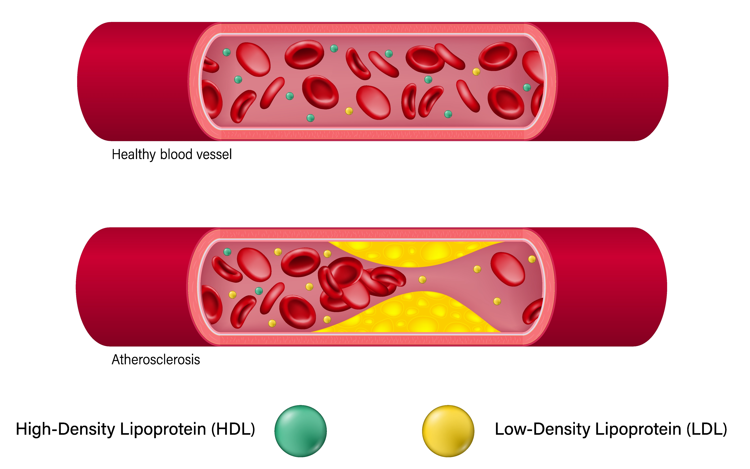
Lipoproteins
Cholesterol is transported in the bloodstream by lipoproteins, which are complexes of lipids (fats) and proteins
There are two main types of lipoproteins:
Low density lipoproteins (LDL)
High density lipoproteins (HDL)

Slide 57
Low-density lipoproteins
Low-density lipoproteins carry cholesterol and triglycerides from the liver to the body’s cells
Contain high levels of cholesterol and are sometimes referred to as “bad’ cholesterol
Some types of LDL cause inflammation, damage to arterial walls, and can lead to the build up of fatty plaques within arteries (atherosclerosis)
High LDL cholesterol is associated with a higher risk of heart attack and other cardiovascular diseases

Slide 58
High-density lipoproteins
High-density lipoproteins carry cholesterol and triglycerides to the liver from the body’s cells
Contain lower levels of cholesterol and are sometimes referred to as “good” cholesterol
HDL helps remove excess cholesterol from the body and can clear up some of the fatty deposits from artery walls – helping reduce the risk of cardiovascular diseases
High HDL levels appear to have a protective effect against cardiovascular disease

Slide 59
Cholesterol levels
The NHS (2023) recommends the following as healthy cholesterol ranges:
A total cholesterol of under 5 mmol/L
Total cholesterol to HDL ratio – below 6 mmol/L
An LDL (or non-HDL) level of 4 mmol/L or below.
An HDL level of above 1 mmol/l for men or above 1.2mmol/L for women
A triglyceride level of under 1.7 mmol/l.

Slide 60

Recommendations to reduce cholesterol levels
Decrease intake of saturated fats and replace with monounsaturated or polyunsaturated
Decrease intake of processed food
Increase intake of soluble fibre
Perform regular physical activity and exercise
If overweight, reduce weight to a healthy level
Stop smoking
Reduce alcohol intake

Slide 61
Learning task
Trio task:
Prepare a presentation to share with group on cholesterol. Ensure you explain:
What is cholesterol
The role of cholesterol in the body
The health risks of high cholesterol levels
Recommendations to reduce or maintain healthy cholesterol levels

Slide 62
Learning outcomes
Are you able to:
Describe the function of fat in the body
Identify dietary sources of different types of fat
Explain the dietary role of fat
Explain the role of fat in ATP production
Describe the role of cholesterol in the body
Describe the risks associated with high cholesterol

Slide 63
Nutrition for physical activity and exercise.
Macronutrients – carbohydrates

Slide 64
Session content
Function of carbohydrates
Sources of carbohydrates
Dietary role of fibre
The role of carbohydrate in ATP production

Slide 65
Question
What is the use of carbohydrates in the body?

Slide 66
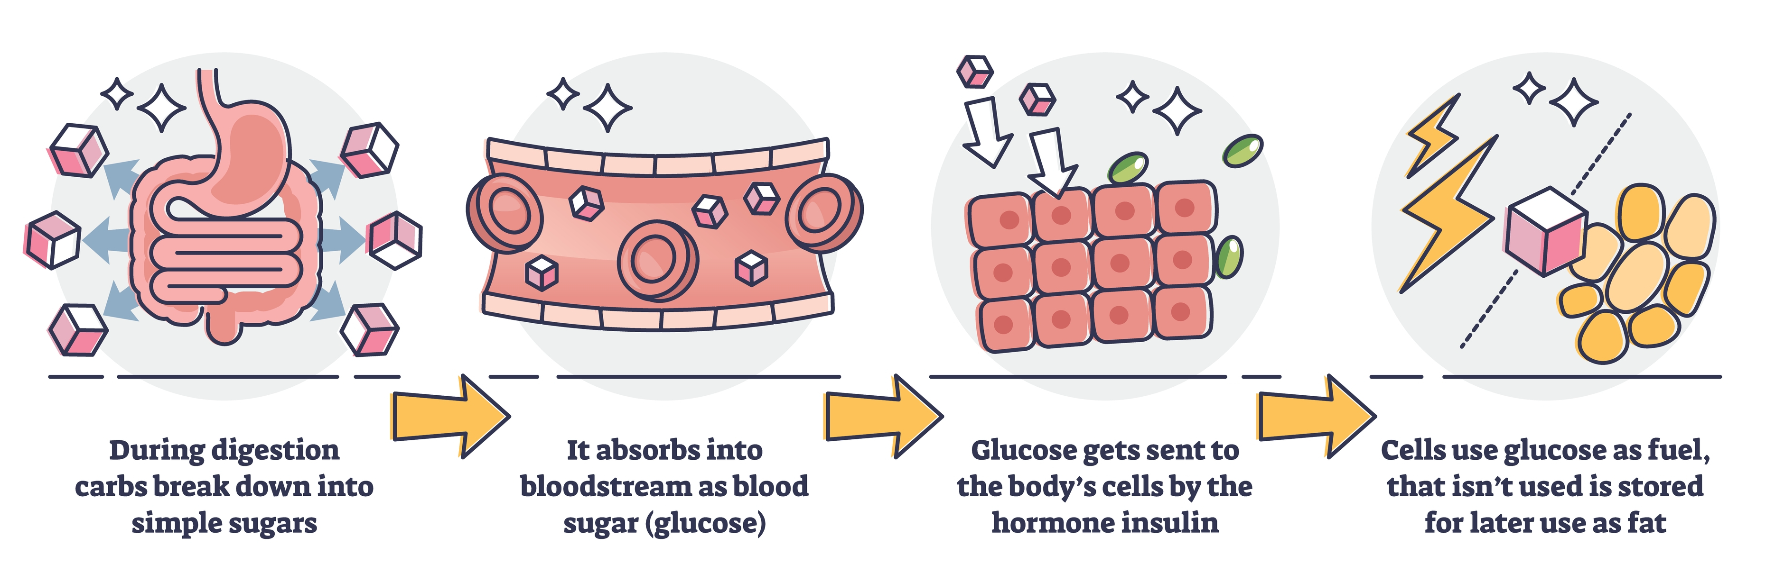
Function of carbohydrate
The main function of carbohydrates is to provider the body and brain with energy

Slide 67
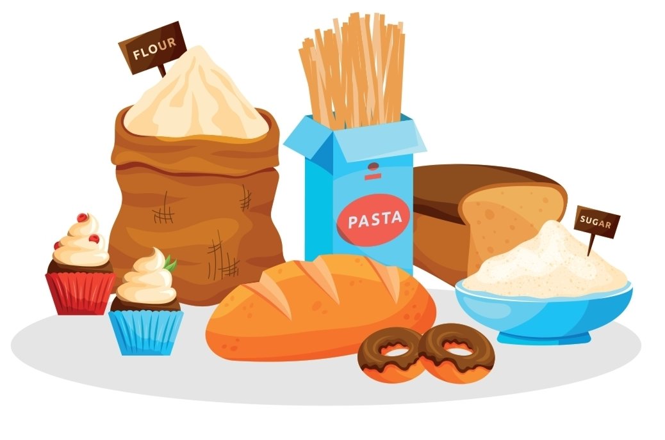
Carbohydrate in the diet
50-60% of total calorie intake
4kcal per gram

Slide 68
Types of carbohydrate
Complex carbohydrates:
Called starches
Found in wholegrain foods
Slower to digest
Often contain fibre
More likely to contain nutrients other than energy
Simple carbohydrates:
Called simple sugars
Found in a variety of natural food sources including fruit, vegetables and milk
Sweet taste
Often provide no nutrition other than energy

Slide 69
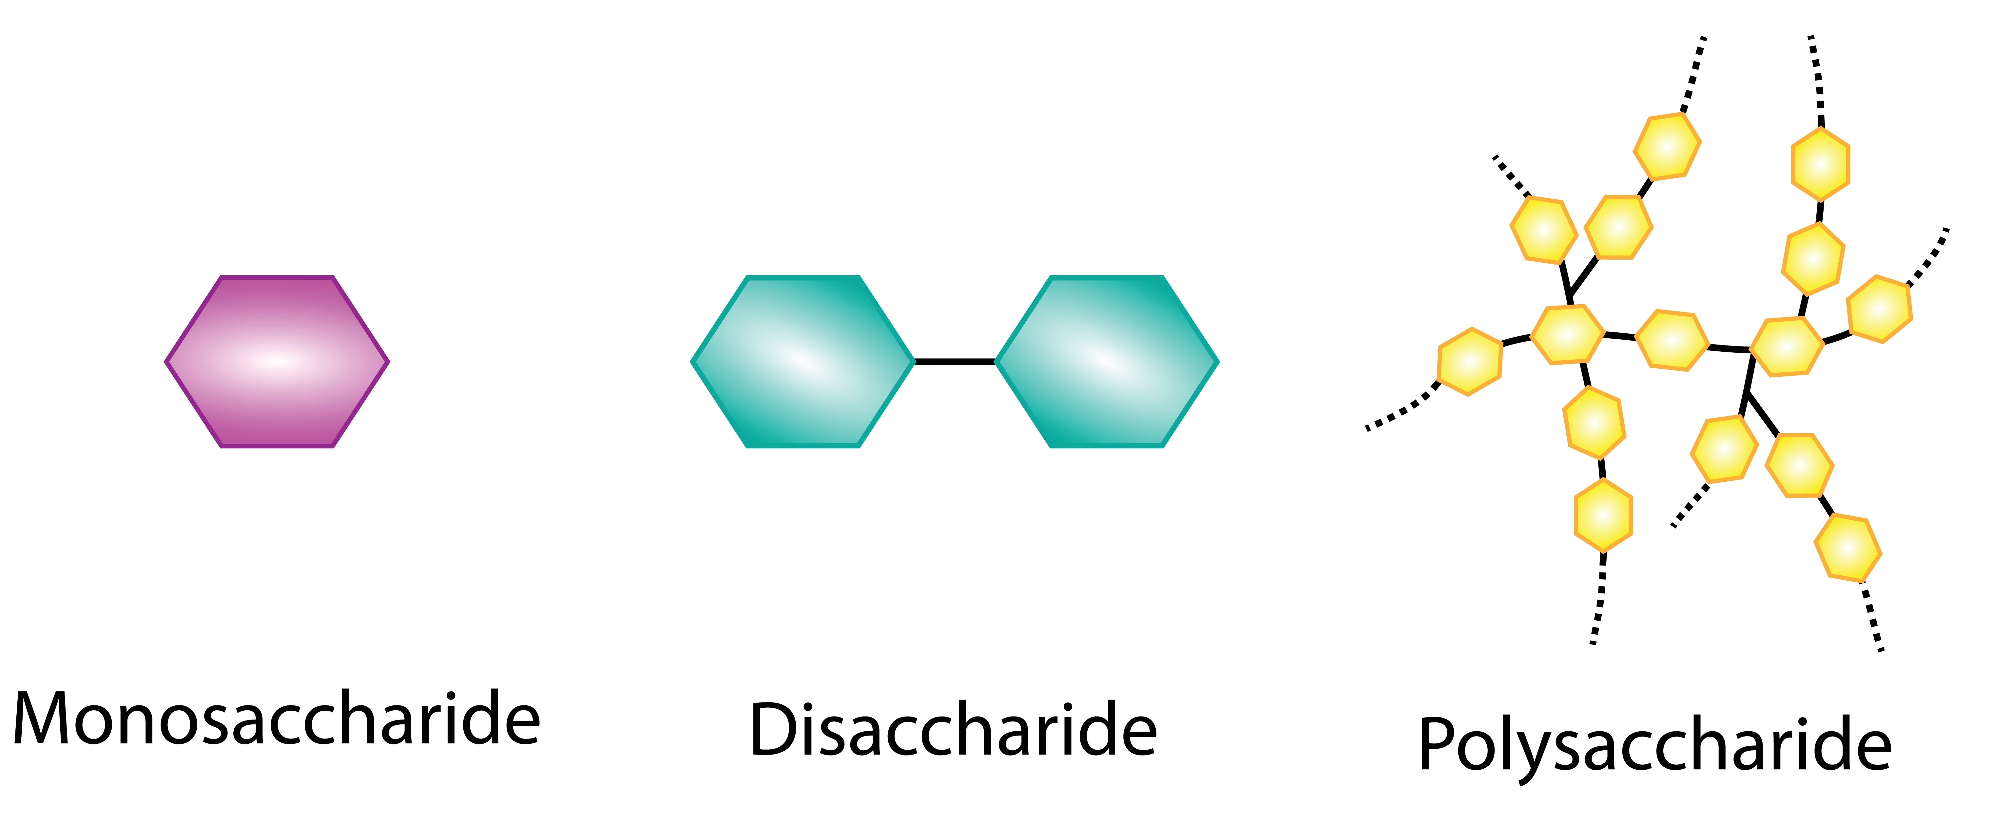
Structure of carbohydrates

Slide 70
Sources of carbohydrate
Simple (sugars) | Mix of both | Complex (starches and fibres)
Table sugar (sucrose) | Biscuits | Wheat (bread, pasta)
Fruit (fructose) | Cakes | Oats
Sweets | Sugary breakfast cereals | Corn
Jam | Starchy fruit (banana) | Barley
Marmalade | Pastries | Potatoes
Honey |  | Rice
Energy drinks (glucose) |  | Beans
Soft drinks |  | Peas
Milk (lactose) |  | Lentils
Energy gels |  | Chickpeas
 |  | Vegetables

Slide 71
Learning Task
Trio task:
Research dietary fibre and prepare a short presentation to share with another group. Ensure you include:
The role of dietary fibre
Types of dietary fibre
Dietary sources of fibre
UK recommended intake

Slide 72
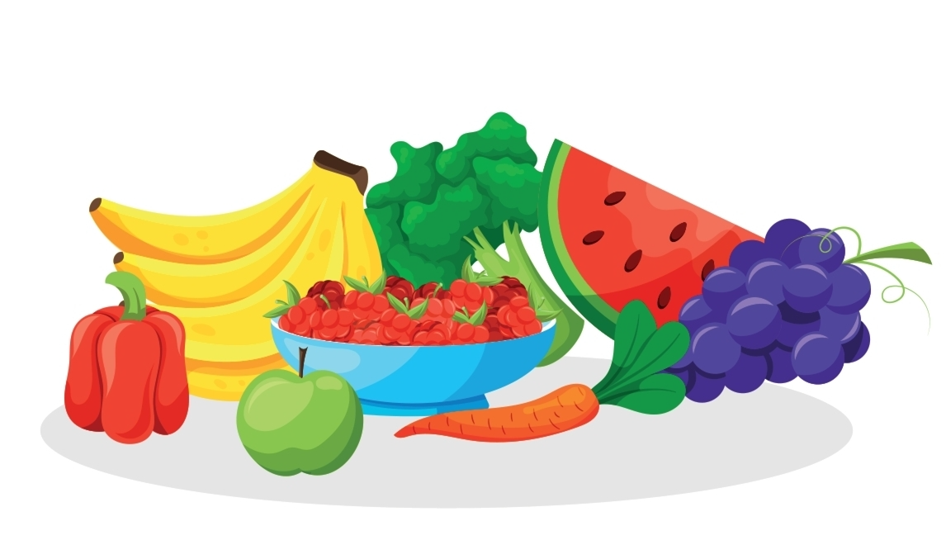
Dietary fibre
Dietary fibre:
‘roughage’ or ‘bulk’
Type of carbohydrate that is not fully digested
Two main types:
Soluble fibre – can dissolve and is partially digested in the gut
Insoluble fibre – can not be broken down or absorbed by the body

Slide 73
Soluble fibre
Role:
Lowers cholesterol
Regulates blood sugar
Promotes feeling of fullness
Sources:
Oats
Barley
Beans
Lentils
Fruits
Some vegetables

Slide 74
Insoluble fibre
Role:
Adds bult to stools
Promotes regular bowel movements
Weight management
Colon health – may reduce risk of colorectal diseases and cancer
Sources:
Wholegrains
Nuts
Seeds
Vegetables (especially skins)
Fruit (especially edible seeds and skins)

Slide 75
Dietary fibre – health benefits
Heart health – lowers cholesterol, assists in maintaining healthy blood pressure
Blood sugar control – slows absorption of glucose
Weight management – less energy dense and promote feeling of fullness
Reduced risk of developing chronic diseases including:
  Cardiovascular disease
  Type 2 diabetes
  Certain cancers
Gut microbiota – prebiotic, promoting growth and activity of beneficial bacteria

Slide 76
UK Dietary guidelines for carbohydrate
The government recommends that carbohydrate should provide 50-60% of total energy/calories intake
  Majority of calories should come from starchy carbohydrates
  Maximum of 10% should come from added sugars
  Aim to include 30g dietary fibre

Slide 77
Question
What are consequences of a diet high in carbohydrates?
What are the consequences of a diet low in carbohydrates?

Slide 78
Diets high in carbohydrates
No known medical conditions associated the the overconsumption of carbohydrates
Excess calories can lead to weight gain and obesity
Simple carbohydrates (sugars) can cause dental decay
Over consumption of fibre can irritate the gut and decrease transit time of food, limiting the absorption time for nutrients

Slide 79
Diets low in carbohydrates
Low carbohydrate diets can lead to:
Insufficient glycogen stores giving low energy and causing gluconeogenesis- the break down of muscle for energy
Insufficient fibre intake leading to constipation and digestive disorders

Slide 80
Carbohydrates and energy
Carbohydrate is stored in as glycogen in the liver and muscles
When needed for energy, stored glycogen is first broken down into glucose in a process called glycogenolysis – this process mainly takes place in the liver
Glucose is then released into the bloodstream and transported to cells to provide energy
Within the cells, glucose is broken down to pyruvate in a process called glycolysis which produces a small amount of ATP
Pyruvate is then used to re-synthesise ATP via:
  Aerobic glycolytic system – when oxygen is available
  Anaerobic glycolytic/ lactic acid system – when oxygen is not available

Slide 81
Learning outcomes
Are you able to:
Describe the function of carbohydrate in the body
Identify dietary sources of different types of carbohydrate
Explain the dietary role of fibre
Explain the role of carbohydrate in ATP production

Slide 82
Nutrition for physical activity and exercise.
Macronutrients – protein

Slide 83
Session content
Function of protein
Sources of protein
Dietary role of protein
The role of protein in ATP production

Slide 84
Question
What is function of protein in the body?

Slide 85
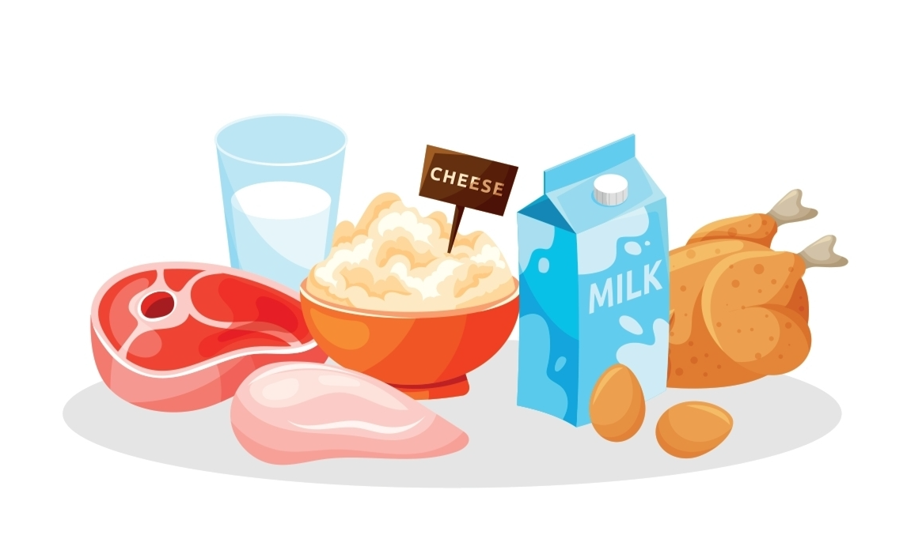
Protein
Protein is digested and broken down into amino acids
Used to build and repair body tissue
Excess protein is transported to the liver to produce energy
Protein provides 4kcal per gram

Slide 86
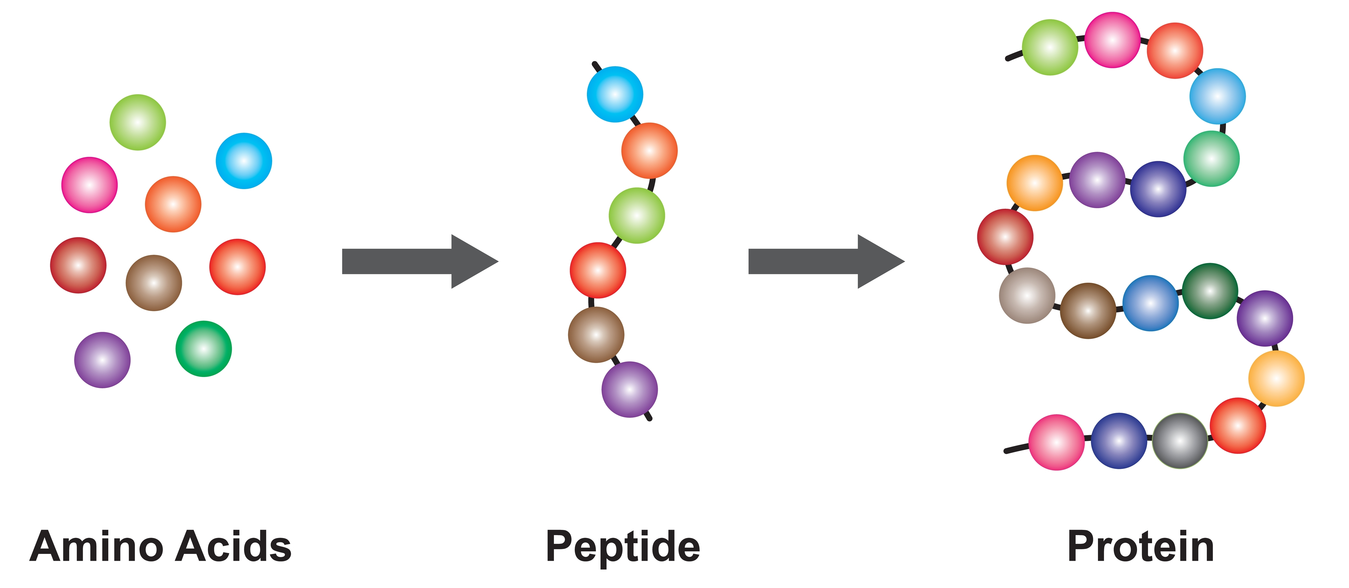
Protein

Slide 87
Functions of protein
Structural proteins:
Building blocks for the formation, growth and repair of body cells and tissues:
  Collagen provides strength and support to connective tissue e.g. tendons and ligaments
  Actin and myosin are contractile proteins in muscles
  Proteins contribute to the structure of cell membranes
Functional proteins:
Protein is an important component in many hormones, enzymes and immune cells
Energy:
Can be used as an energy source during fasting or intense physical exercise

Slide 88
Question
What are the 2 types of dietary proteins?
What are some examples of dietary sources of protein?

Slide 89
Types and sources of protein
Complete proteins – foods that contain all 9 essential amino acids
Incomplete proteins – foods that contain some but not all essential amino acids
Animal sources = complete proteins
Plant sources = mostly incomplete proteins

Slide 90
Food sources of protein
Animal sources | Plant sources
 | Incomplete | Complete
Meats | Cereal | Quinoa
Poultry | Nuts | Soybeans
Fish | Grains | Tofu
Eggs | Beans | Chia seeds
Cheese | Legumes
Other dairy and animal produce

Slide 91
UK Dietary guidelines for protein
The government recommends that protein should provide 10-15% of total energy/calories intake
  The Reference Nutrient Intake (RNI) is 0.75g per kg bodyweight for adults

Slide 92
Guidelines for protein intake
Sedentary adults – 0.75- 0.8g per kg bodyweight per day
Regular endurance exercisers – 1.2-1.4g per kg bodyweight per day
Strength/ power exercisers – 1.6-1.7g per kg bodyweight per day

Slide 93
Learning task
Individual task:
Calculate your daily protein requirement in g and kcal.

Slide 94
Protein and muscle growth
Protein should be consumed regularly throughout the day to maintain maximal synthesis in the body
Post-exercise amino acids are used to repair and rebuild damaged muscles
  Aim to consume protein 2 hours before or after exercise to ensure sufficient amino acid availability

Slide 95
Diets high in protein
Nitrogen-containing amine group is converted into urea and excreted.
  Potentially harmful for people with established liver and kidney disorders
Energy containing carbon skeleton is metabolised by the same pathways as carbohydrates and can be used for energy or converted and stored as fat
High intakes from animal protein may lead to high saturated fat consumption
May contribute to reduced bone density due to increased calcium secretion

Slide 96
Diets low in protein
Protein deficiency in most developed countries is rare
Reduced growth in children
Muscle loss in adults
Susceptible to disease

Slide 97
Protein and energy
Protein is not the primary macronutrient used to produce ATP, protein metabolism makes up less than 5% of total energy used each day
Dietary protein can be broken down and used as an energy source when fat and carbohydrate stores are limited
Some amino acids can be converted into glucose through gluconeogenesis, for use in glycolysis
Some amino acids can be used for aerobic cellular respiration (Krebs cycle)

Slide 98
Learning outcomes
Are you able to:
Explain the function of protein
Identify dietary sources of protein
Explain the dietary role of protein
Describe the role of protein in ATP production

Slide 99
Nutrition for physical activity and exercise.
Fuel for exercise

Slide 100
Session content
Role of nutrients in energy and ATP production
The effects of different types of training on fuel for exercise

Slide 101
Learning task
Trio task:
Discuss what you can recall about the energy systems:
Name
Aerobic/ anaerobic
Fuel
Duration
By-products

Slide 102
Energy
Energy is the ability or capacity to carry out work or function
Body systems, organs, tissues and cells requires energy for all biological work
Energy is required for:
Muscular contraction
Respiratory function
Cardiovascular function
Digestive function
Cell and tissue regeneration

Slide 103
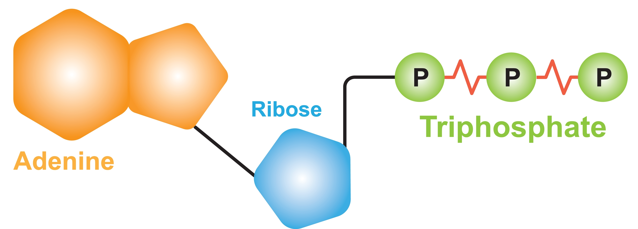
Energy
Energy is released in the body from the breakdown of:
Carbohydrates
Fats
Proteins
The breakdown of these substrates produces Adenosine triphosphate (ATP)
Referred to as the body’s ‘energy currency’

Slide 104
Energy systems
There are three biological pathways that can be used to resynthesise ATP:
Phosphocreatine (PC) or creatine phosphate (CP) system (anaerobic)
Anaerobic glycolysis or lactic acid system (anaerobic)
Aerobic system (aerobic)
Anaerobic = without oxygen
Aerobic = with oxygen

Slide 105
Energy systems
Phosphocreatine (PC) or creatine phosphate (CP) system (anaerobic) – used for predominantly short burst of high intensity activity – up to 15 seconds
Anaerobic glycolysis or lactic acid system (anaerobic) – used predominantly during moderate to higher intensity activities – 2-3 minutes
Aerobic system (aerobic) – used during longer lasting events or lower to moderate intensity activity
All the energy systems require macronutrients to support their continued action

Slide 106

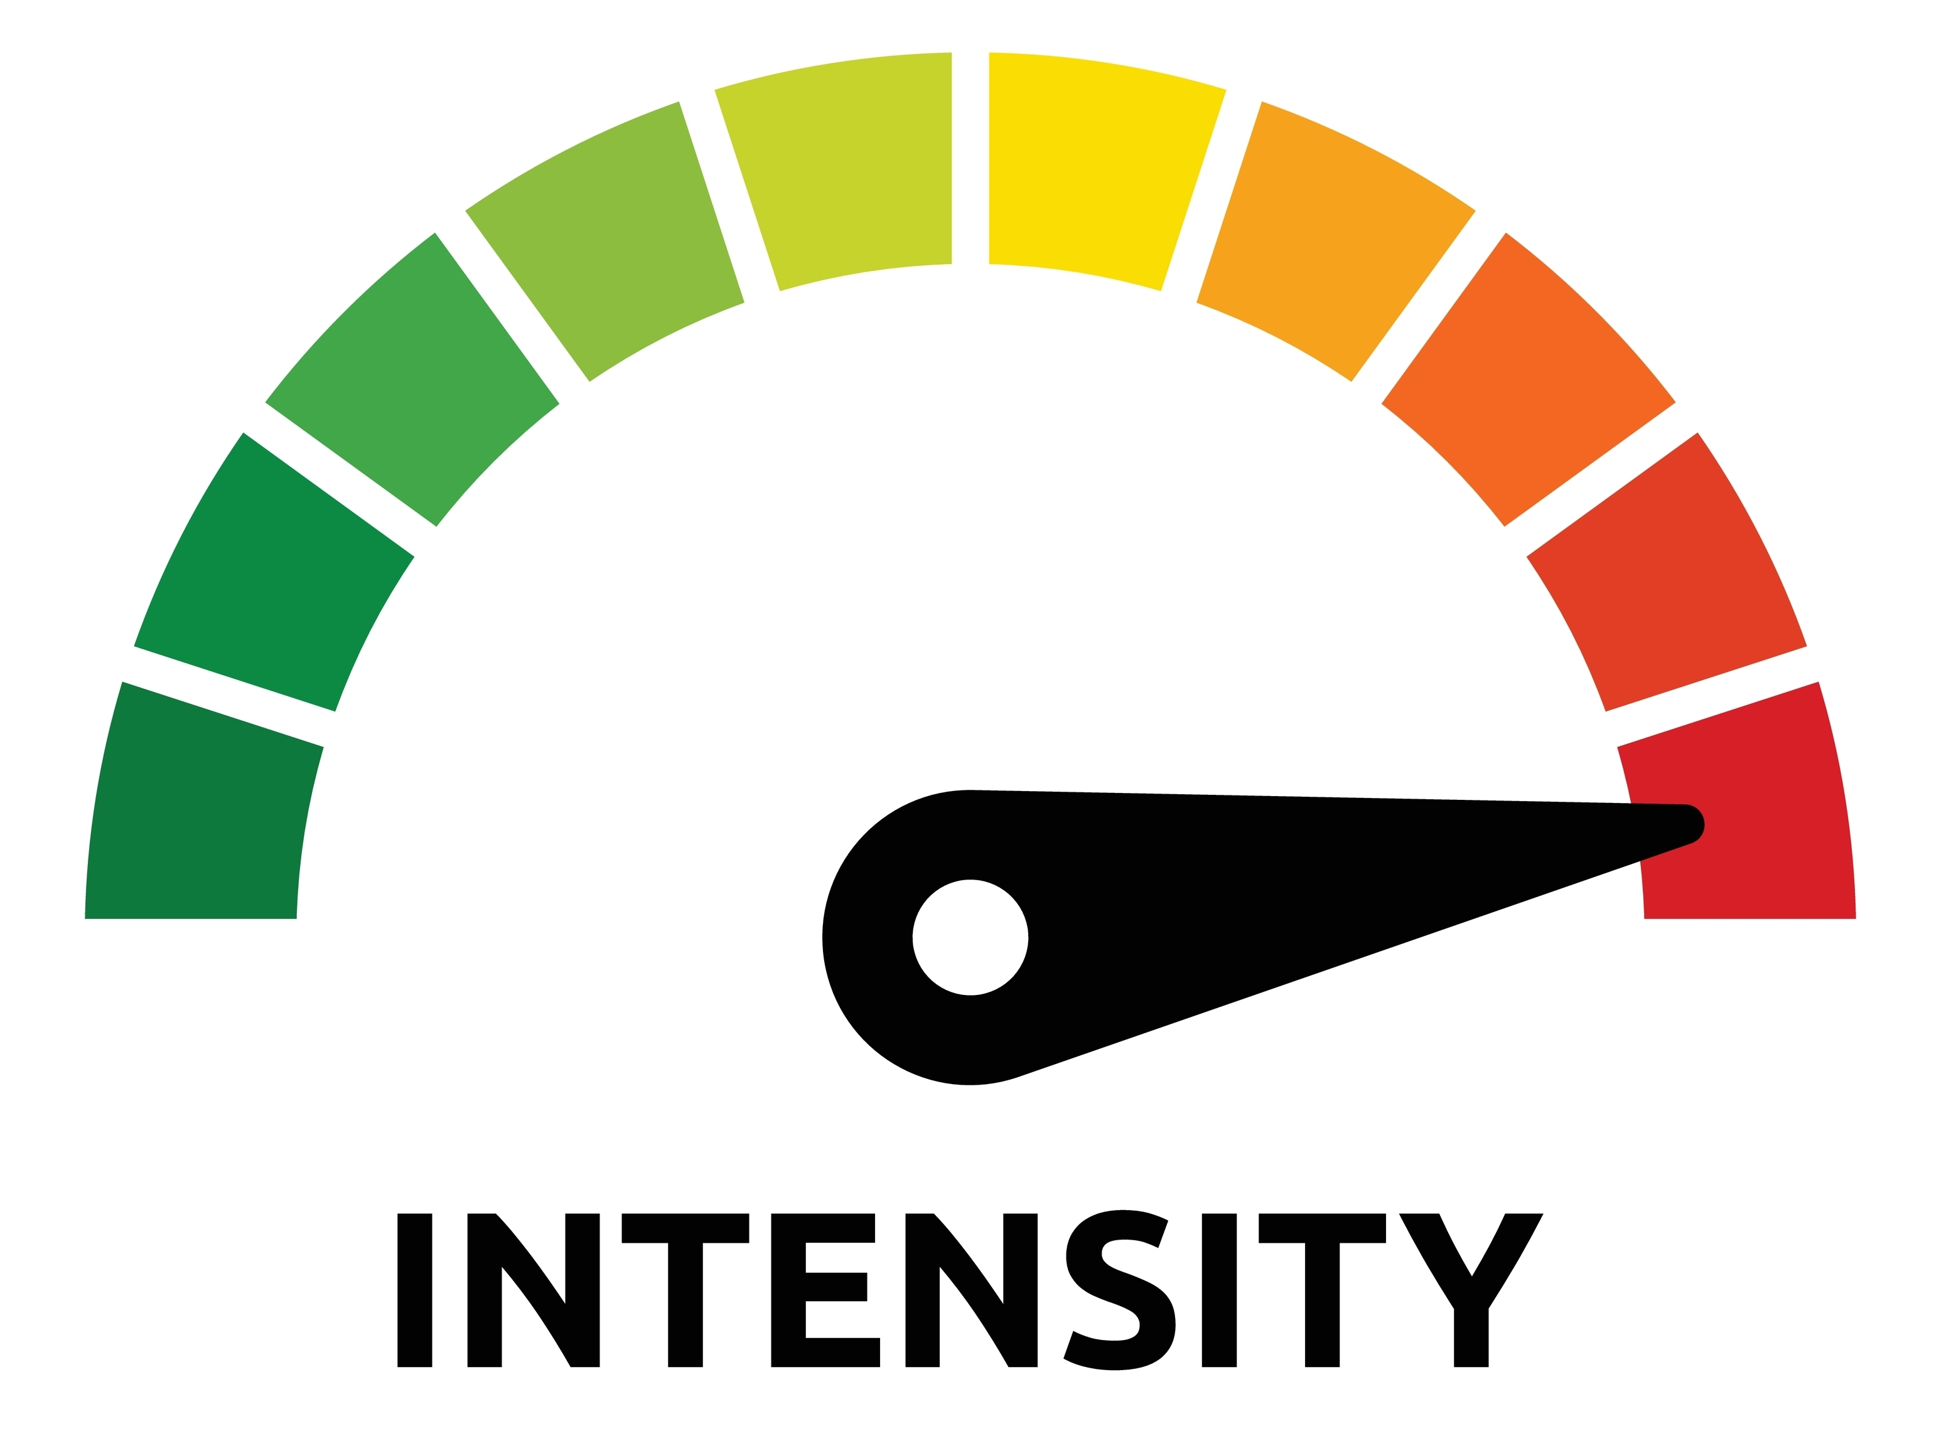
Energy systems and exercise
When exercising, energy is derived from all three systems:
Predominant system determined by:
Intensity of the activity
Duration of the activity
Fitness level

Slide 107
Energy systems and exercise
Predominantly anaerobic - short, sharp, intense bursts of activity, eg, jumping, sprinting, throwing
Predominantly aerobic - sustained, long duration rhythmical movements, eg, cycling, rowing
Mix of anaerobic and aerobic - short bursts of high-intensity interspersed with longer periods of low to moderate intensity activity, eg, netball, football.

Slide 108
Energy systems and exercise
Anaerobic exercise – predominantly carbohydrate
Aerobic exercise - mixtures of fat and carbohydrate depending on intensity
Fat used in presence of oxygen and alongside carbohydrates
General rule - higher intensity, lower the fat consumption, even when aerobic
Implications for fat loss programmes
For most people,
the ratio of fat to carbohydrate used is about 50:50.
ratio improves with training and improved fitness

Slide 109
Fat and fat use
Fat utilised for energy in the absence of carbohydrates:
fasting
starvation
low-carbohydrate diet
poorly controlled diabetes mellitus
Issues:
ketone bodies produced
acidic
prolonged ketosis can lead to ketoacidosis and abnormally low blood pH.

Slide 110
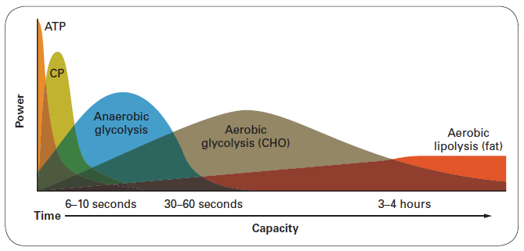
Interplay of the energy systems
Energy contribution
Duration

Slide 111
Excess post-exercise oxygen consumption (EPOC)
EPOC or ‘afterburn’ represents the period during which the body continues to consume oxygen at an elevated level after exercise.
During exercise, the energy systems engage to meet the increased demand for energy.
The body relies on both aerobic (with oxygen) and anaerobic (without oxygen) biological pathways to produce ATP.
After exercise, there is an increased demand for oxygen as the body works to restore physiological processes to their pre-exercise state.

Slide 112
Excess post-exercise oxygen consumption (EPOC)
Several factors contribute to EPOC:
Oxygen debt: during exercise, the demand for oxygen exceeds supply. After exercise the body needs to repay this dept, contributing to EPOC.
Replenishing ATP: during exercise ATP stores are depleted, during the recovery period ATP needs to be resynthesised
Lactate removal: during intense exercise, lactate accumulates in the muscle. After exercise, oxygen is needed to metabolise and remove lactate
Elevated heart rate and respiratory rate: after exercise HR and RR remain elevated as the body works to restore physiological process to pre-exercise levels.
Thermogenesis: Post exercise increase in body temperature contributes to overall energy expenditure as the body works to return to normal temperature

Slide 113
Learning task
Small group task:
Discuss how energy systems and fuels will be used in each of the following:
Endurance training (marathon)
15-minute HIIT session
Interval cycling session – 3 mins high intensity: 6 minutes low intensity
30-minute weights session, 8-12 rep range

Slide 114
Types of training and fuel
Aerobic (endurance) training
  Endurance training relies on aerobic energy production pathways – oxygen, carbohydrates and fats
  Initially body using glycogen for energy, as glycogen stores deplete, there is an increased fat metabolism. Protein breakdown may also contribute to energy requirements.
Anaerobic training (HIIT, high intensity, short duration):
  Anaerobic activities rely on anaerobic metabolism – initially phosphocreatine system then anaerobic glycolysis (lactic acid system).
  Muscle glycogen is main source of energy.

Slide 115
Types of training and fuel
Interval training:
  High intensity intervals rely on anaerobic glycolysis and stored muscle glycogen
  Lower intensity intervals rely on aerobic glycolysis and fat metabolism for energy

Slide 116
Types of training and fuel
Resistance training:
  Can involve aerobic and anaerobic metabolism, depending on intensity and duration of the exercise
  Initially relies on stored ATP and phosphocreatine for short burst of energy.
  As exercise continues anaerobic glycolysis contributes, using glycogen as fuel.
  Post exercise aerobic energy system is used for recovery and repair.

Slide 117
Learning outcomes
Are you able to:
Describe the role of nutrients in energy and ATP production
Explain the effects of different types of training on fuel for exercise

Slide 118
Nutrition for physical activity and exercise.
Micronutrients

Slide 119
Session content
Function and food sources of:
  Vitamins
  Minerals
Supplementation and scope of practice

Slide 120
Micronutrients
Vitamins and minerals are collectively known as micronutrients and are vital to the optimal functioning of all the body’s systems.
Vitamins – to enable us to effectively use the energy from the macronutrients.
Minerals – these are necessary for a range of very specific tasks.

Slide 121
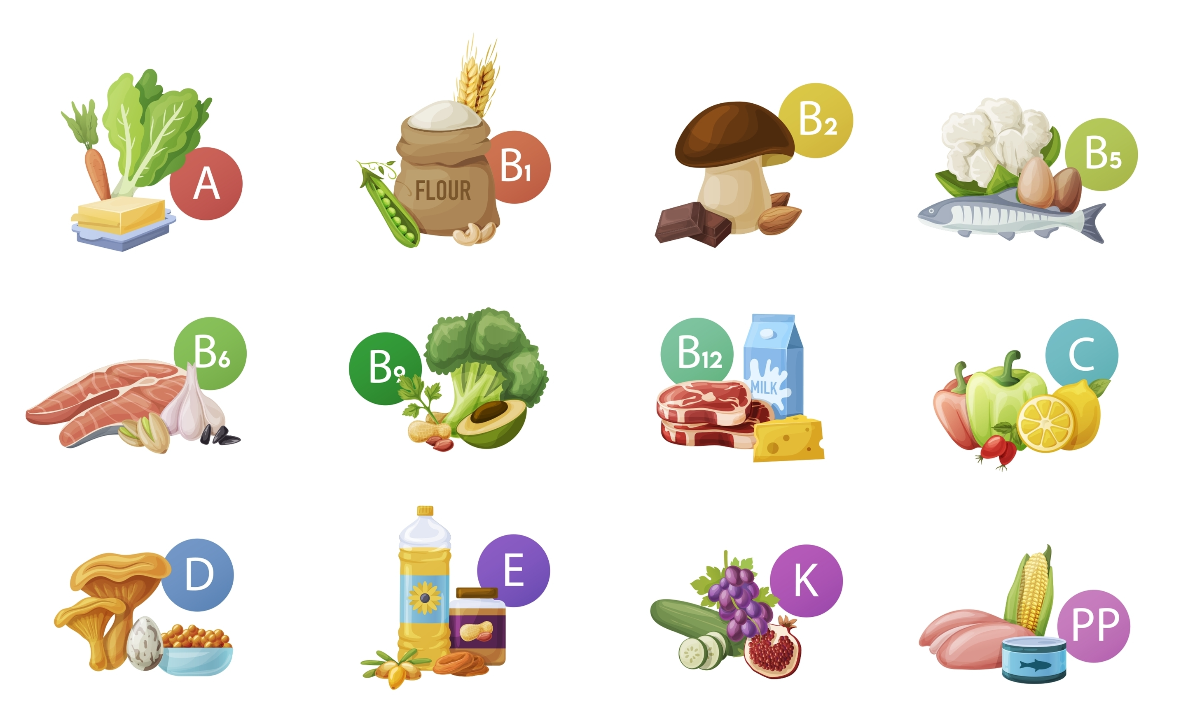
Vitamins
Fat soluble vitamins - A, D, E, K
These need the presence of fat to be absorbed, transported and utilise in the body.
Water soluble vitamins – B and C
These need the presence of water to be absorbed, transported and utilised in the body.

Slide 122
Learning task
Small group task:
For your allocated vitamins/ minerals research their roles in the body and dietary sources.
Prepare to present information back to group.
Include 2 -4 quiz questions for group.

Slide 123
Water-soluble vitamins
Vitamin C and vitamin B group:
Essential for brain functions, supporting energy metabolism and assists with many enzyme actions
Vitamin C is essential for healthy gums a teeth
Need the presence of water to be absorbed, transported and utilised in the body
Are not stored in the body– need regular consumption in diet
Excess is excreted through urine

Slide 124
Water-soluble vitamins
Vitamin | Role | Food source
B complex | Healthy nerves, skin, eyes, hair, liver and muscle tone Prevents fatigue Metabolism Helps maintain iron levels in the blood | Milk and milk products Offal and meat Fish Eggs Whole cereals Fresh fruit and vegetables
C | Antioxidant Healing of wounds Immune system function Tissue growth and repair | Fresh fruit and vegetables Milk (especially breast milk) Some organ meats

Slide 125
Fat-soluble vitamins
Vitamins A, D, E and K:
Vitamin A for vision
Vitamin D for bone growth and development
Vitamin E for protection against chemical damage (antioxidant)
Vitamin K for blook clotting
These vitamins need the presences of fat to be absorbed, transported and utilised in the body
Are stored in the body

Slide 126
Fat-soluble vitamins
Vitamin | Role | Food sources
A | Vision in dim light Maintenance of healthy skin and tissue | Animal origin foods Dairy produce
D | Calcium and phosphorus absorption Strong bones and teeth | Action of sunlight on a substance in the skin Animal origin foods
E | Blood circulation Tissue repair and healing Antioxidant | Animal fats and meats Some cereal products
K | Blood clotting Bone formation | Cauliflower, cabbage, spinach Cereals

Slide 127
Antioxidants
Vitamin A, C and E
Antioxidants help to prevent damage to the body from the effects of free radicals

Slide 128
Minerals
Key minerals:
Calcium – bone growth and development, prevention of osteoporosis, muscle contraction, secretion of hormones and nerve transmissions
Magnesium – keeps bones healthy and assists with cell formation
Iron – component of haemoglobin
Potassium – water and electrolyte balance, assists optimal functioning of cells, muscle and nerve function
Zinc – helps enzymes do their job, supports wound healing, immune support and cell growth

Slide 129
Minerals
Mineral | Food source
Calcium Balances acid and alkali Bone growth Muscle contraction | Dairy products Green leafy vegetables Fish with soft bones
Chloride Assists protein and carbohydrate digestion Balances acid and alkali Regulates fluid balance | Coconut flesh Natural unprocessed sea salt
Magnesium Bone formation Carbohydrate metabolism Tooth enamel Nerve transmission | Dairy Fish Nuts Natural unprocessed sea salt

Slide 130
Minerals
Phosphorus Bone growth Cell growth Kidney function | Animal produce Nuts Pulses Whole grains
Potassium Cell chemistry Fluid balance | Natural unprocessed salt Nuts Vegetables
Sodium Distribution of cell fluid Nerve transmission | Natural unprocessed salt Meat/bone broths Courgettes/marrow
Sulphur Muscle cell structure Protects from infection Cartilage and skin formation Protects against pollution | Eggs Dairy Cruciferous vegetables (broccoli, cauliflower)

Slide 131
Question
Which individuals or groups may be at risk of vitamin or mineral deficiencies?

Slide 132
Vitamin and mineral deficiencies
The following groups are at greater risk of deficiencies:
Iron: vegetarians, vegans, menstruating and pregnant women, pre-school children
Iodine: pregnant/ nursing mothers
Vitamin D: people with dark skin, people with little sunlight exposure, adults with osteoporosis
Calcium: young females, individuals with eating disorders, older adults

Slide 133
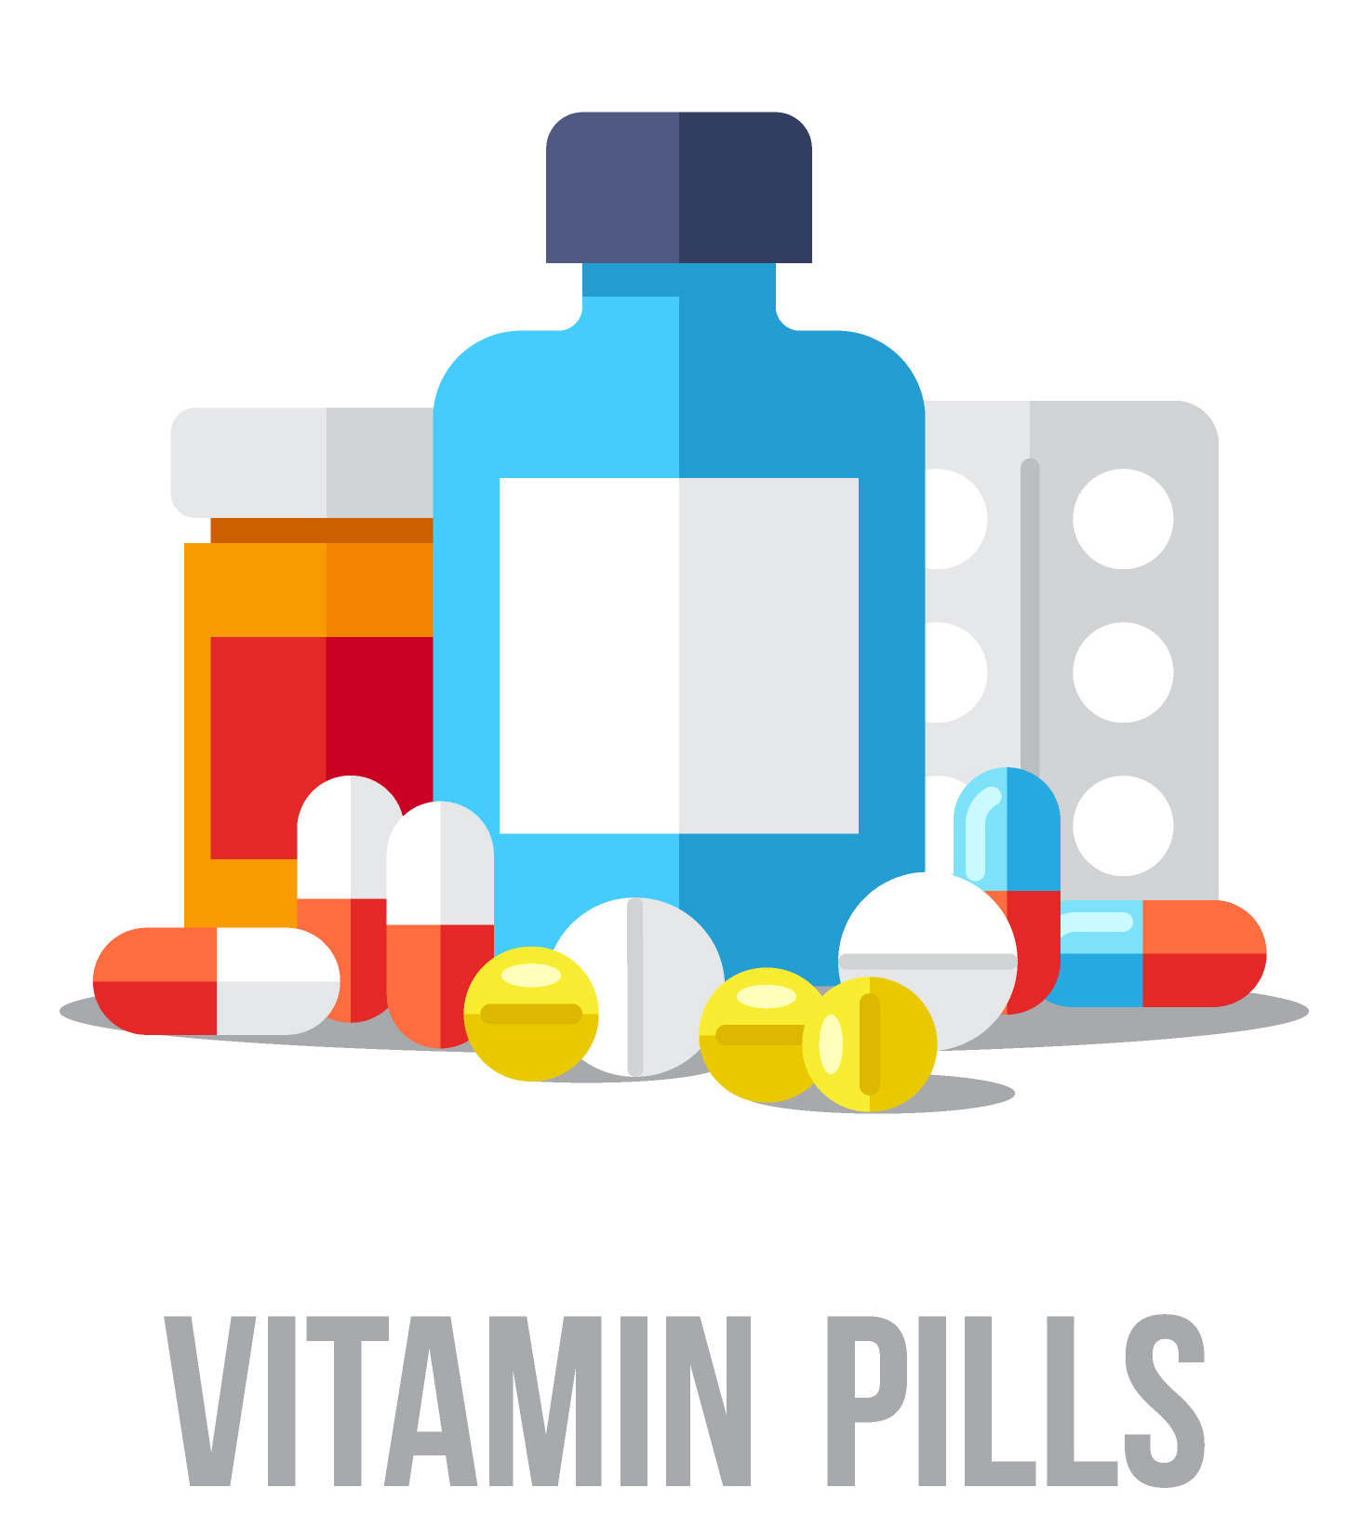
Question
Is advising on vitamin supplementation within you scope of practice?

Slide 134
Vitamin supplementation
As an exercise professional you can only offer evidence-based information in line with the national Eatwell guide recommendations, NICE and NHS recommendations.
Any person seeking advice on supplementation should be signposted to a qualified dietician.
Providing advice on supplementation is outside your scope of practice

Slide 135
Session content
Are you able to:
Identify the function and food sources of:
  Vitamins
  Minerals

Slide 136
Nutrition for physical activity and exercise.
Glycaemic index and blood sugar

Slide 137
Session content
Glycemic index (GI)
The importance of maintaining blood sugar levels
Symptoms of:
  Hyperglycaemia
  Hypoglycaemia
Effects of prolonged high blood sugar levels
How diet can be used to maintain blood sugar levels

Slide 138
Glycaemic index
Glycaemic index: A ranking of carbohydrates on a scale from 0 to 100 according to the extent to which they raise blood sugar (glucose) levels after eating
  Low GI – 55 or less
  Medium GI – 56-69
  High GI – 70 or higher

Slide 139
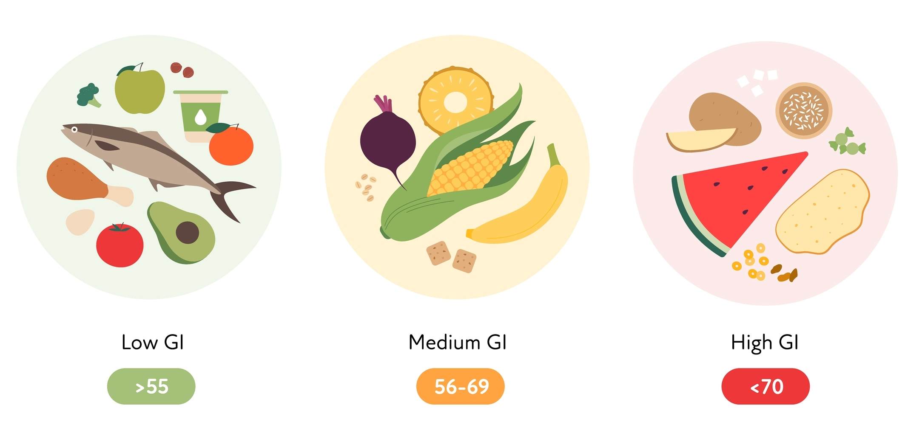
Glycaemic index

Slide 140
Glycaemic index – low
Low GI foods cause slower, more sustained rises in blood glucose.
Tend to be natural foods that are high in fibre and hard to digest
Examples:
Lentils
Mushrooms
Tomatoes
Lettuce
Chickpeas

Slide 141
Glycaemic index – medium
Medium GI foods have a moderate effect on blood sugar and cause a gradual rise in blood sugar overtime
Foods often have a mix of some sugars and fibre, or are higher in carbohydrate
Examples:
Porridge oats
Apples
Pears
Strawberries
Cous cous

Slide 142
Glycaemic index – high
High GI foods are rapidly absorbed and cause a quick and significant rise in blood sugar
Typically processed foods with lots of refined sugar, or natural foods that are low in fibre and easy to digest
Examples:
Sugar, sugary foods and soft drinks
White bread
Potatoes
White rice

Slide 143
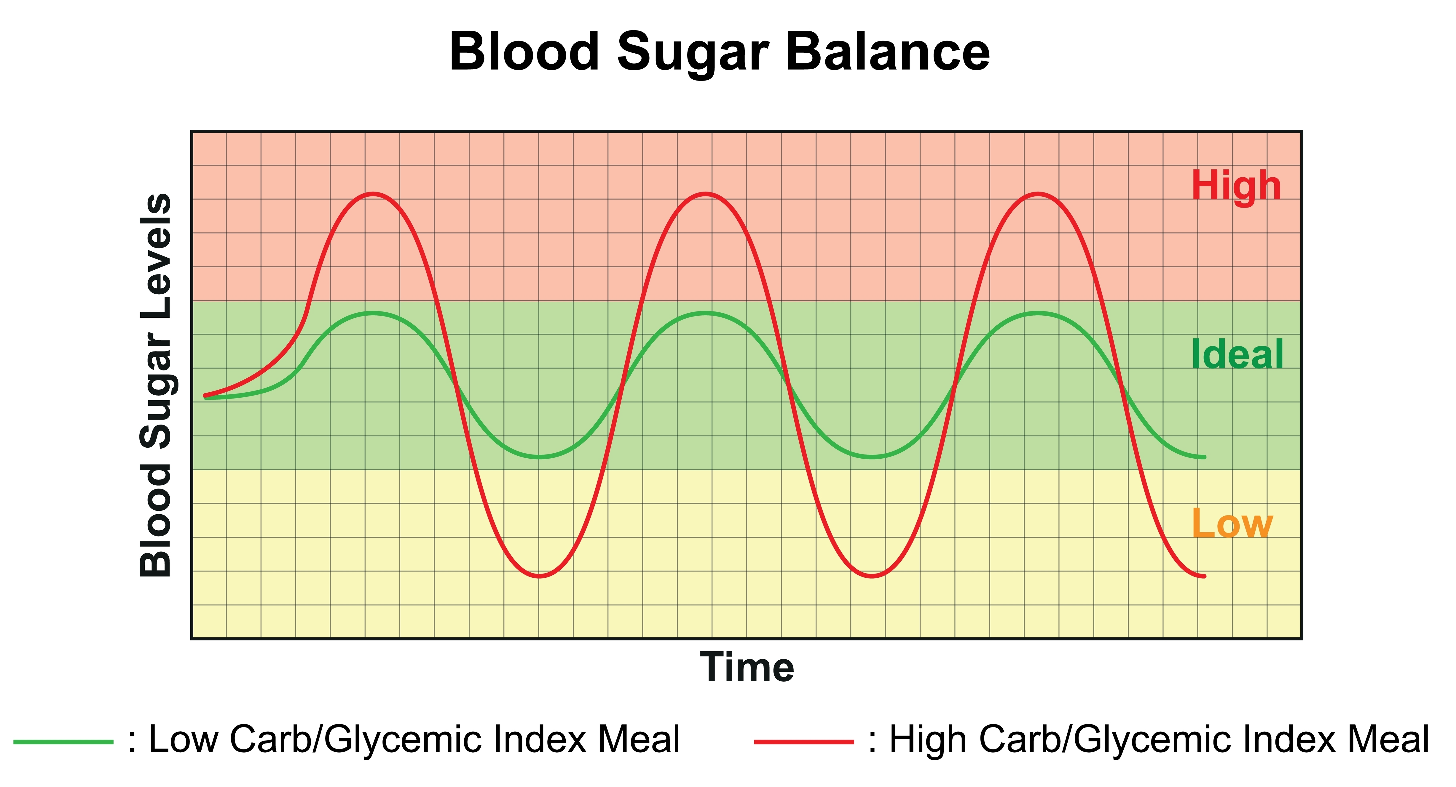
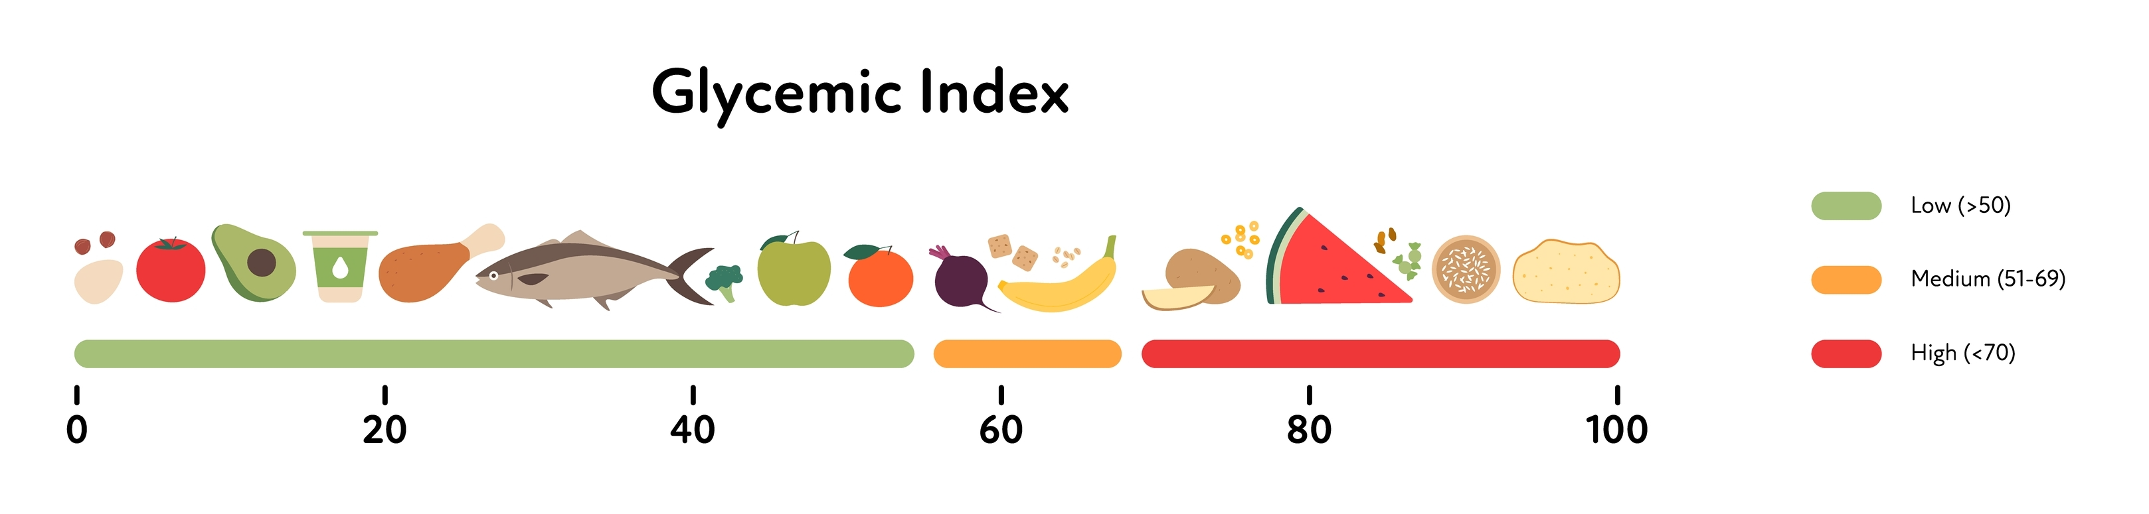
Glycaemic Index (GI)

Slide 144
Glycaemic load
Glycaemic load: A method to compare the speed an amount of glucose released from different carbohydrate foods
Calculation:
GL = (GI x amount of carbohydrate in grams) divided by 100
  Low GL – 10 or less
  Medium GL – 11-19
  High GL – 20 or higher

Slide 145
Learning task
Pair task
In pairs discuss and recap :
Glycaemic index
Low, medium and high GI foods
Glycaemic load

Slide 146
Question
What hormones control blood glucose (sugar) levels?

Slide 147
Insulin and glucagon
Produced and released in the pancreas
Insulin – signals cells to absorb glucose, reducing blood sugar levels and providing cells with glucose for energy
Glucagon – signals the liver to release stored glucose, increasing blood sugar levels to rise

Slide 148
Blood sugars
After eating carbohydrates:
Blood sugar levels increase
Insulin is released
Glucose is sent to cells
Any excess intake is stored as fat

Slide 149
Learning task
Pair task:
Discuss:
What are the benefits of maintaining stable blood sugar levels?
What are the risks associated with prolonged high blood glucose levels?

Slide 150
Blood sugars
Maintaining stable blood glucose levels is import for:
Energy regulation – stable blood sugars ensure consistent, reliable energy supply
Weight management – stable blood sugar levels help control appetite and reduce cravings
Mood stability – low blood sugar levels can lead to irritability, anxiety and mood swings, high blood sugars can lead to feeling of lethargy and frustration

Slide 151
Prolonged high blood sugar levels
Prolonged high blood sugar levels can lead to:
Insulin resistance – body cells become less responsive to insulin – this can lead to an increased risk of developing type 2 diabetes
Weight gain - high sugar intake can lead to weight gain and obesity
Cardiovascular risk – elevated blood sugars increases the risk of CVD
Metabolic syndrome – a cluster of conditions which include obesity, diabetes, high cholesterol and high blood pressure

Slide 152
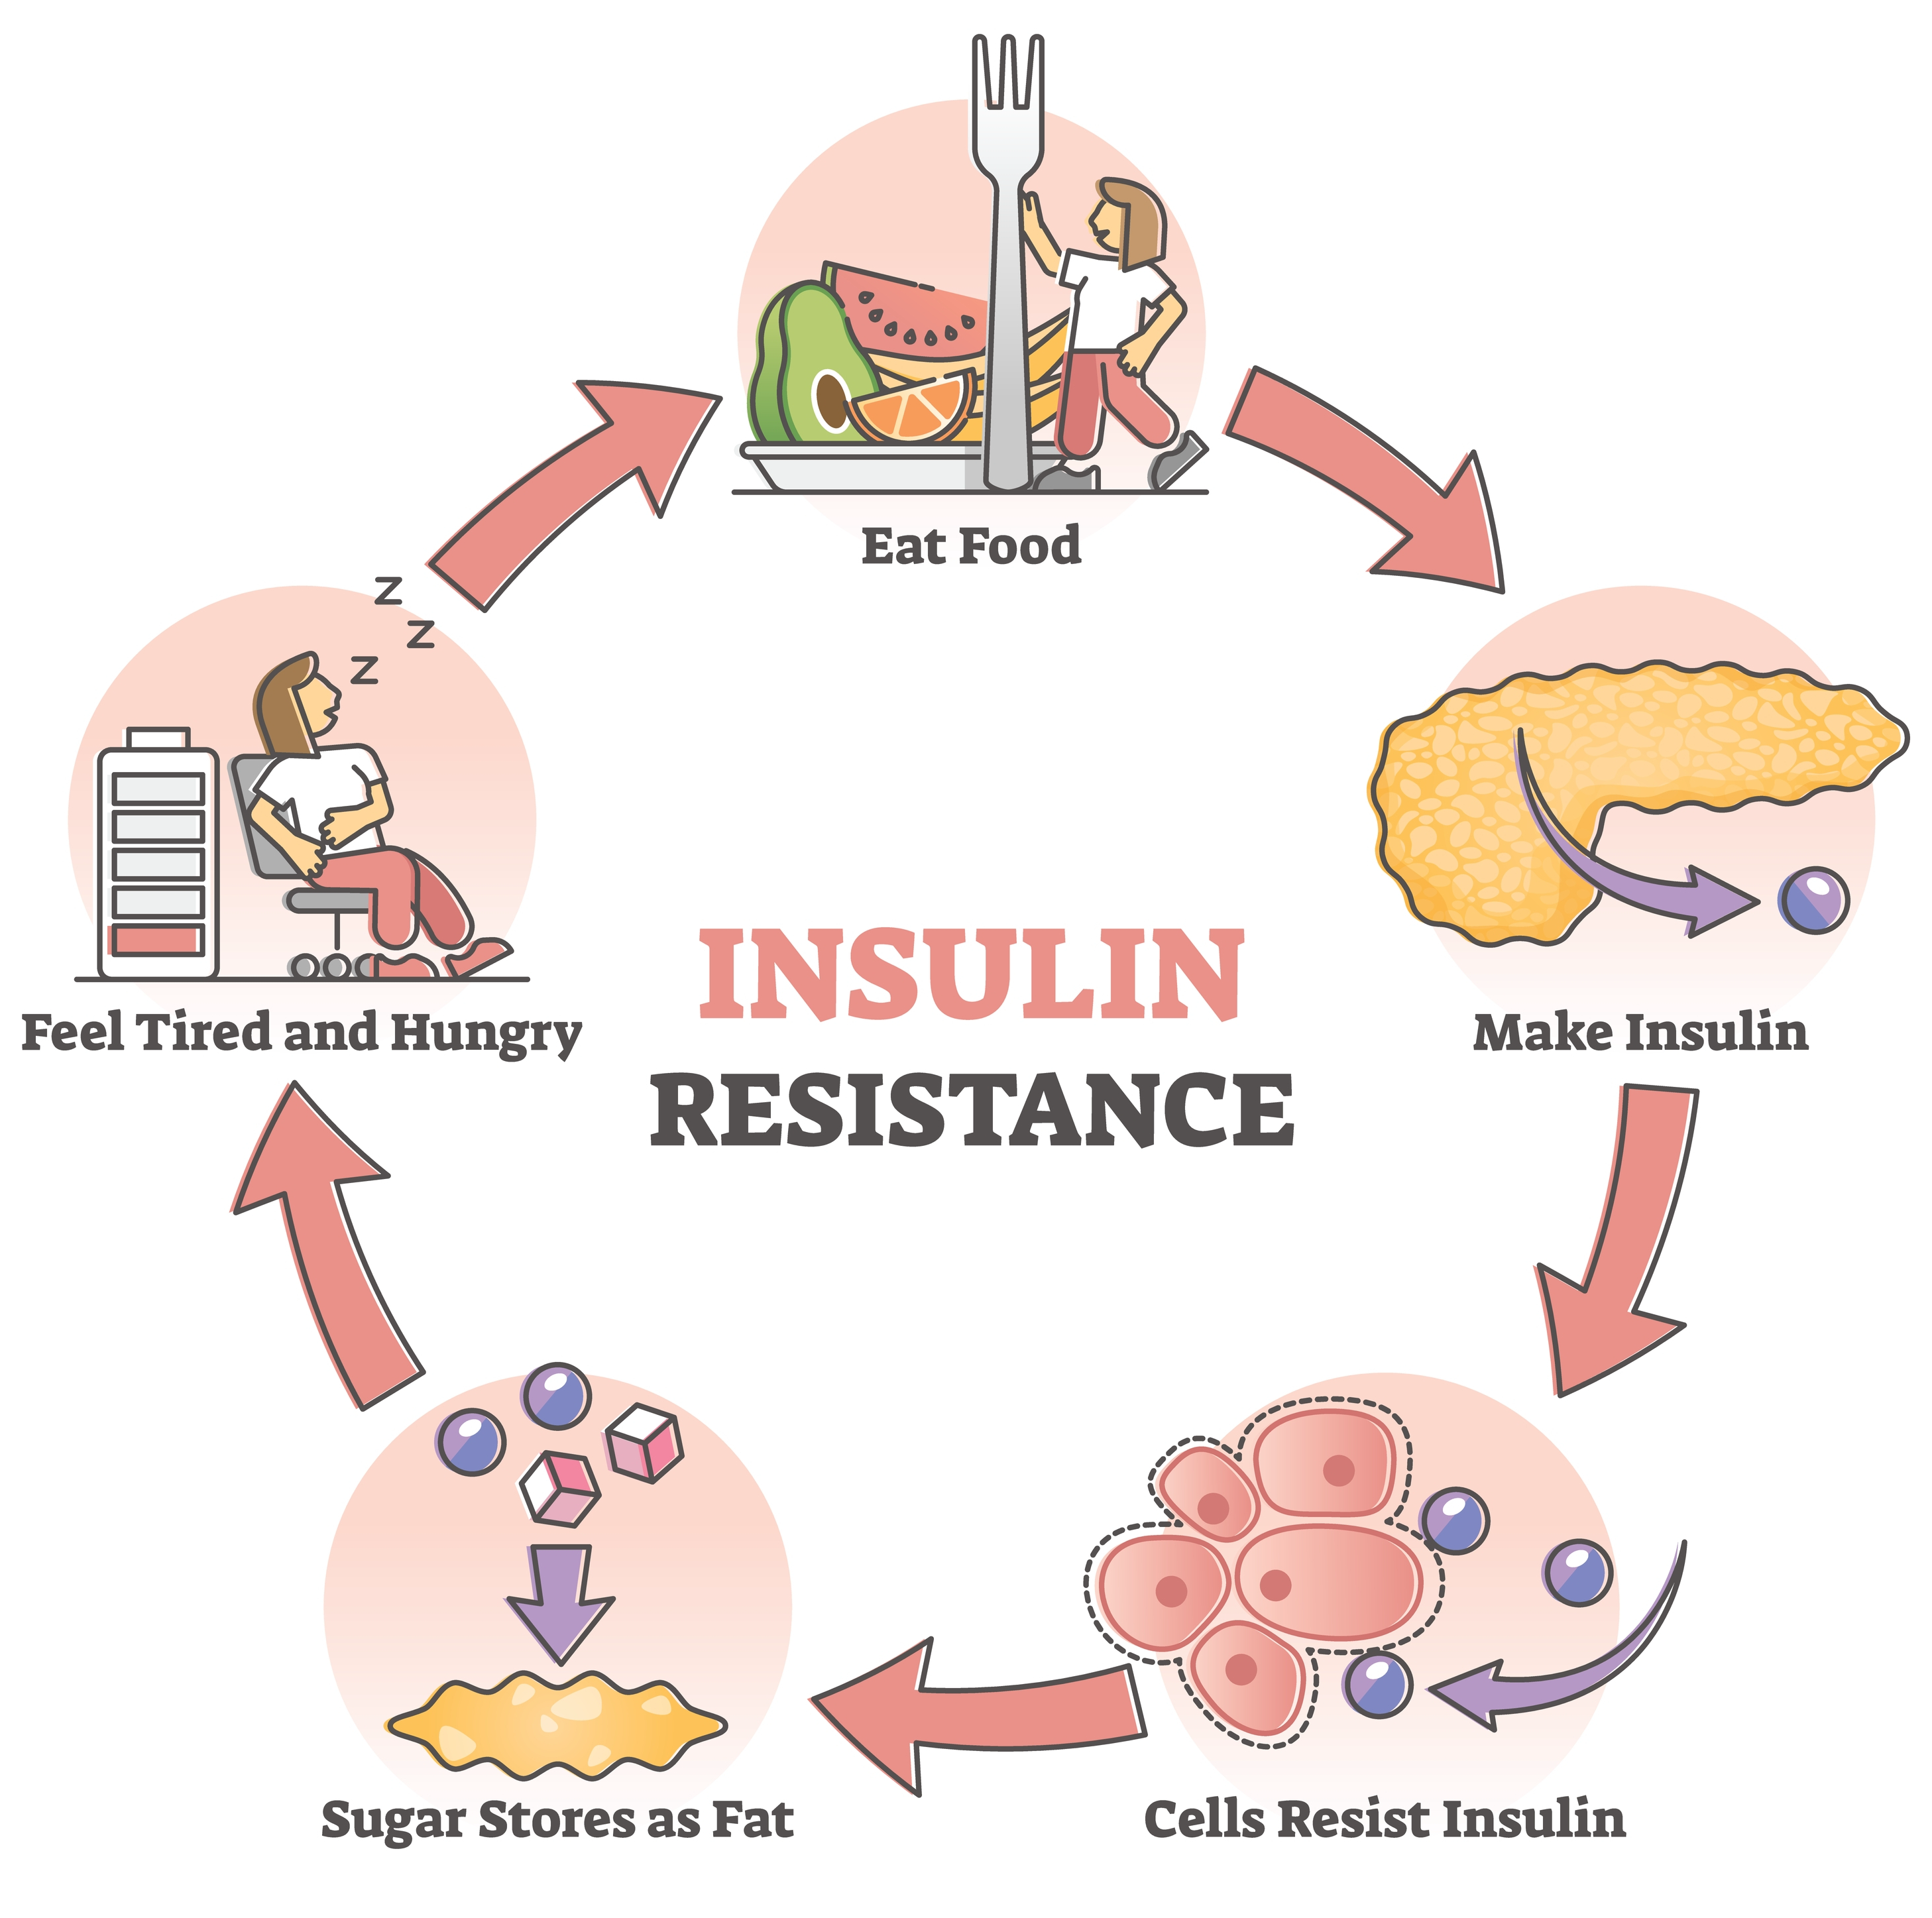
Insulin resistance

Slide 153
Diabetes
Diabetes is a chronic medical condition characterised by elevated blood sugar levels.
Type 1 diabetes – autoimmune condition which attacks the insulin producing cells in the pancreas
Type 2 diabetes – characterised by insulin resistance and a gradual decline in insulin production overtime. Genetics, lifestyle choices and obesity are contributing factors
Elevated blood sugar levels is particularly concerning for individuals with diabetes and should be monitored closely.

Slide 154
Prolonged high blood sugar levels – diabetics
Prolonged high blood sugar levels in diabetics can lead to:
Nerve damage (neuropathy) – high blood sugars can damage nerves throughout the body
Kidney damage (nephropathy) – prolonged high blood sugars can contribute to kidney damage and impaired kidney function
Eye problems (retinopathy) – damage to the blood vessels in the eyes
Foot problem – impaired blood flow to feet, increasing risk of infections and ulcers
Slow wound healing – impaired ability to heal wounds and injuries
Compromised immune function – weakened immune function, making individuals more susceptible to infections

Slide 155
Symptoms of high and low blood sugar
Symptoms of hyperglycaemia | Symptoms of hypoglycaemia
Fatigue | Shaking
Feeling thirsty | Sweating
Blurred vision | Nervousness, anxiety
Frequent and excessive urination | Irritability or confusion
Recurrent infections | Dizziness
Unintentional weight loss | Hunger
Risk of ketoacidosis or diabetic coma | Risk of seizures and coma

Slide 156
Recommendations
For health, it is recommended that an individual’s diet should be based on low glycaemic index (GI) foods in order to maintain stable blood sugars and reduce the risk of developing chronic conditions such as cardiovascular disease, diabetes and obesity.

Slide 157
Maintaining stable blood sugars
To maintain stable blood sugar levels:
Eat regular meals
Do not skip meals
Eat more lower GI foods
Drink plenty of water
Limit alcohol and sugary drinks

Slide 158
Learning outcomes
Are you able to:
Explain the glycemic index (GI)
Explain the importance of maintaining blood sugar levels
Identify the symptoms of:
  Hyperglycaemia
  Hypoglycaemia
Describe the consequences of prolonged high blood sugar levels
Describe how diet can be used to maintain blood sugar levels

Slide 159
Nutrition for physical activity and exercise.
The relationship between nutrition, physical activity, body composition and health

Slide 160
Session content
The health risks of poor nutrition and physical inactivity
The energy balance equation and weight management
Individuals and groups at risk of over and under nutrition
Cultural and religious practices that will influence nutritional advice
Recognising the signs and symptoms of eating disorders

Slide 161
Health risks
Poor nutrition and lack of physical activity can reduce the quality and quantity of years lived. Unhealthy lifestyle choices are contributory factors for many chronic health conditions including:
Overweight and obesity
Type 2 diabetes
Metabolic syndrome
Cardiovascular disease
Some cancers
Depression and anxiety

Slide 162
Learning task
Trio task:
Research your allocated medical condition and prepare to present to the group:
Definition of conditions
Risk factors for condition
Progression/ health risks of condition

Slide 163
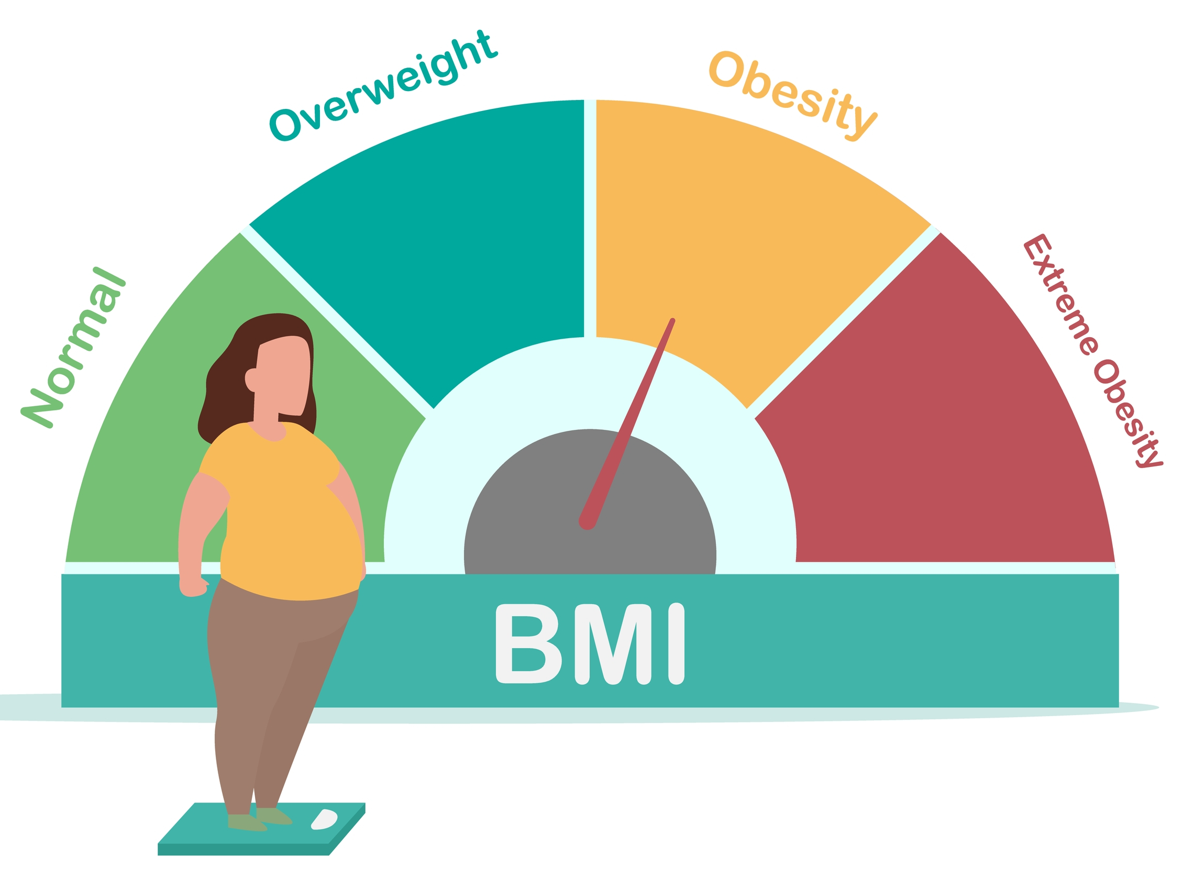
Obesity
Obesity is defined as the excessive accumulation of body fat to the extent it can have adverse effects on health
It is a complex multifactorial condition influenced by genetic, environmental, behavioral and metabolic factors.
Risk factors:
Sedentary lifestyle
Unhealthy diet
Certain socio-economic conditions

Slide 164
Obesogenic environments
The environment has a major influence on lifestyle.
Cars
TVs
Computers
Desk jobs
Long-working hours
Fast food outlets
High-calorie food
Food marketing.

Slide 165
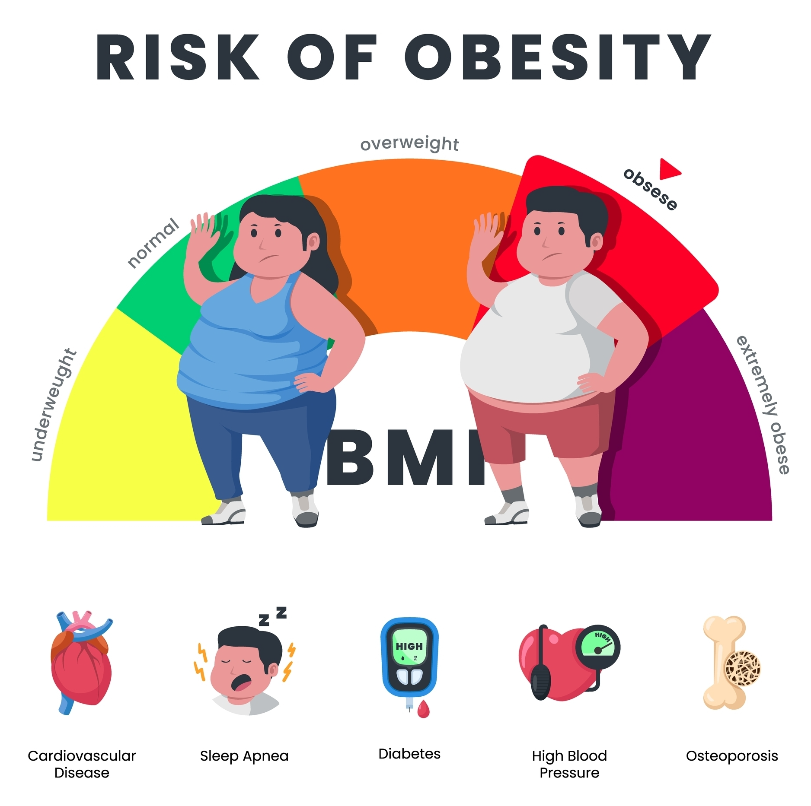
Obesity
Obesity is associated with an increased risk of developing:
CVD
Type 2 diabetes
Depression
Metabolic syndrome
Certain cancers
Gallbladder disease
Osteoarthritis and back pain
Reduced mobility

Slide 166
Type 2 diabetes
Diabetes – a condition that causes an individual's blood sugar level to become too high
Type 1 diabetes – a lifelong condition where the body’s immune system attacks and destroys the cells that produce insulin
Type 2 diabetes – characterised by insulin resistance and a gradual decline in insulin production overtime. Genetics, lifestyle choices and obesity are contributing factors

Slide 167
Type 2 diabetes
Risk factors:
Age – most people diagnosed with T2DM are over 45 years
Family history – parent or sibling with diabetes
Genetics
Obesity
Physical inactivity
Unhealthy diet – high in refined carbohydrates

Slide 168
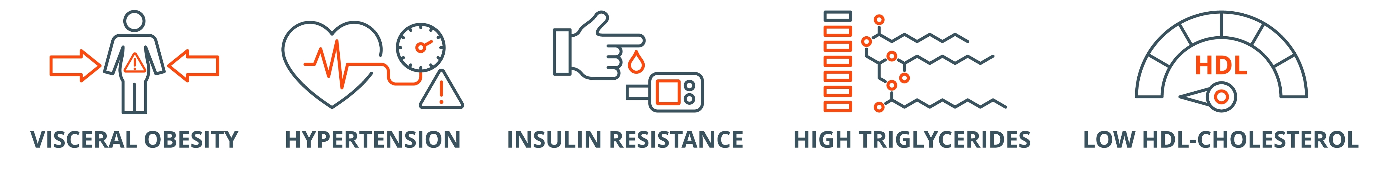
Metabolic syndrome
Metabolic syndrome is a term used to describe a cluster of conditions that occur together and increase the risk of heart disease, stroke and type 2 diabetes.
Symptoms:
Increased abdominal adiposity
Elevated blood pressure
Elevated blood sugar/ pre-diabetes
High triglyceride levels
High LDL cholesterol, low HDL cholesterol

Slide 169
Metabolic syndrome
Risk factors:
Age
Obesity
Physical inactivity
Genetics – family history of metabolic syndrome or related conditions
Insulin resistance
Lifestyle changes are the primary approach to managing metabolic syndrome

Slide 170
Cardiovascular disease (CVD)
7.6 million people in UK living with circulatory disease
~80% of people with CVD have at least one other health condition
Everyday in the UK, 460 people die for CVD
Several studies have shown an association between high fat intakes and high levels of coronary heart disease (CHD)
Many sources of fat, particularly those from animas and trans fats may cause an increase in the levels of cholesterol circulating in the blood

Slide 171
Cardiovascular disease (CVD)
Hypertension: sustained high blood pressure
Coronary heart disease: results from conditions such as atherosclerosis that causes narrowing of coronary arteries so that blood flow to the heart is reduced. In CHD the heart muscle receives inadequate blood supply.
Hyperlipidemia: elevated blood lipids (cholesterol and triglycerides)
Stroke: condition where blood flow to part of the brain is disrupted (TIA) or completely blocked

Slide 172
Cardiovascular disease (CVD)
Risk factors:
Family history
Age
Smoking
Environment
Physical inactivity
Diet e.g. high in saturated fats and cholesterol
Hypertension
Stress
Hormone replacement therapy

Slide 173
Cancer
Characterised by uncontrolled growth and reproduction of cells in a specific area of the body
Can spread to other more distal parts of the body (metastasis)
Cancer and nutrition:
Nutrition plays a key role in overall health
Can also influence the risk of developing some cancers
Diet can have a role in cancer prevention however it is important to remember it is just one aspect
Many cancers have no known link to nutrition or lifestyle

Slide 174
Cancer
Cancers with a known nutritional component:
Colorectal cancer – red and processed meats, low fibre and lacking in fruit and veg
Certain breast cancers –diets high in saturated fat and low in fruit and veg
Prostate cancer – diets high in red and processed meat, low in fruit and veg
Liver cancer – chronic alcohol consumption and obesity are risk factors
Oesphageal cancer - diets low in fruit and veg
Stomach – diets high in salted, pickled or smoked foods, low in fruit and veg
Pancreatic – diets high in red and processed meat, low in fruit and veg
Nutrition is just one risk factor for these cancers

Slide 175
Stress and anxiety
Stress: defined as a state of worry or mental tension caused by a difficult situations
Anxiety: is characterised by feelings of tension, worried thoughts, and physical changes including increases in blood pressure.
Risk factors:
Family history and genetics
Chronic stress
Trauma
Social isolation

Slide 176
Stress and anxiety
Nutrition:
Eating a balanced diet can help with managing stress and anxiety
Caffeine can make anxiety symptoms worse
Some research suggests polyunsaturated fats, omega 3 fatty acids and vegetables may help regulate cortisol levels

Slide 177
Scope of practice
Individuals with health conditions should be signposted to a dietician or registered nutritionist for dietary advice

Slide 178
Groups at risk of nutritional deficiencies

Slide 179
Undernutrition
The main symptom of malnutrition (undernutrition) is unintentional weight loss
Other symptoms include:
Reduced appetite
Lack of interest in food and drink
Feeling tired all the time
Feeling weaker
Frequent illness and taking a long time to recover
Slow wound healing
Poor concentration
Low mood, sadness and depression

Slide 180
Overnutrition
The World Health Organisation includes overnutrition in its definition of malnutrition to recognise the detrimental effects of over consumption of nutrients.
Signs and symptoms:
Obesity
High blood pressure
Insulin resistance
Heart disease

Slide 181
Groups at risk
Those most at risk of undernutrition include:
Poor and low income
Children
Chronically ill
Elderly
Those most at risk of overnutrition include:
Poor and low income
Sedentary lifestyles

Slide 182
Vitamin and mineral deficiencies
The following groups are at greater risk of deficiencies:
Iron: vegetarians, vegans, menstruating and pregnant women, pre-school children
Iodine: pregnant/ nursing mothers
Vitamin D: people with dark skin, people with little sunlight exposure, adults with osteoporosis
Calcium: young females, individuals with eating disorders, older adults

Slide 183

Cultural and religious dietary practices

Slide 184
Learning task
Pair task:
Discuss the reasons people may choose to follow specific dietary practices?

Slide 185
Reasons
There are many reasons people may choose to follow specific dietary practice:
Personal choice
Belief systems
Environmental concerns
Religious beliefs

Slide 186
Dietary practices
Vegetarians – don’t eat meat or fish, may eat eggs and dairy products.
Vegans – only eat a plant-based diet, they do not eat any animal or dairy products
Pescatarians - don’t eat meat, but do eat fish, and may eat eggs and dairy products.

Slide 187
Religious dietary practices
Islam
Only consume halal meat
Do not consume pork
During the holy festival of Ramadan will fast between sunrise and sunset
Hinduism and Buddhism
Generally follow a vegetarian or vegan diet

Slide 188
Religious dietary practices
Judaism
Only eat Kosher meat
Meat and dairy foods must not be prepared or eaten together
Sikhism
Do not eat halal or kosher meat, beef or pork, because they are not permitted to take part in religious rituals apart from those within the Sikh religion

Slide 189
Religious dietary practices
Eastern Orthodox Christianity
Weekly fasts include abstention from meat, fish, eggs, dairy and sometimes other foods such as olive oil and alcohol
Christian festivals
During religious festivals, such as Christmas and Easter, people may overindulge or chose to consume specific foods associated with these events

Slide 190
Cultural factors
Cultural factors influencing diet include:
Family and convenience
Budget and financial status
Food availability
Allergies and intolerances

Slide 191
Learning task
Trio task:
Research typical meals from a different religion or culture.
Compare one meal to the Eatwell guide & make recommendations to meet UK government recommendations.
Prepare to present findings to group

Slide 192
Eating disorders and relative energy deficiency in sport

Slide 193
Eating disorders
Eating disorders are classified as mental health conditions.
Those at most risk include teenage girls, young women and female athletes
Anyone can be affected!

Slide 194
Anorexia nervosa
Anorexia nervosa presents with with a range of mental, physical and behavioural symptoms. These may include:
Fear of gaining weight
Refusal to maintain a health weight
Excessive weight loss
Use of dieting, laxatives, purging and excessive exercise to lose weight
Eating very little and skipping meals
Excessive body measuring, weighing and calorie counting
Distorted body image
Self-esteem linked to being thin
Depression and anxiety linked with body image
Loss of menstrual cycle (amenorrhea)

Slide 195
Bulimia
Bulimia is more common than anorexia. Symptoms include:
Secretive binge eating and rapid consumption of large quantities of food in a short time frame
Purging behaviours following binges e.g. self-induced vomiting, fasting, excessive exercise, use of laxative and diuretics
Feelings of guilt, shame or remorse attached to binging or purging behaviours
Low self-esteem, self-loathing and a powerful desire to be thin
Depression
Lazy bowels
Damage to teeth, calluses on knuckles caused by self-induced vomiting
Electrolyte imbalances

Slide 196
Disordered eating
Disordered eating – term used to describe various unhealthy eating behaviours that are used to control or lose weight.
Disordered eating and eating disorders affect:
19% of male athletes
45% of female athletes

Slide 197
Relative energy deficiency in sport (REDs)
Relative energy deficiency in sport (REDs) is where there is insufficient energy intake relative to energy expenditure which results in impaired functioning
Disordered eating and eating disorders are more prevalent in those with REDs
REDs was previously known as the female athlete triad which identified three components:
Disordered eating
Irregular menstrual cycle
Low bone mineral density

Slide 198
Relative energy deficiency in sport (REDs)
Further research has identified that many more body systems are affected:
metabolic and endocrine
menstrual function and bone health
cardiovascular
growth and development
immunological
gastrointestinal
psychological

Slide 199
Relative energy deficiency in sport (REDs)
Physiological | Performance | Psychological and behavioural
Three missed periods | Persistent fatigue | Disrupted sleep
Low libido | Poor recovery | Mood changes
Digestive issues | Recurring illnesses and injury | Reduced social interaction
Poor muscle mass development | Reduced performance | Problematic relationship with food and/or training
Bean (2022)

Slide 200
Further information and support
For further information and support:
Beat – beating eating disorders
National Centre for Eating Disorders
MGEDT – Men Get Eating Disorders Too

Slide 201
Learning outcomes
Are you able to:
Explain health risks of poor nutrition and physical inactivity
Identify individuals and groups at risk of over and under nutrition
Describe cultural and religious practices that will influence nutritional advice
Identify the signs and symptoms of eating disorders

Slide 202
Nutrition for physical activity and exercise.
Hydration

Slide 203
Session content
Importance of hydration
Fluid requirements for different activities and goals
Fluid sources for optimal hydration
Sports drinks
Risks of dehydration

Slide 204
Question
What is water used for in the body?

Slide 205
Importance of adequate hydration
The body is almost two-thirds water, so it is vital water is consumed regularly to maintain health.
Functions include:
Thermoregulation
Maintaining blood plasma volume
Transport of nutrients and the removal of waste products
Maintaining cell activity and homeostasis
Supporting brain and body functioning
Maintaining joint lubrication
Supporting physical and mental performance

Slide 206
Hydration
Even without moving, you can lose 2–2.5 litres of water per day.
Water is lost in a number of ways:
  Through urine and faeces
  Evaporation from the skin as sweat
  Expired breath.
Lost water must be replaced
  Approximately 50% of fluid loss can be replaced from food
  Still essential to drink plenty of fluids.

Slide 207
Eatwell guidance – hydration guidelines
Drink 6-8 glasses of fluid every day.
Water, lower fat milk and sugar-free drinks, tea and coffee all count.
Fruit juice and smoothies count but are a source of sugar.
Sugary drinks one of the main contributors to excess sugar consumption amongst children and adults in the UK.
Alcohol contains lots of calories and should be limited.

Slide 208
Hydration – sportsperson in training
Need to drink much more than the recommended amounts
Up to 4-5 litres of water can be lost in sweat in a day
  Even more in hot environments
Excess water loss without being replaced affects
  the building of body tissues
  temperature regulation
  metabolic rate

Slide 209
Question
What are the recommendations for hydration pre, during and post exercise or event?

Slide 210
Fluid requirements and exercise
Pre-exercise or event
Aim to drink 5-10ml/kg between 2 and 4 hours before session of event
~300ml-600ml for a 60kg person
During event:
Aim to drink 400ml-800ml per hour, divided into equal amounts at around 20-minute intervals
Unlikely to be able to absorb more than 1litre per hour – sweat rates may outstrip fluid absorption leading to dehydration

Slide 211
Fluid requirements and exercise
Post exercise or event:
Aim to replace 1.5 x fluid lost in session within 2-3 hours
1 litre of fluid is equivalent to 1kg body weight
Aim to drink 750ml for every 0.5kg of body weight lost during exercise
If fluid loss is not assessed continue to drink to 400-800ml per hour

Slide 212
Factors affecting fluid requirements
The weather
Humidity
Intensity, type and duration of physical activity, exercise and sport
Individual factors including age, gender, body size

Slide 213
Question
What are the different types of sports drinks?
Which are each most suitable for?

Slide 214
Hydration – sports drinks
Sports drinks contain:
Water – to replace lost fluid
Carbohydrates – to replenish energy stores
Electrolytes – sodium, magnesium and potassium, to prevent hyponatraemia
Sports drinks are not necessary if exercise lasts less than one hour

Slide 215
Hydration – sports drinks
Isotonic drinks - contain the same concentration of electrolytes as body fluids. They rehydrate at a similar rate to water and are most useful if participation in exercise is prolonged or when perspiration levels are high, like during hot or humid weather
Hypotonic drinks - contain electrolytes and a lower concentration of sugar than body fluids. This increases the uptake of the fluid from the gut and may rehydrate at a faster rate than drinking pure water.
Hypertonic drinks - contain higher levels of sugar and may also contain electrolytes. They may support recovery after exercise and may be useful for those participating in multiple training sessions in a day, e.g. athletes

Slide 216
Key terms
Dehydration – the process of losing water
Euhydration – a state of normal hydration
Hypohydration – a state of reduced body water
Hyperhydration – a state of increased body water

Slide 217
Dehydration effects
Fatigue
Headaches
Lack of concentration
Constipation

Slide 218
Symptoms of dehydration

Slide 219
Hydration and urine colour

Slide 220
Dehydration risks
A loss of body fluids, AT:
3% - reduced blood volume, blood flow, inefficient kidney function, reduced exercise performance, dry mouth and headache.
4% - capacity for hard muscular work declines by 20–30%.
5% - heat exhaustion, requiring medical attention.
7% - physical and mental function severely affected, hallucinations.
10% - heat stroke, circulatory collapse and death.

Slide 221
Learning outcomes
Are you able to:
Explain the importance of hydration
Describe the fluid requirements for different activities and goals
Identify fluid sources for optimal hydration
Describe the different types of sports drinks
Explain the risks of dehydration

Slide 222
Nutrition for physical activity and exercise.
Impact of portion size and food preparation techniques

Slide 223
Session content
Portion size
The effects of portion size on health
Interpreting food labels
The impact of food preparation techniques on nutrition

Slide 224
How much food do we need to eat
Everyone needs different amounts of energy (or calories) to maintain a healthy weight.
If more food consumed than the body needs, they will put on weight.
The UK government recommends that adults (and children and young people over 11 years) eat no more than
  2,500 calories per day for males
  2,000 per day for females.

Slide 225
Energy balance equation
Calories (energy) taken in versus calories burned as energy (out)
Neutral energy balance - calories in are equal to calories expended.
Positive energy balance - more calories are taken in than expended - weight is gained.
Negative energy balance (energy deficit) – consuming fewer calories than the number of calories expended – weight is lost.

Slide 226
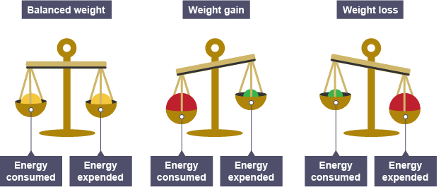
Energy balance equation

Slide 227
Energy balance
The body will remain the same weight when calorific intake equals calorific expenditure
If intake exceeds output, the excess is stored as fat weight
If output exceeds input the result is weight loss
Energy in > energy out = weight gain
Energy in < energy out = weight loss
Energy in = energy out = weight maintenance

Slide 228
Energy balance
To lose fat weight, a deficit must be achieved.
The recommended strategy is a deficit of 3,500 kcals to lose 1 lb of stored fat.
Generally, best achieved through increased physical activity and a reduction in daily consumption of calories.

Slide 229
Portion size
Portion size has a big impact on nutrient and energy intake.
Helping clients interpret and apply the evidence-based guidelines of the Eatwell guide by offering practical guidance on portion sizes is within the scope of practice of a personal trainer.

Slide 230
Learning task
Discuss with a partner what you think a portion size for each section of the Eatwell plate would be.
Use the internet to research portion sizes – the British Nutrition Foundation is a good source of information!

Slide 231
Portion size – examples
Recommended number of portions |  | Portion size
Fruit and vegetables | 5+ | One handful of fruit 3 serving spoons of veg
Carbohydrates | 3-4 | 3 small handfuls of cereal 2 handfuls of dried rice of pasta 1 baked potato around size of fist 2 slices of bread
Protein | 2-3 | Chicken breast – around the size a a hand Steak –the size palm of the palm of hand 2 handfuls of dried beans, pulses or lentils
Dairy | 2-3 maximum | Cheese – the size of 2 thumbs together One individual pot or 4 tablespoons

Slide 232
Learning task
Use the internet to look up some food labels on packaged foods
Identify the information that is contained on all the labels?

Slide 233
Food labelling
In the UK all packaged food must show the following information on the label:
The name of the food
A ‘best before’ or ‘use by’ date
Any necessary warnings, like allergens it contains
Net quantity information
A list of ingredients, listed in descending order according to weight
The country or place of origin, if required
A lot number or ‘use by’ date
Any special storage considerations
Instructions for use or cooking, if necessary

Slide 234
Food labels and food choices
Many food manufacturers and supermarkets use a traffic light system to highlight energy, fat, sugar and salt content of foods in relation to recommended daily limits.
Red = high
Amber = medium
Green = low

Slide 235
Learning task
Use the internet to look up some food labels or common foods which use the traffic light system.
Analyse each label using the traffic light system
Compare products and evaluate their healthiness

Slide 236
Food hygiene
When preparing food, it is import to:
Wash hands thoroughly
Clean surfaces where food is prepared
Clean any utensils used to chop or prepare food
Wear a head covering or tie long hair back
No coughing or sneezing near food
Make sure foods such as poultry, fish and seafood are not prepared with the same utensils or on same surfaces as other foods to prevent cross contamination.
Following basic hygiene rules ensure that the food and meals being prepared is safe to eat

Slide 237
Question
What are some healthy methods of cooking?
What are some less healthy methods of cooking?

Slide 238
Healthier cooking methods
Stir frying in a small amount of unsaturated oil
Dry frying
Oven baking
Grilling
Steaming
These methods help preserve nutrients and limit the amount of fat in foods.
Boiling vegetables can be a healthy method of cooking, but overboiling will reduce vitamin and mineral content

Slide 239
Less healthy cooking methods
Deep frying
Roasting in oil or fat
These methods increase the fat content as fat is absorbed by the food during the cooking process

Slide 240
Learning task
Trio task:
Prepare a 5–10-minute presentation suitable for use with clients which explains:
Portion sizes
How to interpret a food label
Includes healthy food preparation techniques

Slide 241
Scope of practice
Exercise professionals can support clients to lose weight or gain weight by:
Providing information about healthier eating.
Asking them to complete a food diary and discussing healthier foods and food swaps.
Offering recipe recommendations or meal ideas based on the Eatwell guide information.
Explaining the principles of energy balance
Individuals who have medical conditions or specific dietary requirements would need to be signposted to a qualified dietitian.

Slide 242
Learning outcomes
Are you able to:
Explain portion size
Describe the effects of portion size on health
Explain how to interpret a food label
Explain the impact of food preparation techniques on nutrition

Slide 243
Nutrition for physical activity and exercise.
Risks of weight loss and fad diets

Slide 244
Session content
Risks of weight loss and fad diets
Importance of communicating the risk of diets to clients
Importance of regular eating patterns for a healthy, balanced diet

Slide 245
Risks and limitation of fad diets
Fad diets are typically characterised by quick fixes and extreme calorie restrictions which have several risks and limitations including:
Lack of nutritional balance - can lead to nutritional deficiencies
Unsustainability – both physically and psychologically
Loss of muscle mass – reduces basal metabolic rate (BMR)
Focus on weight loss not health
Ineffective long term – weight lost is often regained once normal eating patterns resume

Slide 246
Health and performance implications of dieting
Some of the health and performance implications associated with dieting include:
Reduced energy
Reduced physical and mental performance.
Reduced mood
Loss of muscle mass
Hormonal changes and imbalances
Reduced aerobic capacity and muscular fitness
Increased fatigue and lethargy
Weakened immune system
Reduced self-esteem and negative body image

Slide 247
Hormones that affect appetite
Ghrelin – hormone that spikes in anticipation of food, links to circadian rhythms
Leptin – decreases appetite after a meal, associated with satiety
Maintaining a lower intake when hormones are signally the body to eat is challenging.

Slide 248
Energy restriction and hormones
Rapid weight loss can cause a decrease in:
Thyroid hormones
Testosterone
Leptin
Insulin
Insulin-like growth factor 1
And an increase in:
Catecholamines
Glucagon
Ghrelin

Slide 249
Survival mechanisms linked with dieting
Survival mechanisms linked with dieting are:
Gluconeogenesis – the break down of protein (skeletal muscle) to release amino acids into the blood stream for use as energy
Ketosis – ketone bodies are formed from stored fats to maintain blood sugar levels and fuel the brain. High ketone levels can make blood too acidic and can be fatal.
Signs of ketoacidosis include:
Excess thirst
Increased urination
Tiredness and fatigue
Headache

Slide 250
Questions
What are the short-term risks of calorie restricted diets?
What are the long-term risks of calorie restricted diets?
What are some psychological impacts of calorie restricted diets?

Slide 251
Short-term risks of calorie restricted diets
Nutritional deficiencies
Electrolyte imbalances
Dehydration
Muscle loss
Fatigue and weakness
Hormonal imbalances – insulin production, thyroid hormones and reproductive hormones
Gastrointestinal issues – constipation
Heart arrhythmias

Slide 252
Long-term risks of calorie restricted diets
Nutrient deficiencies
Reduced resting metabolic rate
Muscle loss
Hormonal changes – can affect menstrual cycle, fertility and overall hormonal health
Reduced bone mineral density – diets low in Calcium and Vitamin D
Weakened immune system
Mental health issues
Increased risk of developing eating disorders
Reduced energy levels

Slide 253
Long-term impact on hormonal and metabolic regulation
Reduced resting metabolic rate (RMR) – slows down metabolism making weight loss more challenging
Insulin sensitivity – very low-calorie diets can decrease insulin sensitivity
Reduced production of thyroid hormones which regulate metabolism
Elevated cortisol levels
Decreased reproductive hormones – can impact fertility and decrease libido

Slide 254
Psychological impact
Increased stress and anxiety
Mood swings
Social isolation – dieting can limit social interactions involving food e.g. eating out
Disordered eating patterns
Negative body image
Reduced enjoyment of food

Slide 255
Communicating health risks of extreme dieting
It is important to communicate the health risks associated with extreme dieting to clients.
When evaluating diets ask clients to consider:
Is exercise included within the recommendations?
Are all the main nutrients and food groups included?
Does the energy or calorie intake meet the minimum requirements for health?
Are individual lifestyles and needs considered?
Are there any longer-term recommendations provided for diet and exercise to encourage sustainable change?

Slide 256
Learning task
Trio task:
Research your allocated diet and evaluate based on questions below:
Is exercise included within the recommendations?
Are all the main nutrients and food groups included?
Does the energy or calorie intake meet the minimum requirements for health?
Are individual lifestyles and needs considered?
Are there any longer-term recommendations provided for diet and exercise to encourage sustainable change?

Slide 257
Health risks of diets
Very low calorie diets:
Low energy, fatigue
Nausea, headaches
Constipation or diarrhea
Lack of essential nutrients
Negative effects on mental health (low mood)
Hunger

Slide 258
Health risks of diets
Fasting:
Risk of dehydration
Lack of essential nutrients
Low energy, fatigue
Increased headaches, aches and pains, allergies, and bad breath

Slide 259
Health risks of diets
Food combining:
Erratic blood sugar levels
Very restrictive meals
May lack essential nutrients
Reduced absorption of nutrients

Slide 260
Importance of regular eating patterns
Regular healthy eating patterns can help support weight loss or weight management though:
Maintaining stable blood sugar levels
Preventing overeating
Preserving lean muscle mass
Balancing hormones
Improving energy levels
Establishing healthy habits
Reducing emotional eating
Adhering to calorie goals

Slide 261
Learning outcomes
Are you able to:
Identify the risks of weight loss and fad diets
Understand the importance of communicating the risk of diets to clients
Explain the importance of regular eating patterns for a healthy, balanced diet

Slide 262
Nutrition for physical activity and exercise.
Alcohol

Slide 263
Session content
Alcohol content and units in common measures
Calorific value of alcohol
Responsible drinking guidelines
Risks of excess alcohol

Slide 264
Units of alcohol
Units are a simple way of expressing the amount of pure alcohol in a drink
1 unit = 10ml or 8g of pure alcohol
1 unit is about the amount of alcohol an adult can process in an hour
Alcohol by volume (ABV) is a measure of the amount of pure alcohol as a percentage of total volume of liquid in a drink
Calculation:
Strength (ABV) x volume (ml) divided by 1000 = units

Slide 265
Learning task
Individual task:
Calculate the number of units of alcohol in the following drinks:
Glass of wine – 175ml, 12%ABV
Shot of vodka – 25ml, 40% ABV
Pint of lager – 5.2%ABV
Calculation
Strength (ABV) x volume (ml) divided by 1000 = units

Slide 266
Alcohol content
– common drinks

Slide 267
Alcohol – energy
7 kcal per gram
No nutritional value

Slide 268
Responsible drinking guidelines
The UK guidance for lower risk drinking for men and women is:
A maximum of 14 units of alcohol a week.
Spread these evenly over 3 or more days.
Have a few drink-free days each week.

Slide 269
Risks and prevalence of excess alcohol consumption
Alcohol Concern’s (2016)
more than 9 million people in England drink more than recommended daily limits.
excess alcohol use causes 10% of the UK’s disease and death.
one of the three biggest lifestyle risk factors for disease and death in UK (after smoking and obesity).
estimated 7.5 million people unaware of damage caused by excess alcohol.

Slide 270
Question
What are the risks of excessive alcohol?

Slide 271
Risks of excess alcohol
Regularly drinking more than 14 units a week for 10-20 years, increases risk of:
Brain damage
Cancers of the mouth, throat and breast
Damage to the nervous system
Heart disease
Liver disease
Stroke

Slide 272
Risk of excess alcohol
Physical | Psychological
Cardiovascular disease (coronary heart disease, heart attack and stroke) | Alcohol dependence and addiction
Cirrhosis of the liver | Alcoholic psychosis
Depression and anxiety | Anxiety
High blood pressure | Depression
Osteoporosis | High stress levels
Pancreatitis | Dementia
Reduced fertility | Risk of suicide
Risk of falls | Inability to function in daily activities
Stomach ulcers | Inability to hold down a job
Various cancers | Anger issues
Weight gain | Paranoia

Slide 273
Session content
Are you able to:
Describe alcohol content and units in common measures
State the calorific value of alcohol
Identify UK responsible drinking guidelines
Identify the risks of excess alcohol

Slide 274
Nutrition for physical activity and exercise.
Supplementation

Slide 275
Session content
Scope of practice
Evidence and limitation of supplements and performance aids

Slide 276
Question
What is scope of practice?
What advice do you think you can give clients on supplementation within your scope of practice?

Slide 277
Scope of practice
Advising or recommending the use of supplements or performance aids would exceed your scope of practice
Clients seeking recommendations on the sure of supplements or performance aids should be signposted to a qualified dietician or registered sports nutritionist.
Promoting or selling supplements or performance aids within the workplace could be a conflict of interest and result in disciplinary action
Providing guidance on the limitations and risks associated with some supplements and performance aids, is within your scope of practice, and may help clients make informed choices

Slide 278
Question
What are some examples of supplements and performance aids?

Slide 279
Supplements and performance aids
Examples include:
Vitamins and mineral supplements
Herbal remedies
Meal replacement products
Fat-loss supplements
Ergogenic (performance enhancing) aids

Slide 280
Learning task
Pair task:
Research your allocated supplement and/or performance aid.
What is the product claiming to do ?
What evidence is there to support this claim?
What are the risks/ limitations of this product?

Slide 281
Key issues
Unregulated industry – there is no guarantee that claims made on label are accurate or evidence-based
Much research to support the effectiveness of supplements has been funded by manufacturers and published in low-quality journals
Some supplements contain substances banned in competitive sports including stimulants, steroids or steroid precursors

Slide 282
Vitamin and mineral supplements
Most vitamin and mineral supplements are approved for general population
May be some benefits for supporting a restricted diet or intense training programme
Sourcing nutrients from natural food is always preferable.

Slide 283
Fat burners
Most fat burning supplements contain caffeine and green tea extract, and may elevate metabolism slightly, but have not been shown to have any significant impact on weight loss
Some contain other chemicals which have more serious side effects including muscle loss and death if stated doses are exceeded

Slide 284
Protein supplements
Most people, including regular exercisers, can get adequate protein through a balanced diet
Supplementation may be beneficial if:
  Individuals are regularly failing to meet their required protein intake
  The demand of the sport or discipline requires a high protein intake that is hard to meet through food alone e.g. body building, strength athletes
  Individuals are struggling to eat adequate protein due to dietary restrictions e.g. vegans and vegetarians

Slide 285
Ergogenic aids
Ergogenic aids are substances that are believed to enhance and improve performance
Some have a strong evidence base, but most do not.
Some contain banned substances that have been linked with kidney failure, seizures, stroke and death

Slide 286
Caffeine
Caffeine is a stimulant that can improve performance
Benefits:
  Increases alertness
  Alters perception of effort of fatigue by increasing endorphins
  Increases fatty acid oxidation and may help preserve glycogen stores
Side effects:
  Anxiety
  Shaking
  Diuretic – may cause dehydration

Slide 287
The risks of excessive caffeine

Slide 288
Question
What are the risks of excessive caffeine?

Slide 289
Risks of excessive caffeine
Caffeine is mildly addictive - one of the world’s most widely used drugs
Caffeine is found in:
Coffee
Tea
Cola-based drinks
Energy drinks
Chocolate
Diet pills
Recommended caffeine should be limited to 400mg per day

Slide 290
Risks of excessive caffeine
Caffeine can have a positive effect and has many benefits in the short-term:
feel alert
boosts mood.
Other short-term effects:
Dizziness and light-headedness
Jitters and shakiness
Nausea
Rapid heart-beat

Slide 291
Risks of excessive caffeine
Limited to no more than 400mg per day:
4-6 instant coffees
6-8 cups of tea
3 shots of espresso
Avoid caffeine after 10pm as it takes about 10 hours for caffeine to leave system so can affect sleep quality.
Other effects of caffeine:
Interferes with iron absorption (avoid at mealtimes for risk of iron deficiency)
Stimulates central nervous system (increasing heart rate and blood pressure)
Stomach irritation (causing headaches and insomnia).

Slide 292
Learning outcome
Are you able to:
Explain your scope of practice relating to giving advice on supplements and performance aids
Describe the evidence and limitation of different supplements and performance aids

Slide 293
Nutrition for physical activity and exercise.
Nutritional terminology and healthy eating guidelines
-

