Slide 1
Group training methods and protocols
Planning and instructing group training sessions

Slide 2
Aims and objectives
By the end of the session, you should be able to:
Use appropriate exercises and movement patterns to accommodate different clients’ needs
Explain how small equipment can be incorporated into group training sessions, for example, dumbbells, barbells, resistance bands, plyo box, foam rollers, tyres and battle ropes
Instruct a safe and effective warm-up
Instruct a safe and effective cardiovascular component
Instruct a safe and effective muscular fitness component
Instruct a safe and effective cool-down component
Monitor exercise intensity
Monitor exercise safety
Adapt or modify exercise, as appropriate, to accommodate clients’ needs
Record a session in the appropriate format
Use appropriate language and tone that are clear

Slide 3
Aims and objectives
By the end of the session, you should be able to:
Recognise a safe and effective session structure
Identify safe and effective exercises/equipment for inclusion in group training sessions
Select safe and effective exercises that will challenge all components of the session and that will meet the clients’ goals, needs and abilities
Plan a safe and effective group training session to meet clients’ needs and incorporate different components of fitness
Plan adaptations and modifications to regress, progress and accommodate different clients’ needs
Use appropriate techniques and communication skills
Use the appropriate instructional and coaching methods to support the client’s performance

Slide 4

Group training methods and protocols
There are a number of training methods and protocols available that can be added to give a group exercise session variety.
These training methods and protocols allow the instructor to plan specifically for the class participants and goals.
Paired activity:
List as many group training methods as you can.
You have 3 minutes!
Get ready to
feed back.

Slide 5
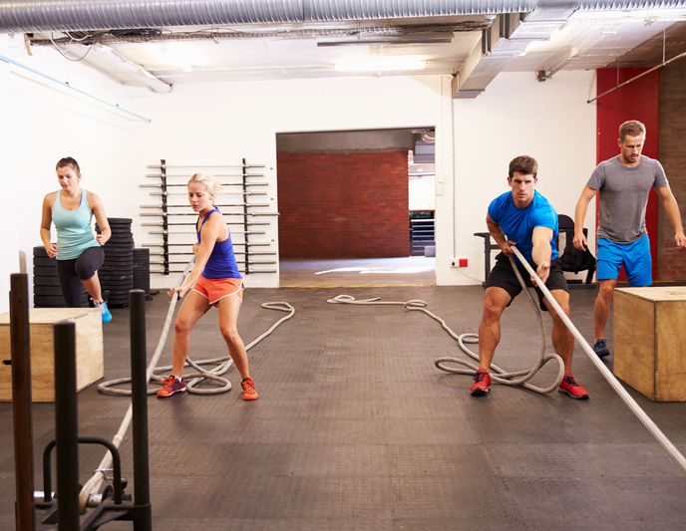
Training method examples
There are number of training methods available to the group training instructor. These include:
Circuits.
Aerobic intervals.
Steady-state cardio.
HIIT.
Tabata.
EMOM.
Pyramid/ladder.
AMRAP.

Slide 6

Circuit training
Circuit training involves performing a series of exercises in an order called a circuit.
Each activity takes place at a ‘station’ and equipment can be used to provide variety.
What are the benefits of a circuit-based class?
Write up all ideas and present to the class.

Slide 7
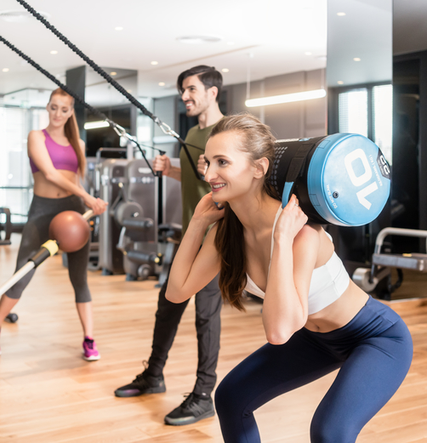
Benefits of circuits
They can be designed with a variety of goals in mind, for example, to improve speed, agility, coordination, balance and muscular endurance.
Each participant exercises at a station on their own at their own pace.
It can be completed with or without music.

Slide 8
Example circuits session
Goal | Exercise | Time/intensity | Rest | Sets
Strength endurance | DB squat Press-up Lunge BB bent-over row Battle rope wave Ab curl | 30 seconds @ 8RPE | 60 seconds | 3

Slide 9

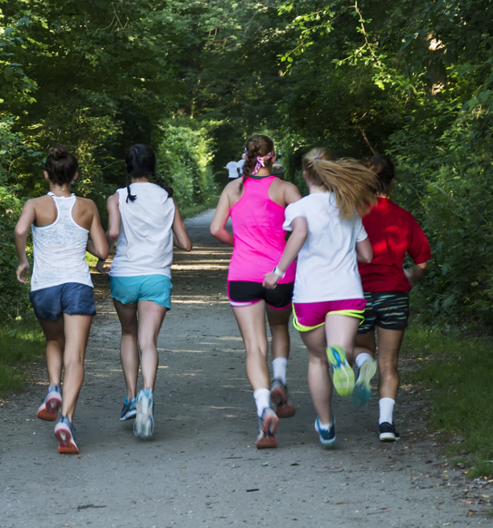
Intervals
This method involves introducing a short, extra-intense burst of exercise intermittently throughout a regular, steady aerobic routine.
Task: With a partner, discuss the benefits of this method of training and feed back to the group.

Slide 10
Benefits of aerobic intervals
This technique causes the body to burn calories at a higher rate than it would during a workout consisting of a constant, steady exertion.
Aerobic intervals can break up the potential boredom of continuous, steady-state training.
Goal | Exercise | Time/intensity | Rest | Sets
Endurance | Walk/light jog Fast jog | 3mins @ 7RPE 1min @ 8+ RPE | None | 5

Slide 11

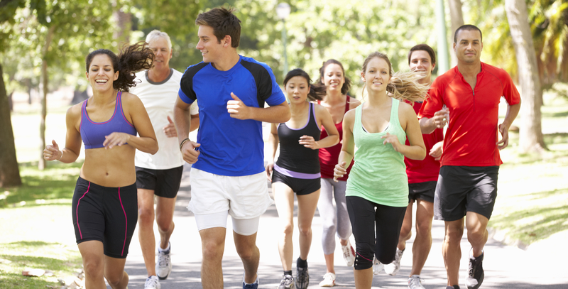
Steady-state training
This method is a cardio workout that involves a continuous, steady effort.
It is ideal for a mixed-ability group session and for participants who are focused on gaining or maintaining a base level of cardiovascular fitness.
Therefore, it is great for participants with an endurance-based goal.

Slide 12
HIIT
High-intensity interval training (HIIT) is a system of organising CV training into repeated bouts of short-duration, high-intensity exercise intervals, intermingled with periods of lower-intensity intervals of active recovery.
HIIT can include outdoor activities such as running or cycling, or using equipment such as treadmills, elliptical runners, stair-climbers or stationary bikes.
What are the benefits of HIIT training?
Write up all ideas and present to the class.

Slide 13
Benefits of HITT training
HIIT training protocols create challenging work rates such as sprints (whether on a bicycle or running) for short time frames lasting from 20 to 60 seconds.
Participants can alternate between high- and low-intensity exercise(s) or between high-intensity exercise and a short period of rest. For example, a short sprint up a flight of stairs followed by a walk back down, or a set of burpees followed by bodyweight rows, are examples of interval training.
There are many HIIT protocols, which can combat boredom and plateau.

Slide 14
Example of a HITT session
Goal outcome | Exercise | Time/intensity | Rest | Set
Strength/endurance | Press-ups Squats Heel to bum (jog on spot) Tricep dips Side lunge | 45 secs @8RPE 45 secs @8RPE 45 secs @8RPE 45 secs @8RPE 45 secs @8RPE | 15 seconds after each exercise | 3

Slide 15
Tabata
This is a form of high-intensity interval training, designed to increase the heart rate.
It challenges the anaerobic training zone for short periods of time, and therefore all of the energy systems are trained.
An example of the Tabata protocol would be:
20 seconds of very high-intensity exercise (e.g. sprints, burpees, squat jumps) followed by 10 seconds of rest.
This is repeated eight times for a total of 4 minutes.

Slide 16
EMOM
EMOM stands for ‘every minute, on the minute’.
This involves a specific set of movements or exercises every minute, then rest once the set has been completed until the end of the minute.
When the next minute begins, the set of movements of exercises starts again.
What are the benefits of EMOM training?
Write up all ideas and present to the class.

Slide 17
Benefits of EMOM
Increases muscular strength and endurance.
Teaches people to understand proper pacing for different movements, which can be useful for training for specific sports.
It is a very time-efficient style of training.
It can teach people to focus on improving technique while under duress.
Depending on the goal or sporting focus of the group, EMOM training can be practised with any movements and weights. For example, when the focus and goal are on cardiovascular endurance, higher reps and lower weights should be used. When the focus is on strength endurance, lower reps and heavier weights should be used.

Slide 18
Example of an EMOM session
Goal outcome | Exercise | Time/intensity | Rest | Sets
Strength/endurance | Press-ups DB lunges DB squats Battle ropes waves Squat thrusts | 20 reps @8 + RPE 20 reps @8 + RPE 20 reps @8 + RPE 20 reps @8 + RPE 20 reps @8 + RPE | No rest | 3

Slide 19
Pyramid or ladder
This involves performing an exercise, for a particular rep number, and then working down from the initial rep number to 1 rep, for example, 12, 10, 8.
This method is designed to achieve muscle fatigue.
This type of training can be employed as an upwards or downwards sequence in weights or reps.
Task: Working within a small group, provide an example to show the following types of pyramid:
  Descending.
  Ascending.
  Triangle.

Slide 20
Benefits of pyramid and ladder
The benefits of using the pyramid and ladder method are:
It works across all the energy systems in one workout.
It can increase muscular strength and hypertrophy very effectively.
It helps to avoid training plateau by adding in several different training stimuli.
It helps to focus on specific numbers, which can help to maintain the focus and attention of the participants.

Slide 21
Example of a pyramid session
Goal outcome | Exercise | Time/intensity | Rest | Set
Strength | BB squat DB row DB lunge BB overhead press | 10/8/6/4 reps @ 8+RPE 10/8/6/4 reps @ 8+RPE 10/8/6/4 reps @ 8+RPE 10/8/6/4 reps @ 8+RPE | 45 secs 30 secs 15 secs | 1

Slide 22
AMRAP
There is a dual meaning to AMRAP:
As many reps as possible.
As many rounds as possible.
AMRAP is a strength and conditioning training technique. The goal is to perform as many repetitions of an exercise movement as possible, or ‘rounds’ of multiple exercises.
AMRAP may also specify a time frame in which the work must be completed.

Slide 23
Benefits of AMRAP
You can AMRAP anything!
With heavier weights or larger amounts of resistance, there will be more of a strength-building focus. With lighter weights it will significantly stress the cardiovascular system. Body-weight exercises, such as press-ups, pull-ups or squats could also be used.
The nature of AMRAP means that the weight or resistance is sub-maximal, meaning that the method will not develop maximum strength and the focus is on muscular endurance.20 reps @8 + RPE

Slide 24
Example of AMRAP
Perform ‘as many reps as possible’.
Goal outcome | Exercise | Time/intensity | Rest | Sets
Strength/endurance | BB deadlift Press-ups Kettlebell clean Suspension body row | 60 secs @ 8+ RPE 60 secs @ 8+ RPE 60 secs @ 8+ RPE 60 secs @ 8+ RPE | 30 secs | 4

Slide 25
Group session
Part A – the tutor demonstrates an exemplar group workout, including:
A circuit session.
A HITT session.
Part B – in pairs, devise a 2-minute group training exercise session, including two group training protocols/methods.
Part C – each pair to teach their planned session to the group. Partner A will teach one group training protocol and then Partner B will teach the remaining method. The pairs must demonstrate appropriate, simple, clear, jargon-free teaching points to ensure clear instruction when presenting to the groups. On completion, the learners will receive tutor, as well as peer, feedback.

Slide 26
Learning review
Can you now:
Recognise a safe and effective session structure?
Identify safe and effective exercises/equipment for inclusion in group training sessions?
Select safe and effective exercises that will challenge all components of the session and that will meet clients’ goals, needs and abilities?
Plan a safe and effective group training session to meet clients’ needs and incorporate different components of fitness?
Plan adaptations and modifications to regress, progress and accommodate different clients’ needs?
Use appropriate techniques and communication skills?
Use the appropriate instructional and coaching methods to support clients’ performance?

Slide 27
Learning review
Use appropriate exercises and movement patterns to accommodate different client needs?
Explain how small equipment can be incorporated into group training sessions, for example, dumbbells, barbells, resistance bands, plyo box, foam rollers, tyres and battle ropes?
Instruct a safe and effective warm-up?
Instruct a safe and effective cardiovascular component?
Instruct a safe and effective muscular fitness component?
Instruct a safe and effective cool-down component?
Monitor exercise intensity?
Monitor exercise safety?
Adapt or modify exercise, as appropriate, to accommodate clients’ needs?
Record a session in the appropriate format?
Use appropriate language and tone that are clear?

