Slide 1
Instructing skills
Planning and instructing group training sessions

Slide 2
Learning objectives
By the end of the lesson you will be able to:
Use the appropriate instructional methods, techniques and communication skills to greet clients, build a rapport and gather information and check readiness to exercise
Provide appropriate advice and guidance in response to the information gathered
Use the appropriate instructional and coaching methods to support clients’ performance
Use the appropriate music for components, where applicable, for example, genre, speed and volume
Explain the appropriate health and safety considerations to a group of clients
Monitor exercise intensity
Monitor exercise safety

Slide 3
Learning objectives
Use motivation techniques that are appropriate to clients’ questions
Use appropriate language and tone that are clear, encouraging and support clients’ goals
Select appropriate types of music for the group training session
Respond accurately and appropriately to clients’ questions

Slide 4

Skills and qualities of a group training instructor
In pairs, make a list of the essential and desirable skills and qualities of a good group exercise instructor.

Slide 5
Skills and qualities of a group training instructor
Approachable and friendly.
Effective communication and instruction skills.
Good posture and technique.
Professional appearance.
Sound knowledge.

Slide 6
Safe and effective session structure
As a group exercise instructor you must ensure that the session is safe and effective; therefore, you must consider the following:
Exercise prescription and programming
Exercise adaptations
Pre-class set-up
Safe and effective
Pre-class Screening
Positioning
Class introduction

Slide 7
Pre-class set-up
In a small group, compile a list of checks (minimum of four) that the group training instructor should conduct prior to the session beginning.

Slide 8


Pre-class set-up
Head mic check.
Music system and sound check.
Equipment requirements.
Range of equipment, including different weights.
Space available.
Spillages.
Lighting.
Air conditioning.
Fire exits clear.
Ceiling height.

Slide 9
Pre-class screening
The purpose of pre-class screening is to check readiness to exercise and for the group trainer to understand if there are any contra-indications.
The best time to carry out pre-class screening is at the entrance to the group training area, prior to the class beginning.
This should be done individually prior to the start of the class and again at the start of the class, addressing the whole group.
For example:
  ‘Are there any injuries, contra-indications, conditions or pregnancies that I should be aware of, or is there anything else that I should be aware of before we start? Please raise your hand and I will come to you.’

Slide 10
Pre-class screening
Be aware of your body language and facial expressions when greeting customers.
Make them feel welcome and comfortable about approaching you if they have something they need to inform you about.
Once the verbal pre-class screening question has been asked, it is important to have an answer that doesn’t appear to dismiss the injury or condition and that some guidance is given.
Show empathy.
Ensure the pre-screening and information-gathering at the start of the class lasts no longer than 2–3 minutes.
Communicate clearly and directly with customers if they need to inform you of something, and avoid long conversations that take up too much time.

Slide 11

Class introduction
The session may be full of regular participants and there is a likelihood that there will be a small number of newcomers.
It is imperative that the first minute of the session begins with a quick informative overview of the class so that participants can visualise the session structure and flow.
What do you think you should include in the session introduction?
Discuss with a partner and feed back to the group.

Slide 12
Session introduction
Introduce yourself and the class title.
Give a brief overview of the planned session.
Check for new participants.
Check the group’s health status.
Ask if there are any questions.
For example:
Welcome to this 30-minute circuit class. I am [say your name] and I’ll be your trainer today. I have asked each of you about injuries or other conditions, so I am aware of those that may require some further support today. Could I check if there is anything else I should be aware of from people who have just arrived?
Is there anyone new to this class? [Welcome newcomers if you haven’t already met them.]
The session is split into five rounds. First, we’ll warm up for 5 minutes where you are currently standing and we’ll be using your bodyweight only.
Any questions? [Pause and observe group.]
Are you ready to begin? [Ensure you get a response.]
Let’s do this!

Slide 13
Coaching method – ICM
Instruct
C
Communicate
I
M
Motivate

Slide 14
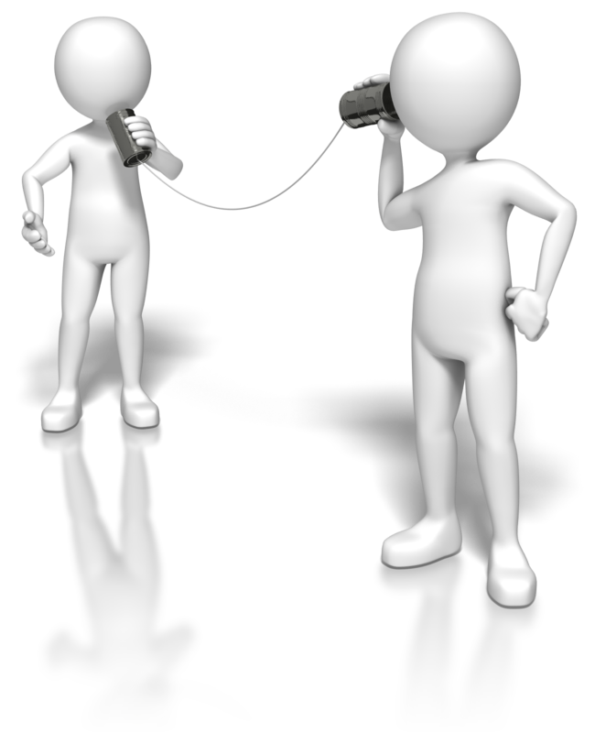
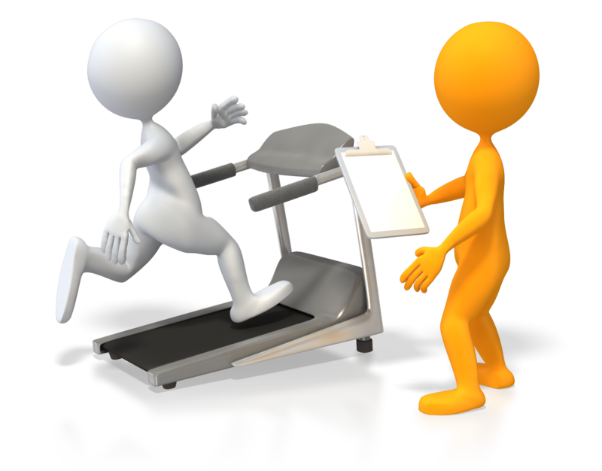
Communication skills
        Verbal communication
          Instructions and explanations.
          Motivational language.
          Voice tone and projection.
          Teaching points.
        Visual communication
          Body language and facial expressions.
          Demonstrations and technique.
          Posture and alignment.

Slide 15

Communication
In a group training session it is important that the instructions given are:
Clear.
Concise.
Consistent.
Cued.
In small groups provide examples of how your communication will meet the 4 Cs.

Slide 16

Motivating clients
Positive and constructive language.
Accentuate the positive.
Reinforce good technique.
Use encouraging phrases:
  To improve technique.
  To push through difficult exercises.
Examples include:
‘Good job.’
‘Two more and you can all do it.’
‘Keep your form.’
‘You’re nearly there.’

Slide 17
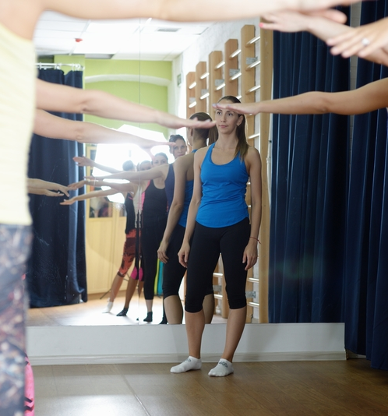
Positioning
Unlike one-to-one training, where the attention is on one person, a group training instructor must be aware of everyone in the class.
Positioning must change throughout the session in order to see everyone at different points in the class, while not impeding any movement.
The technique of those at the back, as well as those at the front, sides and middle, must be considered.
If the exercise moves around the room you must ensure you are positioned out of the customers’ path and in a position where you can interact with the majority.

Slide 18


Positioning top tips
Choose safe spots to stand in to be aware of the whole class.
Move position to get a different perspective and interact with others.
While moving, don’t impede participants’ movement.
When coaching, be on a level with participants (e.g. come down to their level while correcting/praising a plank).

Slide 19

Key instruction points
Be positive.
Concentrate on what needs to be done, rather than what needs to be avoided.
Use simple terminology – avoid jargon.
Use precise instructions.
User-friendly language.
Be easy to understand.
Clear and audible voice.
Interesting tone.

Slide 20

Music
Music can have an impact upon a group training session.
In pairs, compile a list of ‘pros’ and ‘cons’ regarding the use of music.
Consider the genre, speed, etc.
Note your findings and feed back to the class.

Slide 21
Music
Music married with movement has been used in many cultures over centuries for enjoyment, to feel a sense of connection and for personal expression. In this way, music has the power to inspire, transform an atmosphere and change moods.
However, there are many ‘pros’ and ‘cons’ to be mindful of:
Pros | Cons
Atmosphere. Sense of connection. Mood changer. Provides a focus. Provides speed/rhythm to work to. Increases energy. Increases enjoyment. Supports movement pattern. | Lyrics of songs can produce emotions/feelings. Volume can be too loud. Different taste in music. Choice of music could be too fast/too slow.

Slide 22

Group session – tutor demo!
The tutor demonstrates an exemplar group workout, including verbal screening, health and safety introduction, warm-up, main session and cool-down, using the coaching method ICM and positive instructor skills.
In pairs, devise a 15-minute group exercise programme and discuss appropriate, simple, clear, jargon-free teaching points to ensure clear instruction when presenting to clients.

Slide 23
Learner demonstration – tutor feedback
Each paired group should now have a 20-minute session planned.
Using the experience of the tutor’s demonstrations, each paired group is to teach their sessions to all group members.
Ensure that you:
  Include verbal screening, health and safety introduction.
  Demonstrate a warm-up, main session and cool-down.
  Use a logical coaching method, for example, ICM and positive instructor skills.
Finally, use simple, clear, jargon-free teaching points to ensure clear instruction when presenting to the group.

Slide 24
Learning review
Can you now:
Use the appropriate instructional methods, techniques and communication skills to greet clients, build a rapport and gather information and check readiness to exercise?
Provide appropriate advice and guidance in response to the information gathered?
Use the appropriate instructional and coaching methods to support clients’ performance?
Use the appropriate music for components, where applicable, for example, genre, speed and volume?
Explain the appropriate health and safety considerations to a group of clients?
Monitor exercise intensity?
Monitor exercise safety?

Slide 25
Learning review
Can you:
Use motivation techniques that are appropriate to clients’ questions?
Use appropriate language and tone that are clear, encouraging and support clients’ goals?
Select appropriate types of music for the group training session?
Respond accurately and appropriately to clients’ questions?

