Slide 1
Lesson 1 – Planning group-training-based sessions
Planning and instructing group-training-based exercise

Slide 2
Learning objectives
By the end of the lesson you will be able to:
Recognise a safe and effective session structure
Identify safe and effective exercises/equipment for inclusion in a group training session
Describe how to adapt and modify exercises and equipment to regress, progress and accommodate different client needs
Describe the purpose of a warm-up and cool-down
Describe the appropriate exercises for inclusion in a warm-up and cool-down
Describe the purpose and benefits of cardiovascular exercise
Describe the purpose and benefits of muscular fitness and resistance exercises

Slide 3
Learning objectives
By the end of the lesson you will be able to:
Explain the purpose and benefits of flexibility exercises
Describe the appropriate exercises to improve the different components of fitness within a group training session
Describe the different methods for monitoring exercise intensity
Select safe and effective exercises for all components of the session, which meet the client’s needs, goals and abilities
Plan adaptations and modifications to regress, progress and accommodate different client needs
Explain how small equipment can be incorporated in a group training session
Identify the different ways of using music in a group training session
Record the session plan using an appropriate format

Slide 4

Importance of collecting client information
Part A – in pairs, discuss and write down the different reasons for taking part in a group training session (swap tables/flipchart paper with another pair).
Part B – discuss and write down the different components of an exercise class, in an order that is considered appropriate (swap tables/flipchart paper with another pair).

Slide 5
Tutor consolidation
Benefits of group training
Can target all components of fitness. Improves social interaction. Improves adherence. Supportive environment. Sense of belonging. Fun and enjoyable. Improves health and well-being.
Components of a group training session
Welcome and introduction. Warm-up and stretch. Main component (including CV, muscular fitness, functional fitness). Cool-down and stretch. Closing the session and feedback.

Slide 6
Session structure
Warm-up
Mobilise joints.
Main workout
CV fitness.
Muscular fitness.
Cool-down
Maintain/increase flexibility.
Return the body to non-exercising state.
Increase body temperature.
Lengthen stretch.
Functional fitness.

Slide 7

Planning considerations
What needs to be considered when planning a group-training-based session?
Write up all ideas and present to the class.

Slide 8

Planning considerations
Goals – What is the desired outcome?
Current activity levels.
Age and any age-related physiological changes.
Current fitness and skills level.
Health status.
Music preferences.
Time, space and equipment availability.

Slide 9
Purpose of a warm-up
Increase ROM at joints.
Increase body temperature.
Increase pliability and length of muscles.
Reduce injury risk and improve performance.
Improve mind–muscle link.
Prepare mentally for the main workout.
Gradually increase heart rate.
Give the group trainer the opportunity to observe posture and technique.

Slide 10


Warm-up guidelines
There are many ways to warm up; however, it should depend upon what the group trainer has planned within the session.
The trainer must be aware that the warm-up should be a rehearsal to prepare the group for the main component.
The warm-up is made up of three elements:
  Mobility (if necessary).
  Pulse-raiser.
  Preparatory stretch.

Slide 11

Warm-up guidelines – mobility
If the group trainer decides to perform individual mobility exercises, it is advised that the joint is taken through its full ROM.
Specific mobility, for example, shoulder rolls or hip circles, is only necessary if:
  A client is particularly ‘stiff’ in a certain area/s.
  Pulse-raising activities do not mobilise all joints.
  15–20 reps at each joint, gradually increasing ROM, are performed.

Slide 12
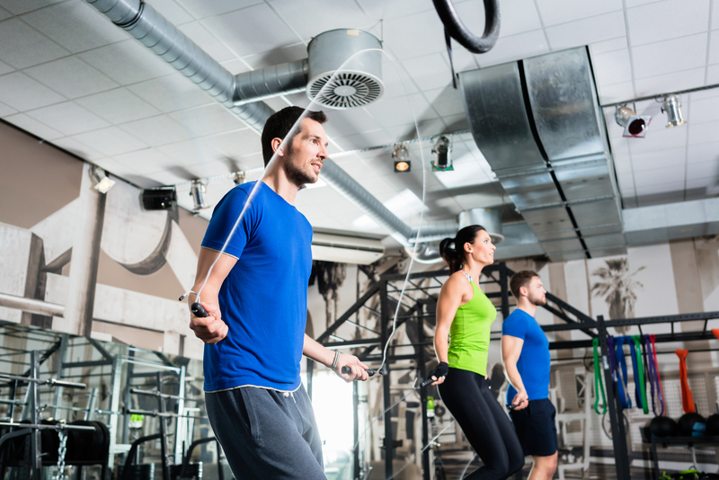
Warm-up guidelines – pulse-raiser
A pulse-raiser should take 5–10 minutes for a group of healthy clients in a ‘normal’ exercising environment (may need to adapt for colder environments or other factors, e.g. client age).
The aim is to gradually increase intensity throughout the pulse-raiser to ensure that the client achieves a rate of perceived exertion (RPE) of between 4 and 7 (1–10 scale), dependent on the intensity of the main workout.

Slide 13
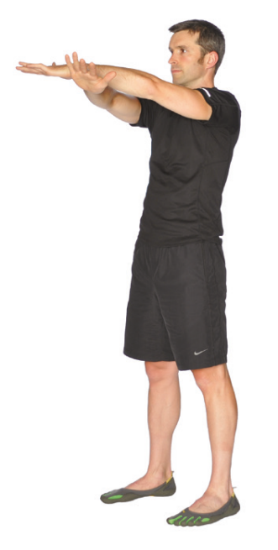
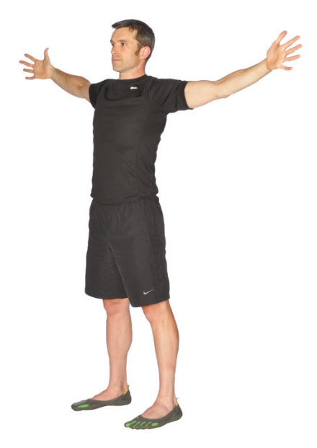
Warm-up guidelines – stretch
Dynamic stretching should be performed in the warm-up. Examples include leg swings, heel flicks, lunges and chest-press movements.
8–10 reps for each movement should be performed.
They aim to lengthen muscles to the end of their range of motion under control, while keeping the heart rate elevated and increasing the power output of the muscle, therefore improving performance in the main workout.
Static stretches may be used in the warm-up, if:
  The client is particularly ‘tight’ in a certain muscle/s.
  Dynamic stretches can’t be performed safely.

Slide 14
Plan a warm-up
In pairs, plan a safe and effective warm-up for a small group (minimum of three) and record the information using an appropriate format.

Slide 15


Benefits of CV training
Improves sport-specific performance.
Reduces risk of chronic health conditions, for example, heart disease.
Weight management.
Improves self-esteem and mental health state.
Improves cholesterol levels.
Improves efficiency of heart and lungs.

Slide 16
CV guidelines – for health benefits
150 minutes of moderate-intensity aerobic activity per week.
75 minutes of vigorous-intensity aerobic activity per week.
An equivalent combination of moderate- and vigorous-intensity aerobic activity each week.
OR
OR

Slide 17
CV guidelines – intensity differences
Moderate intensity
Causes a person to become slightly out of breath without undue fatigue.
Equivalent to a brisk walk or gentle cycle for an average client.
Vigorous intensity
Causes a person to become out of breath and start to sweat.
64–76% MHR.
RPE 12–13 (6–20 scale).
Equivalent to sustained fast jogging or sprinting.
77–95% MHR.
RPE 14–17 (6–20 scale).

Slide 18
Plan a CV workout
In pairs, plan a safe and effective cardiovascular workout for a small group (minimum of three) and record the information using an appropriate format.

Slide 19
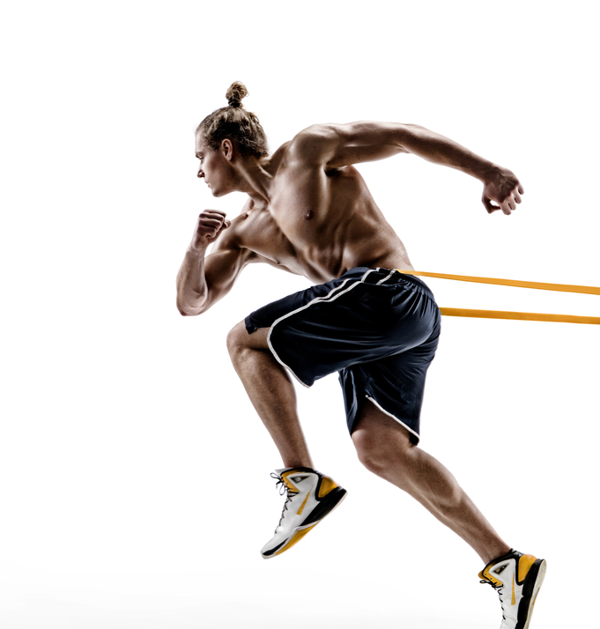
Benefits of resistance training
Improved muscular strength/hypertrophy/ endurance.
Improved resting metabolism (ability to burn calories).
Improved posture.
Improved motor fitness, for example, balance, coordination, power.
Sport-specific benefits.

Slide 20
Resistance training guidelines
Strength
1–2 days/week (per muscle
group).
2–6 sets of 1–6 reps at
≥ 85% 1RM.
Hypertrophy
1–2 days/week (per muscle
group).
90 seconds’ rest.
Endurance
2–3 days/week (per muscle
group).
≤ 30 seconds’ rest.
2–5 minutes’ rest.
3–6 sets of 6–12 reps at
67–85% 1RM.
2–3 sets of 12+ reps at
≤ 67% 1RM.

Slide 21
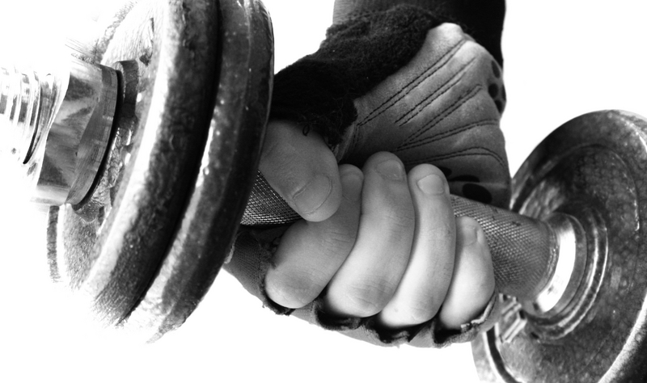
Resistance planning considerations
Exercises and equipment – fixed machines, free weights, body weight, functional kit.
Number of exercises – dependent upon fitness, goals, time and training approach.
Training approach/method – dependent upon fitness, goals, time and training approach.
Muscle balance – important to balance training of muscles across a week’s programming.
Exercise order – large to small muscles for most clients; advanced clients may reverse this to avoid plateaus.
Exercise sequence – push–pull, upper–lower, upper–lower rotation.

Slide 22
Resistance programming variables
No. of exercises
No. of reps and sets
Resistance
Range of movement
Rest duration
Speed/ratio, e.g. 2:2
Frequency
Stability
Type of equipment/ exercise
Order of exercises
Training methods

Slide 23
Basic resistance progression – group training
Group training classes can be programmed so that they are progressive.
Small group training is where there are between two and six participants, who are of a similar level of ability in terms of fitness, level, skill and experience.
However, the larger the group, the more generic the goal and periodised programming will be. It cannot be specific to individuals.
With large groups, there are inevitably mixed abilities in terms of fitness level, skill and experience. The overall goal of the class could be based around hypertrophy or strength so long as there are no beginners and everybody has a base level of muscular endurance.
:.
:.

Slide 24

Basic resistance progression
The main principle of the progression pyramid is to begin with endurance training, that is, low resistance, high repetitions.
This allows participants to develop and improve their technique and joint stability, while the smaller load keeps the injury risk to a minimum.
However, when the focus of a mixed-ability class is on muscular endurance, the pyramid approach may not be wholly applicable.
If this is the case, the fitness professional must still seek to provide exercise progression and manipulate other training variables.

Slide 25

Basic progression variables
Progression can be achieved using the following variables:
Reducing rest periods between sets.
Increasing the number of sets.
Increasing the number of exercises.
Encouraging participants to attend more sessions.
Introducing more challenging/complex exercises.

Slide 26
Resistance training methods – PHA
Peripheral heart action – this is basic circuit training designed to get lots of blood pumping into one specific body part or a specific set of muscles in one area of the body.
The way to achieve this ‘blood pumping all over the body’ effect is to conduct a series of exercises that alternate between one exercise for the upper body or torso, and then one exercise for the lower body.
These exercises can be done as a circuit, three to six times through, with ten to fifteen repetitions per exercise, with a relatively rapid lifting tempo and with minimum recovery between sets.

Slide 27
Resistance training methods
Compound sets to isolation sets:
This approach sequences compound movement sets prior to prescribing isolated movement sets.
It can be used in various formats, for example, circuit, Tabata, intervals, and is designed to use the higher-skill exercises first (e.g. deadlift, chin-up) to fatigue the larger muscle groups before targeting the lower-skill and single-muscle groups on their own (e.g. bicep curl, reverse fly).
The advantage of this method is that execution of the more coordinated compound exercise is more likely when the muscles are not fatigued.
Isolating and fatiguing large muscle groups first can lead to too much exhaustion to complete what are often new movement patterns for beginners.

Slide 28
Resistance training methods
Isolation sets to compound sets:
This approach is less common but, for more intermediate to advanced participants, isolating muscle groups first can exacerbate the effect on the targeted muscle group when the second compound exercise is performed.
The positive of this type of training is ensuring complete muscle fatigue of the targeted muscle.

Slide 29

Resistance training methods
Supersets.
This is a very common approach and involves completing one exercise immediately followed by a second, with little to no rest in between.
Supersets can be planned in a number of ways:
  Differing or opposing muscle groups.
  • Peripheral heart action training.
  • Compound to isolation.
  • Isolation to compound.

Slide 30

Task
In pairs, plan a safe and effective resistance session for a small group (minimum of three).

Slide 31
Purpose of a cool-down
Repay oxygen debt.
Avoid blood pooling.
Reduce tension in muscles.
Disperse lactic acid.
Facilitate muscle recovery.
Remove waste products.
Maintain and develop flexibility.

Slide 32
Cool-down guidelines
Cardio-flush: a CV cool-down after resistance training helps to provide the muscles with nutrients and oxygen to aid recovery.
Pulse-lowering exercise: heart rate should be reduced gradually at the end of a session to avoid blood pooling.
Stretch: bring muscles back to their normal length and develop the range of movement in tighter muscles.

Slide 33

Cool-down flexibility guidelines
Static maintenance: 10–15 seconds.
Static developmental: 30–60 seconds.
All muscles worked during the session should be stretched.
Stretch should be taken to the point of mild tension; it should not be painful.

Slide 34
Plan a cool-down
In pairs, plan a safe and effective cool-down for a small group (minimum of three) and record the information using an appropriate format.

Slide 35


What is functional fitness?
Functional training can be defined in many ways, but the simplest explanation is that exercises are planned and performed to improve optimal human movement and physical capacity.

Slide 36
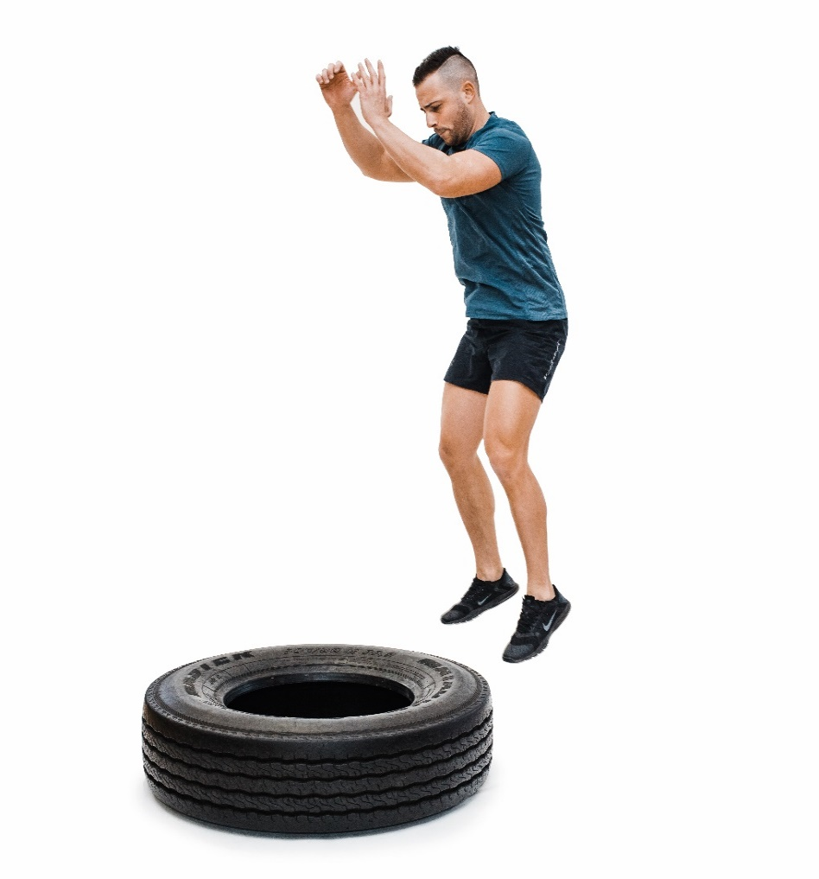
Alternative functional equipment
What equipment can you use in fitness facilities (other than machines and standard free weights) to develop ‘functional fitness’?
What exercises can be performed with each?
Provide three examples of equipment and three exercises that could be performed.

Slide 37
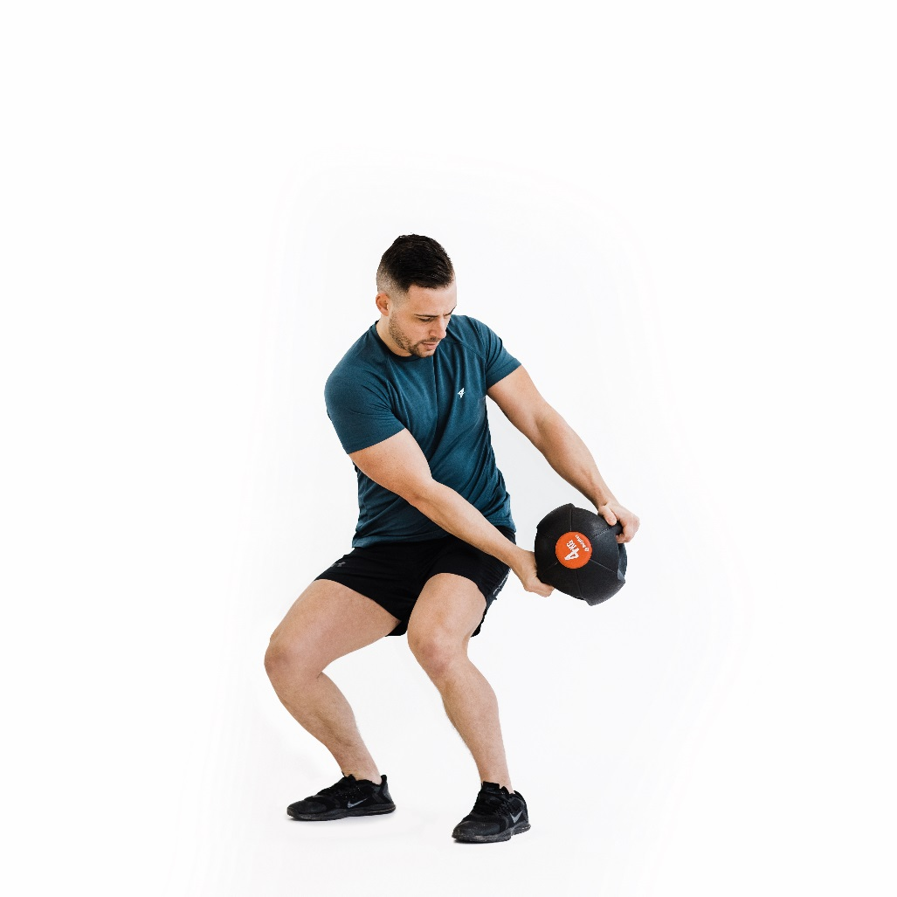
Alternative functional equipment
Tyres
Plyo boxes
Medicine balls
Core balls
Kettlebells
Weighted bags
Suspension equipment
Resistance tubing

Slide 38
Session structure – exercise options
It is crucial for a group exercise instructor to be able to give the impression of individualisation within the group setting.
Therefore, it is essential that when planning the session the group exercise instructor considers the exercise options, regressions and progression.
In pairs, write a brief definition of the following terms:
* Adaptation.
* Regression.
* Progression.
* Alternative.

Slide 39
Exercise options
There are four variables to consider when planning the exercise options.
Load/resistance
Range of movement
Exercise variables
Stability
Tempo

Slide 40
Exercise options
In a small group, using the table below, choose three exercises to show examples of how each variable can be adapted to suit the client’s needs.
 | Exercise 1 | Exercise 2 | Exercise 3
Load/resistance
Tempo
Stability
Range of movement

Slide 41
Monitoring intensity
Talk test
RPE
Heart rate
Observation

Slide 42
Talk test
Observe a client’s ability to maintain a conversation.
+
Quick and easy to gauge intensity.
No equipment required.
-
Subjective and not scientific.
Talking easily, light breathless-ness.
Talking easily, but more breathless.
Talking becomes more difficult and breathing is heavier.
Unable to talk and breathing very heavily.

Slide 43
Observation
+
Maintain safety of the session.
No equipment.
Can be used to gauge motivation.
-
Subjective and not scientific.
Clients can over- or under-exaggerate how they are feeling.
Posture and alignment
Skin colour
Sweating
Exercise technique
Levels of coordination
Facial expressions
Looking at:

Slide 44
Heart rate
Age-predicted max. HR = 220 - age.
-
Equipment can be costly.
Age-predicted calculation doesn’t take fitness levels into account.
+
Accurate and scientific.
Effective in showing progress.
Simple to calculate.
Intensity | % MHR
Very light | < 57
Light | 57–63
Moderate | 64–76
Vigorous | 77–95
Near max–max | > 95
Notes:
Can you check the point at the bottom of the purple box? Is this right?

Slide 45
Heart-rate formulas
Age-predicted max. HR
220 - age
E.g. 24-year-old looking to work at 60% max. HR
220 - 24 = 196
196 x 0.60 = 118 bpm
Karvonen method
Target heart rate = (max. HR - resting HR) x % intensity + resting HR
E.g. 25-year-old, resting HR of 65 bpm looking to work at 60% max. HR
220 - 25 = 195
195 - 65 = 130
130 x 0.60 + 65 = 143 bpm

Slide 46
Rate of perceived exertion (RPE)
Self-rating of how hard someone is working between 0 and 10 (CR10) or 6 and 20 (Borg).
+
Quick and easy to use and understand (CR10).
Can compare to heart rate (Borg).
No equipment required.
-
Can be subjective.
Borg can be confusing.
Heart rate (bpm) | RPE | Classification
60–80 | 6–8 | Nothing
< 90 | < 9 | Very light
110–120 | 10–11 | Light
120–130 | 12–13 | Moderate
140–160 | 14–16 | Heavy
> 160 | > 16 | Very heavy

Slide 47

Signs and symptoms of over-exertion
Chest pain
Unexpected shortness of breath
Light-headedness
Severe joint pain

Slide 48

Monitoring intensity – tutor demonstration
Tutor demonstrates an example of instructing a group-training CV workout, emphasising how to monitor intensity using:
Heart rate.
Talk test.
RPE.
Observation.

Slide 49
Learning review
Can you now:
Recognise a safe and effective session structure?
Identify safe and effective exercises/equipment for inclusion in a group training session?
Describe how to adapt and modify exercises and equipment to regress, progress and accommodate different client needs?
Explain the purpose of a warm-up and cool-down?
Describe the appropriate exercises for inclusion in a warm-up and cool-down?
Explain the purpose and benefits of cardiovascular exercise?
Explain the purpose and benefits of muscular fitness and resistance exercises?

Slide 50
Learning review
Can you now:
Explain the purpose and benefits of flexibility exercises?
Describe the appropriate exercises to improve the different components of fitness?
Select safe and effective exercises for all components of the session, which meet the client’s needs, goals and ability?
Plan a safe and effective health-related, gym-based exercise programme to meet clients’ needs and incorporate different components of fitness?
Plan adaptations and modifications to regress, progress and accommodate different client needs?
Record exercises using an appropriate format to assist clients’ understanding?

