Slide 1
Lesson 3 – Cardiovascular and respiratory systems
Principles of anatomy, physiology and fitness

Slide 2
Learning objectives
By the end of the lesson you will be able to:
Describe the structure of the heart
Describe the function of the heart
Describe the structure and function of the blood and blood vessels
Describe the structure of the lungs
Describe the function of the lungs
Identify the main muscles involved in breathing
Describe the passage of air through the respiratory tract
Describe gaseous exchange in the lungs
Describe gaseous exchange in the muscles

Slide 3
Learning objectives
By the end of the lesson you will be able to:
Describe systemic and pulmonary circulation
Describe the immediate effects of exercise on the cardiovascular and respiratory systems
Describe the long-term effects of exercise on the cardiovascular and respiratory systems
Recognise changes to the cardiovascular and respiratory systems throughout a person’s lifespan

Slide 4

The heart
World café – small-group activity
Note anything you know about the heart (including structures) on a tablecloth (or piece of flipchart paper).
Notes made are presented to the larger group by a different table of learners.

Slide 5
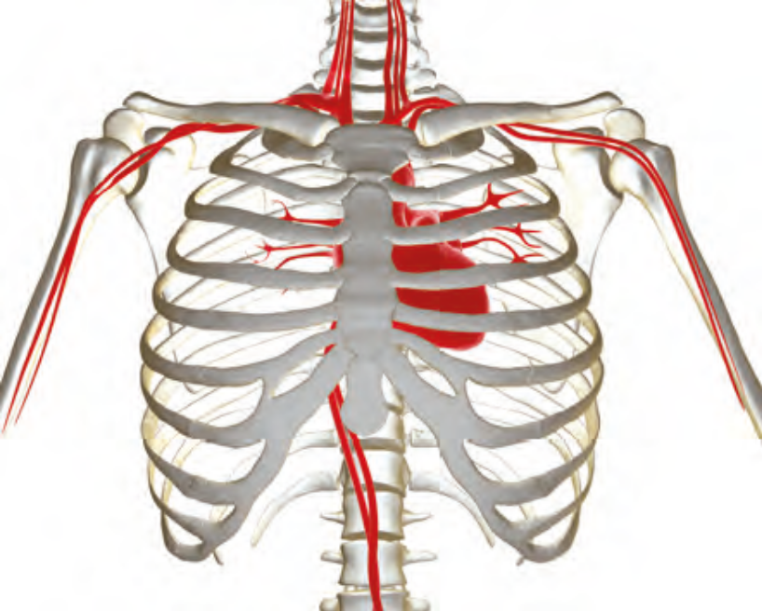
The heart
Muscular pump located behind the sternum (left of centre), in between the left and right lung.
It is responsible for pushing oxygen and nutrients around the body to its tissues.

Slide 6
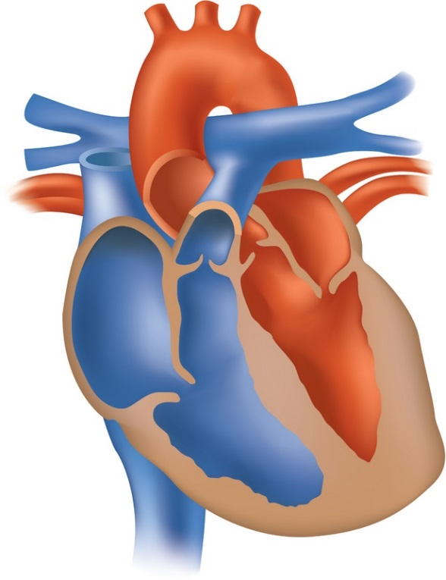
Structure of the heart
Paired activity
In pairs, complete the structure of the heart worksheet, label each section and identify the direction of blood flow.
Pairs to present their answers to the larger group.

Slide 7


Structure of the heart
Comprises:
Two sides – right and left.
Four muscular chambers.
Upper: Atria
Lower: Ventricles
Blood always flows from A to V:
atria to ventricles.
Right
Left

Slide 8
Blood flow
Pulmonary
artery
Aorta
Pulmonary
vein
Superior
vena cava
Right
atrium
Left
atrium
Right
ventricle
Left
ventricle
Inferior
vena cava

Slide 9
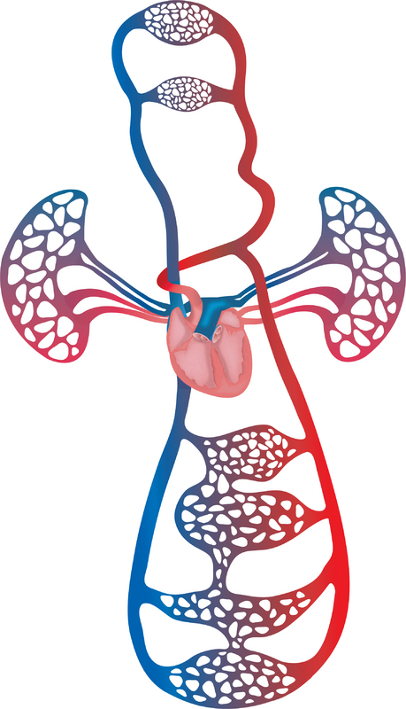
Pulmonary and systemic circulation
Pulmonary
Systemic
Blood flow between the heart and lungs.
Right ventricle.
Pulmonary artery.
Pulmonary arterioles.
Pulmonary capillaries.
Pulmonary venules.
Pulmonary vein.
Left atrium.
Blood flow between the heart and other body systems.
  Left ventricle.
  Aorta.
  Arteries, arterioles.
  Capillaries.
  Venules, veins.
  Vena cava.
  Right atrium.

Slide 10

Summary of the heart and circulation
Watch the video and answer the questions on the next slide.

Slide 11
Quiz!
What carries blood from the lungs to the heart?
Which chamber does it carry blood to?
What carries blood from the heart to the body’s tissues?
What carries deoxygenated blood from the body to the heart?
Which chamber does it carry it back to?
What carries deoxygenated blood from the heart to the lungs?

Slide 12
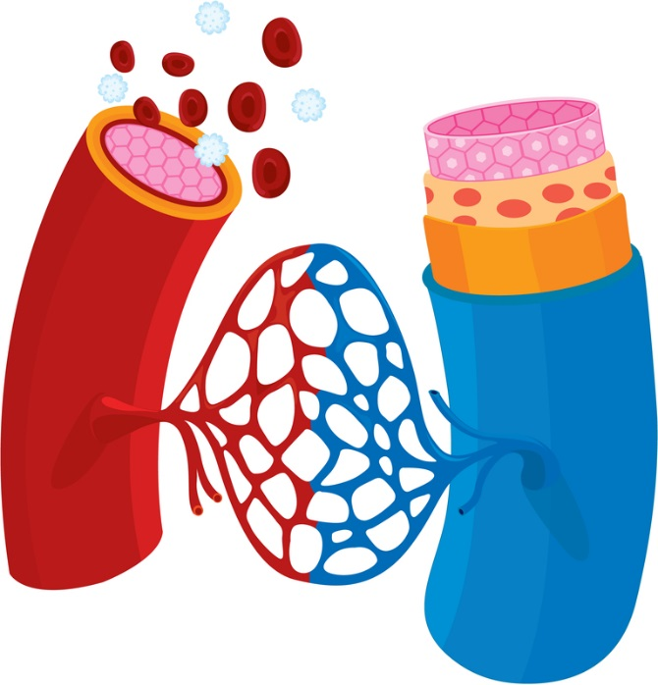
Blood vessels
In pairs, list the structural and functional differences between arteries, veins and capillaries.

Slide 13
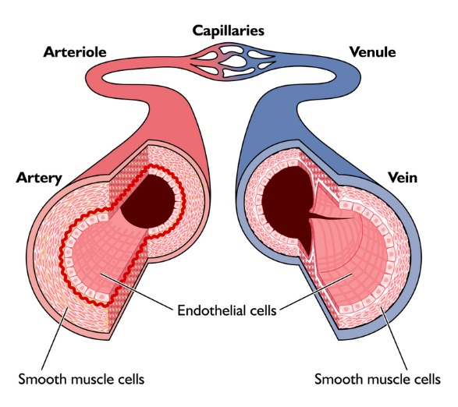
Blood vessels
Arteries
Take blood away from heart.
Thick, muscular walls.
Under high pressure.
Veins
Take blood to the heart.
Thin, muscular walls.
Contain non-return valves.
Under lower pressure.
Capillaries
Smallest blood vessels (one cell thick).
Site of gaseous exchange.
One cell thick to allow diffusion.

Slide 14
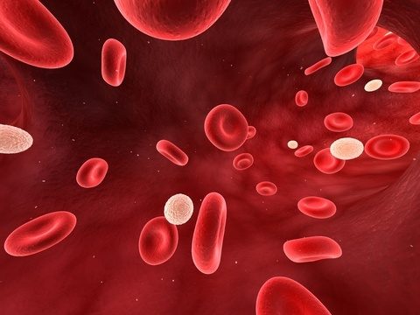
Components of blood
Red blood cells – transport oxygen around the body.
White blood cells – provide immunity to fight infection.
Platelets – serve as blood-clotting agents.
Plasma – straw-coloured liquid medium composed of 91.5% water and 8.5% solutes.

Slide 15
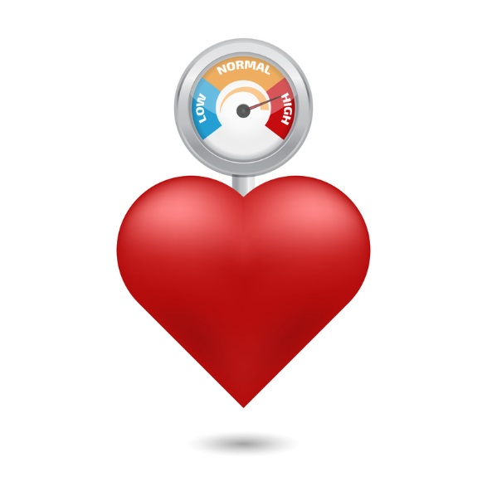
Blood pressure
Blood pressure is defined as:
‘...A measure of the force that blood applies to the walls of the arteries as it flows through them.’
Systolic – pressure exerted when the heart is contracting.
Diastolic – pressure exerted when the heart is relaxed between beats.
Total peripheral resistance – the resistance vessels offer to blood flow.

Slide 16
The lungs and respiratory tract
World café – small-group activity
Note anything you know about the lungs and respiratory tract (including structures) on a tablecloth (or piece of flipchart paper).
Notes made are presented to the larger group by a different table of learners.

Slide 17
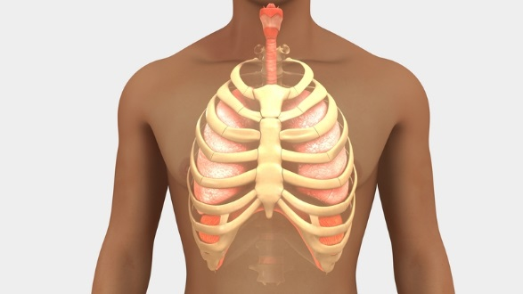
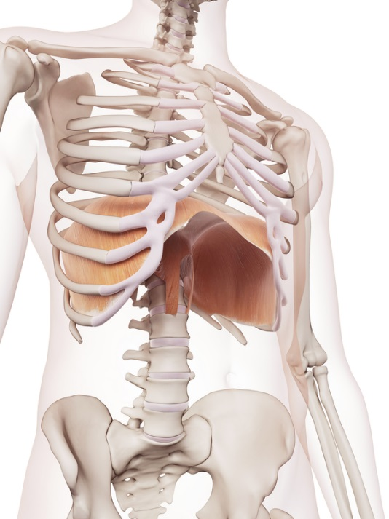
The lungs
Left and right lungs are located in the thoracic cavity (thorax), behind the ribs.
Inhale to receive oxygen to diffuse into the blood stream through gaseous exchange.
Exhale to remove carbon dioxide to diffuse out of the body through gaseous exchange.
Diaphragm and intercostal muscles are responsible for respiration (breathing).

Slide 18
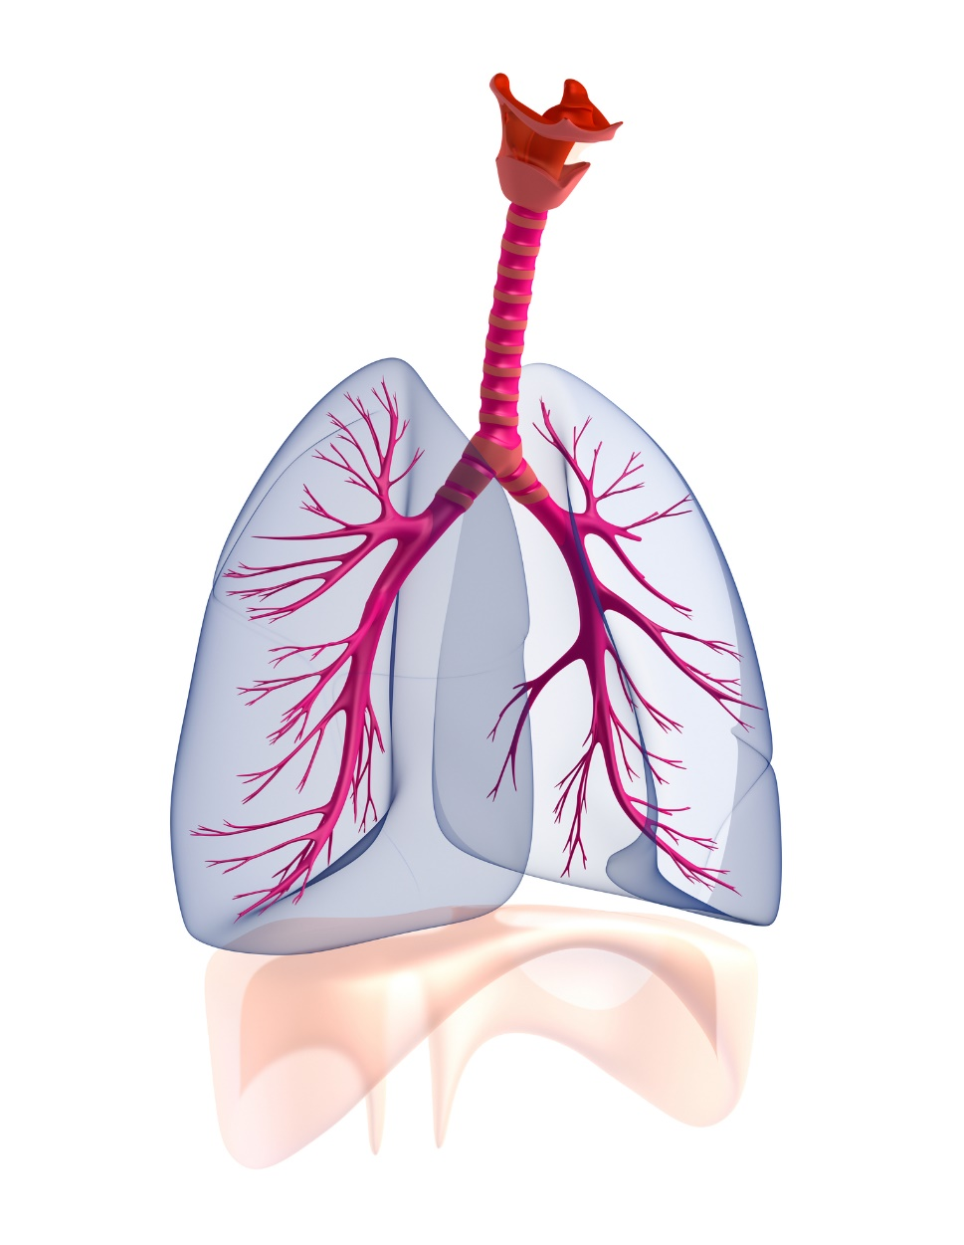
Mechanics of breathing
Place your hands on your ribcage.
Breathe in and out a few times.
What happens to the ribcage as you breathe in?
What happens to the ribcage as you breathe out?

Slide 19
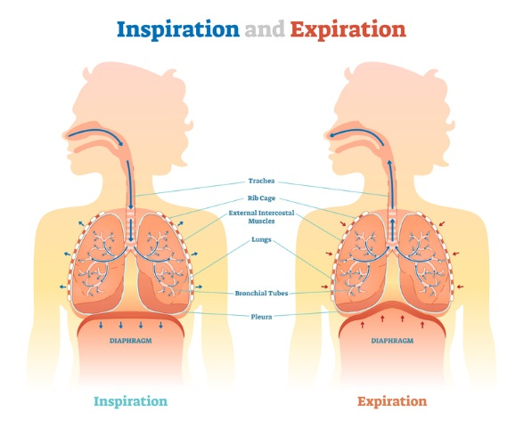
Respiratory (breathing) muscles
Breathe in (inspiration)
Diaphragm contracts and lowers (descends).
Intercostal muscles contract.
Ribcage expands.
Lungs inflate - fill with air
Breathe out (expiration)
Expiration.
Diaphragm relaxes and rises (ascends).
Ribcage returns to normal.
Lungs deflate – air removed.

Slide 20
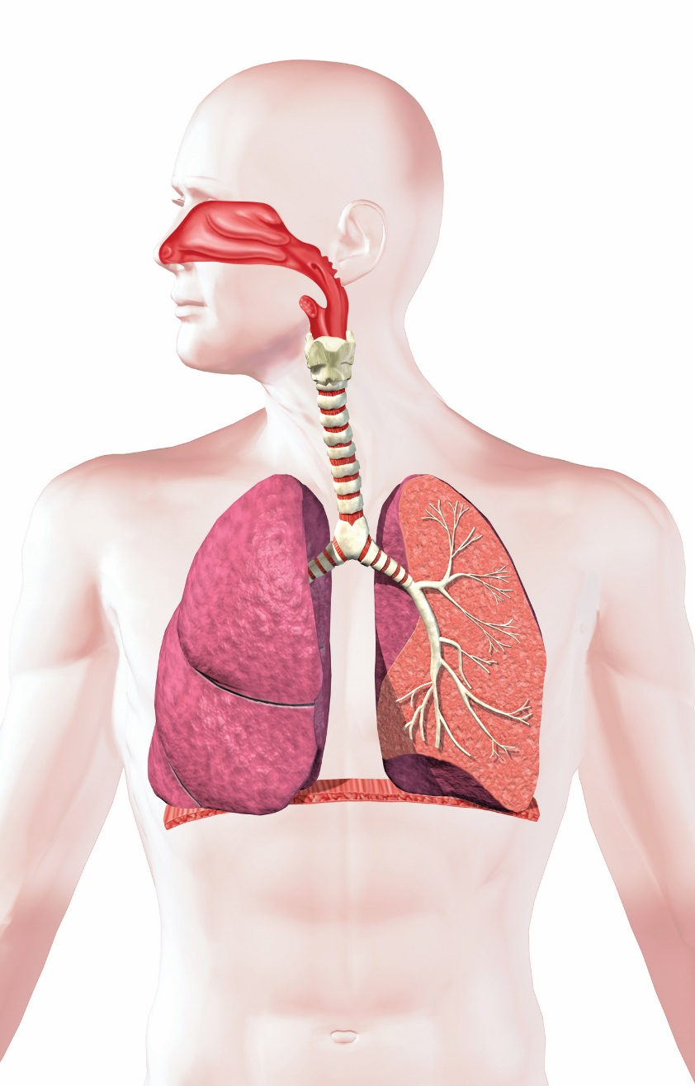
The respiratory tract
Nose and mouth
Pharynx
Larynx
Trachea
Bronchi/ bronchus
Bronchioles

Slide 21
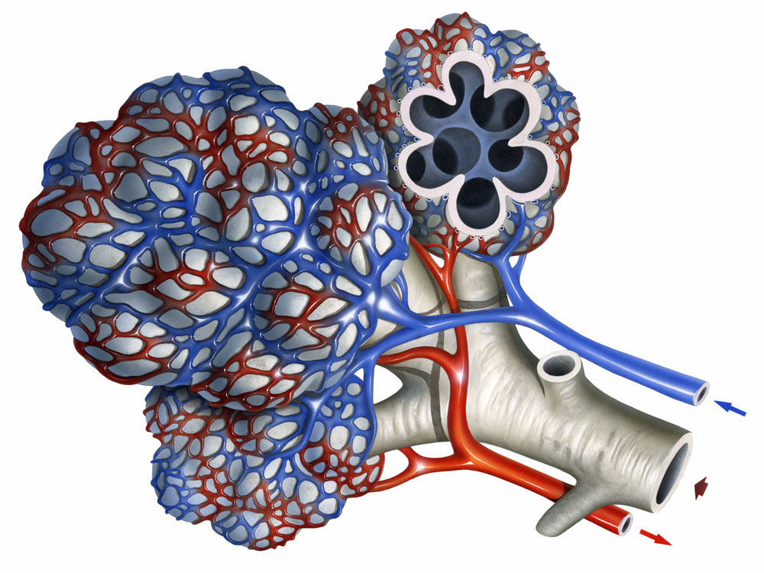
Gaseous exchange
Alveoli
Oxygen passes from the alveoli to the capillaries.
Capillaries
Carbon dioxide passes from the capillaries to the alveoli.
Bronchiole

Slide 22
Gaseous exchange
Watch the video!

Slide 23
Effects of exercise on the cardiovascular and respiratory systems
Immediate
Increased heart rate (bpm).
Long-term
Decreased resting and working heart rate.
Increased breathing frequency.
Increase in systolic blood pressure.
Increased volume of air in the lungs.
Increased stroke volume (amount of blood pumped from the heart per contraction).
Increase in cardiac output (volume of blood pumped from the heart in a minute).
Increased vasodilation (widening) of blood vessels towards the working muscles.
Increased aerobic capacity.
Normalised blood pressure.
Increased hypertrophy (muscle growth) of the left ventricle.
Increased size and elasticity of the arteries.
Increased capillary network, allowing more diffusion of gases.
Increased strength of the respiratory muscles (diaphragm and intercostals).
Increased stroke volume and cardiac output.
Reduced levels of bad cholesterol in the blood (low-density lipoproteins or LDLs).
Increased blood volume.
Increased size and number of mitochondria.

Slide 24
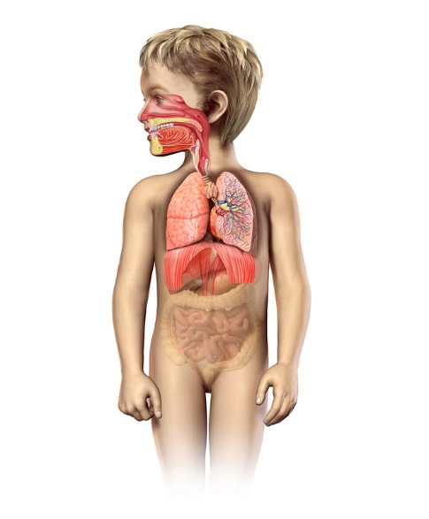
Life cycle of the cardiovascular and respiratory systems – early years
At birth, the left and right ventricles are equal weight, and by early childhood, the LV is double that of the RV.
Resting breathing rate is 30–60 breaths per minute, increasing to 12–20 in the average adult.
By the age of three, the lungs and heart are a mini version of an adult’s.
The organs of this system stop growing around the same time the person stops growing.

Slide 25
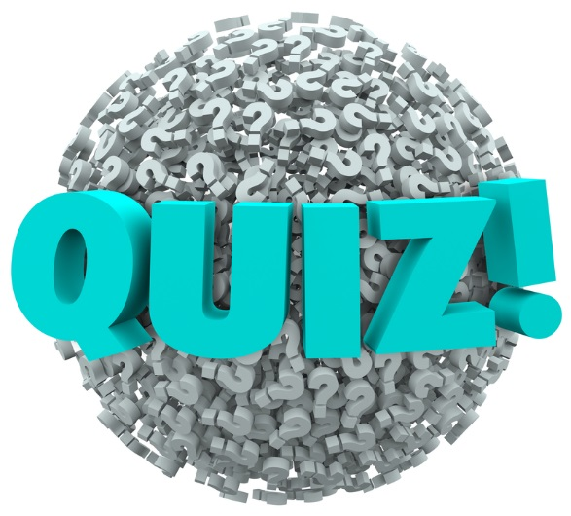
Design your own quiz!
Design some quiz questions on the cardiorespiratory system to challenge your peers.
Style of questions may include:
  True or false.
  Multiple choice.
  Short answer.
  Label a diagram.
  Missing word.

Slide 26
Learning review
Can you now:
Describe the structure of the heart?
Describe the function of the heart?
Describe the structure and function of the blood and blood vessels?
Describe the structure of the lungs?
Describe the function of the lungs?
Identify the main muscles involved in breathing?
Describe the passage of air through the respiratory tract?
Describe gaseous exchange in the lungs?
Describe gaseous exchange in the muscles?

Slide 27
Learning review
Can you now:
Describe systemic and pulmonary circulation?
Describe the immediate effects of exercise on the cardiovascular and respiratory systems?
Describe the long-term effects of exercise on the cardiovascular and respiratory systems?
Recognise changes to the cardiovascular and respiratory systems throughout a person’s lifespan?

